Slide 1
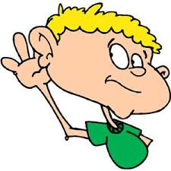

I Can Follow Directions!
Notes:
Read slide with students. Explain that today’s lesson will help them will learn some ways to follow directions at school.

Slide 2
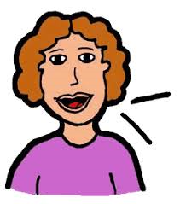
There are always lots of directions I need to follow in school
Put your name on your paper
Line up at the door
Stay in your seat
Quiet please
Notes:
Read slide with students. Click to bring up each callout. Ask students if they ever hear these directions at school.

Slide 3

What other directions do YOU hear at school?
Notes:
Read slide with students. Ask for their input: What other directions do they hear at school? List these on paper or the board.

Slide 4
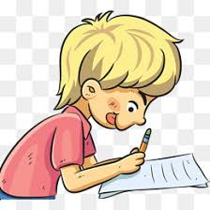
It’s important to follow these directions so that I do what I’m supposed to do
Notes:
Read slide with students. Lead a brief discussion about why it’s important to do what we’re told at school as a lead-in to the next slide.

Slide 5
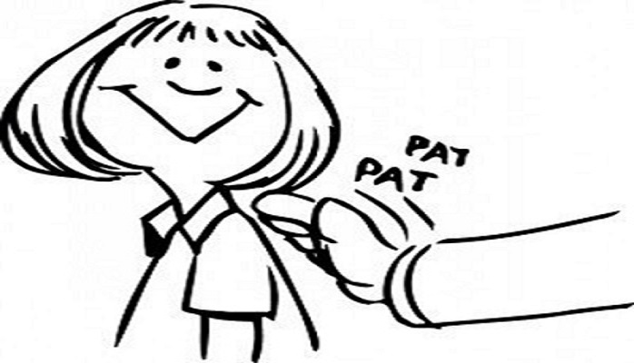
What happens when I do what I’m supposed to do?
I get my work done
my teacher is happy
I don’t get in trouble
I’m proud of myself
my parents are happy too
Notes:
Read slide with students. Talk about the positive outcomes of doing what we’re supposed to do in school. Can they add any other outcomes?

Slide 6
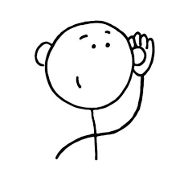
There are things I can do to make sure I really hear all of the directions and do what I’m supposed to do:
Listen carefully to what the teacher is saying
Notes:
Read slide with students. Emphasize that they’ll learn 6 ways to make direction-following easier. Talk about how hard it can be to listen to directions if the classroom is noisy or if the student is busy doing something else.

Slide 7
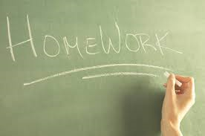
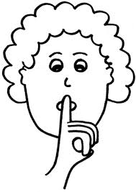

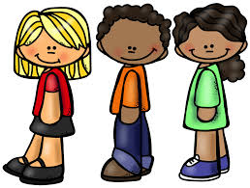
2. Check for visual cues
Notes:
Read slide with students. Define “visual cues” as things they can see in the classroom that can help them better understand spoken directions. Click to bring up each picture: 1. written directions on the chalkboard; 2. gestures, like the teacher putting her finger to her lips to signal “quiet” or the teacher pointing to indicate a location or destination; 3. classmates – what are they doing that I should be doing too?

Slide 8
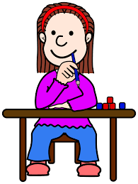
3. Say (or think) “okay”
okay
Notes:
Read slide with students. Explain that sometimes the student might need to say “okay” out loud if the teacher is talking directly to the student so that the teacher knows he/she heard the direction and will follow it. If the teacher is talking to a group or the whole class, the student can think “okay” in their head.

Slide 9

4. Ask questions if I didn’t hear or I don’t understand
Excuse me – could you please repeat the direction?
Notes:
Read slide with students. Explain that sometimes – even if you’re paying attention – you don’t hear the direction. Or maybe you heard it, but you don’t understand. This is the right time to raise your hand and ask a question. Ask students what questions they could ask their teacher to get a better understanding of the expectations.

Slide 10
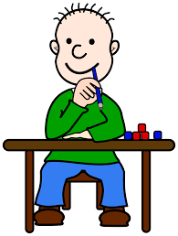

5. Repeat the direction to myself and picture me doing it in my mind
The teacher wants me to do the first row of math problems, then stop
Notes:
Read slide with students. Explain how repeating the directions back to yourself and picturing yourself doing it can really help you to follow the direction correctly.

Slide 11
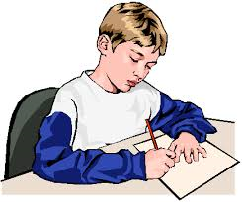
6. Follow the direction as
soon as I can!
Notes:
Read slide with students. Talk about how important it is to follow the direction quickly. Refer back to the points on slide #5 for positive outcomes of following directions.

Slide 12
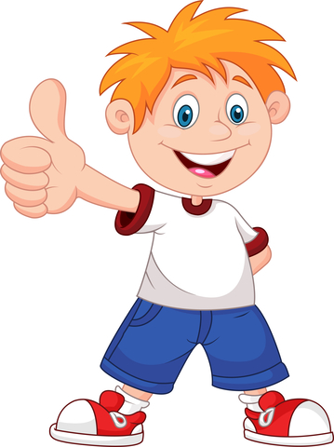
It’s important to follow directions so that I do what I’m supposed to do
Listen carefully to what the teacher is saying
Check for visual cues
Say (or think) “okay”
Ask questions if I didn’t hear or I don’t understand
Repeat the direction to myself and picture me doing it in my mind
Follow the direction as soon as I can!
You did it!
Notes:
Read slide with students. Review the 5 things they can do to follow directions correctly. Is there anything else they would add to the list?

Slide 13

So…what do YOU think?
You listened carefully to the teacher’s directions and think you did what you were supposed to do, but now you’re not sure you did it right.
What can you do?
Notes:
Read slide with students. Lead a discussion about how sometimes you think you did what you were supposed to do but then you start to have doubts…maybe a classmate did something differently and now you wonder if you could be wrong. Ask students for their ideas of how to handle this situation. List their ideas on the board or paper.

