Slide 1
I Can Ask for Help!
adapted from www.snagglebox.com

Slide 2
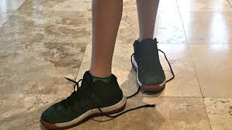
Sometimes we are faced with a problem…

Slide 3
Sometimes we can fix the problem ourselves

Slide 4
But sometimes we can’t…
We need to be able to ask for help!
Sounds easy, right?
But there are certain steps we should take when we need help.

Slide 5
Step 1: Figure out IF you need help
Having a problem is not the same as needing help
You only need help if:
you don’t know how to fix the problem
you can’t do it by yourself
you tried but it didn’t work
adapted from www.snagglebox.com

Slide 6
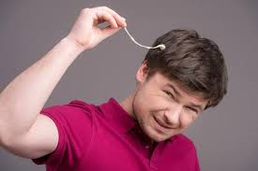
Do I need help?

Slide 7
Step 2: Think about WHO can help
teacher
school nurse
coach
parents
friends

Slide 8
WHO can help if…?
you don’t understand the math assignment
you scraped your knee on the playground
you want to earn extra money to buy a video game
you missed soccer practice and don’t know your new position
you forgot to bring a pencil to class

Slide 9
Step 3: Ask for help the right way
Check to see if the person is busy
Say “Excuse me?”
State the problem
Ask for the exact help you need

Slide 10
It could go something like this…
Excuse me. I missed the homework assignment. Can you please tell me what chapter we’re supposed to read?
Chapter 8

Slide 11
Step 4: Thank him or her for the help!
Thank you – I’ll do it tonight

Slide 12
We all need help sometimes – it’s okay to ask!

Slide 13
I Can Ask for Help!
Step 1: Figure out IF you need help
Step 2: Think about WHO can help
Step 3: Ask for help the right way
Step 4: Thank him or her for the help!
I DID IT!

Slide 14
So…what do YOU think?
You’re taking a test and you get to a question that you don’t understand. You’re not sure if it’s okay to ask for help.
What can you do?

