Slide 1
I Can Ask for Help!
adapted from www.snagglebox.com
Notes:
Read slide with students. Ask students if they’ve ever needed help in a situation and didn’t know what to do. Explain that today’s lesson will give them steps to follow when they need help.

Slide 2
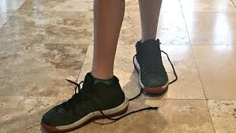
Sometimes we are faced with a problem…
Notes:
Read slide with students. Click to bring up each picture and talk about how we sometimes are faced with a problem. (i.e. untied shoelaces; broken pencil; forgot locker combination)

Slide 3
Sometimes we can fix the problem ourselves
Notes:
Read slide with students. Click to bring up each picture and talk about how we can sometimes fix the problems without any help.

Slide 4
But sometimes we can’t…
We need to be able to ask for help!
Sounds easy, right?
But there are certain steps we should take when we need help.
Notes:
Read slide with students. Explain that sometimes we can’t fix the problem and we need to ask for help. Point out that there are steps we can take to get the help we need.

Slide 5
Step 1: Figure out IF you need help
Having a problem is not the same as needing help
You only need help if:
you don’t know how to fix the problem
you can’t do it by yourself
you tried but it didn’t work
adapted from www.snagglebox.com
Notes:
Read slide with students. Explain that just because we have a problem doesn’t mean that we need help to solve it. Emphasize the bullet points that help us determine if we really need help or not.

Slide 6
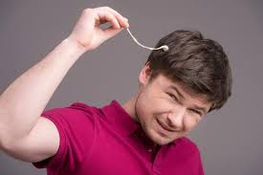
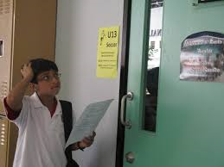
Do I need help?
Notes:
Read slide with students. Click to bring up each picture and talk about whether or not you might need help in this situation (i.e. gum stuck in hair; dog tore up homework; can’t find classroom). Answers may vary depending on students’ skills and abilities.

Slide 7
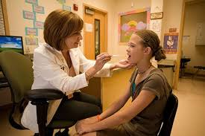
Step 2: Think about WHO can help
teacher
school nurse
coach
parents
friends
Notes:
Read slide with students. Discuss the different people who might be of help at school and home.

Slide 8
WHO can help if…?
you don’t understand the math assignment
you scraped your knee on the playground
you want to earn extra money to buy a video game
you missed soccer practice and don’t know your new position
you forgot to bring a pencil to class
Notes:
Read slide with students. Go through each example and ask students who would be the best person to ask for help with each situation. (There may be more that one answer for the situations. For example, you could ask either the teacher or a classmate to borrow a pencil. You could ask your coach or a teammate about your new soccer position.)

Slide 9
Step 3: Ask for help the right way
Check to see if the person is busy
Say “Excuse me?”
State the problem
Ask for the exact help you need
Notes:
Read slide with students. Explain that there’s a right way to ask for help. You don’t want to interrupt if the person is busy, so it’s always a good idea to say “excuse me” before asking for help. Emphasize that they need to clearly state the problem and ask for the exact help they need.

Slide 10
It could go something like this…
Excuse me. I missed the homework assignment. Can you please tell me what chapter we’re supposed to read?
Chapter 8
Notes:
Read slide with students. Refer back to the previous slide to point out all the correct things the girl did when requesting help from the teacher.

Slide 11
Step 4: Thank him or her for the help!
Thank you – I’ll do it tonight
Notes:
Read slide with students. Explain that a very important part of asking for help is making sure we thank the helper for their assistance!

Slide 12
We all need help sometimes – it’s okay to ask!
Notes:
Read slide with students. Talk about how sometimes we might be embarrassed to ask for help, or we might try to be perfect and think we shouldn’t need help. Emphasize that everyone needs help sometimes and that it’s okay to ask for it – as lone as we do it the right way.

Slide 13
I Can Ask for Help!
Step 1: Figure out IF you need help
Step 2: Think about WHO can help
Step 3: Ask for help the right way
Step 4: Thank him or her for the help!
I DID IT!
Notes:
Read slide with students and review the 4 steps for asking for help.

Slide 14
So…what do YOU think?
You’re taking a test and you get to a question that you don’t understand. You’re not sure if it’s okay to ask for help.
What can you do?
Notes:
Read slide with students. Talk about how sometimes it’s okay to ask for clarification during a test but that sometimes teachers aren’t allowed to help – like during state testing. If this is the situation, try reviewing the test-taking strategies from the I Can Tackle Test-Taking social skills module.

