Slide 1
Everyone is Different!

Slide 2
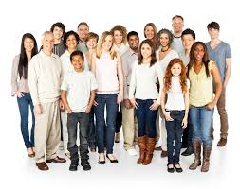
There are lots of people in the world

Slide 3
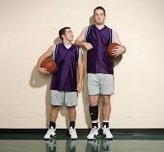
some are taller
some are shorter

Slide 4
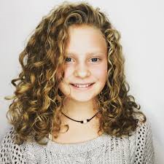
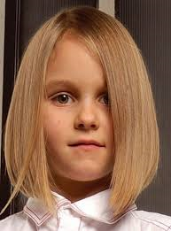
some have curly hair
some have straight hair

Slide 5
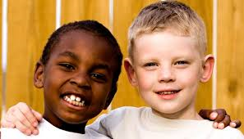
some have darker skin
some have lighter skin

Slide 6
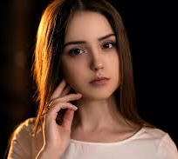
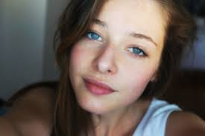
some have brown eyes
some have blue eyes

Slide 7
Everyone is different and that makes each of us special!

Slide 8
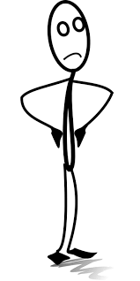
Sometimes the way people look makes us think about them in a certain way
He’s too short to play basketball

Slide 9
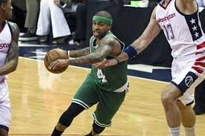
Isaiah Thomas is one of the shortest basketball players in the NBA – and he is a star of the Boston Celtics!

Slide 10
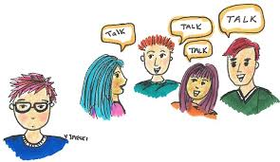
If we judge people by the way they look we could be missing out on making a new friend!

Slide 11
5 things we can do to learn to accept differences
Keep an open mind
Introduce yourself
Learn more about the person
Find things you have in common
Accept your differences!

Slide 12
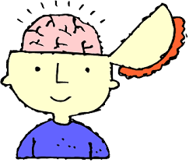
1. Keep an open mind
“open mind” means being willing to understand and accept something different

Slide 13
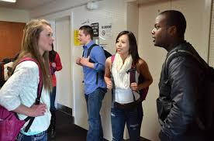
2. Introduce yourself
Hi!
I’m Shannon

Slide 14
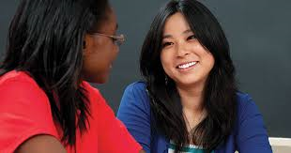
3. Learn more about the person
What was your other school like?

Slide 15
4. Find things you have in common
Favorite:
TV shows or movies
sports
video games or apps
books or music
subjects in school
food!

Slide 16
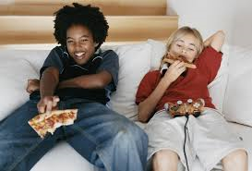
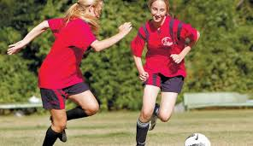
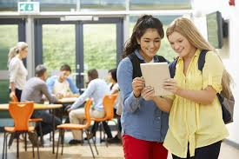
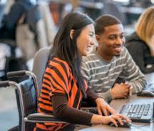

Slide 17
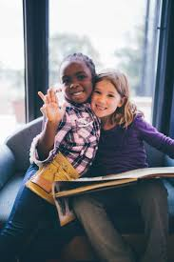
5. Accept your differences!

Slide 18
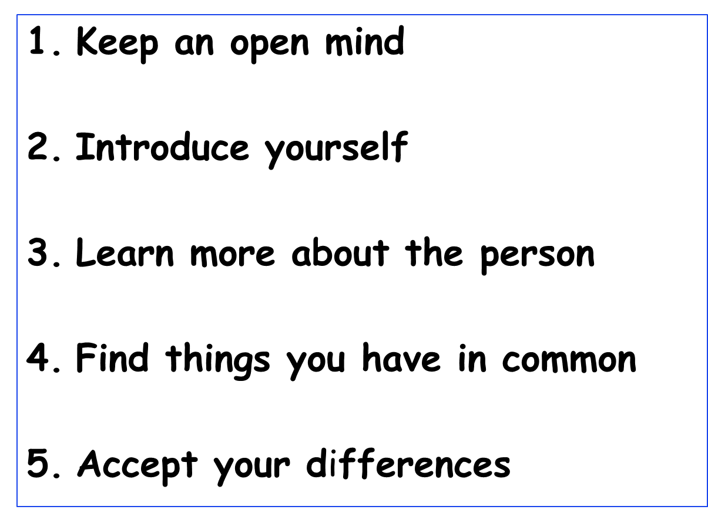
Everyone is different!

Slide 19
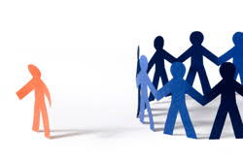
So…what do YOU think?
You want to join a club at school but you don’t know any of the other kids AND you’re afraid they won't accept you because you’re a little different from them.
What can you do?

