Slide 1
Everyone is Different!
Notes:
Read slide with students. Explain that today’s lesson is about learning how to accept differences in each other. Ask students if they’ve ever been in a situation where they felt different or left out. What happened and how did they handle it?

Slide 2
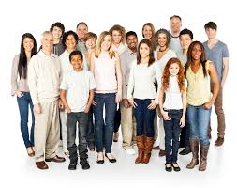
There are lots of people in the world
Notes:
Read slide with students. Talk about the picture and the diversity of the group. Ask students if they have friends or classmates in school that are different from them. How?

Slide 3
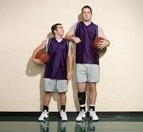
some are taller
some are shorter
Notes:
Read slide with students. Talk about the picture – what do they notice about the two boys? How are they different? What do they have in common?

Slide 4
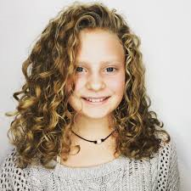
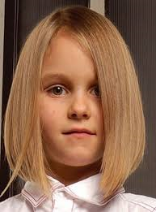
some have curly hair
some have straight hair
Notes:
Read slide with students. Talk about the picture – what do they notice about the two girls? How are they different? What do they have in common?

Slide 5
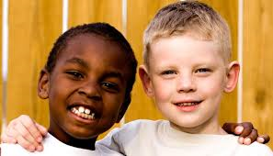
some have darker skin
some have lighter skin
Notes:
Read slide with students. Talk about the picture – what do they notice about the two boys? How are they different? What do they have in common?

Slide 6
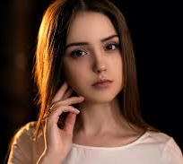
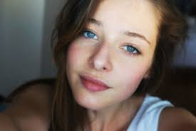
some have brown eyes
some have blue eyes
Notes:
Read slide with students. Talk about the picture – what do they notice about the two girls? How are they different? What do they have in common?

Slide 7
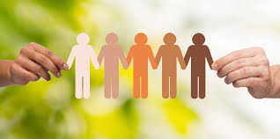
Everyone is different and that makes each of us special!
Notes:
Read slide with students. Emphasize that being different is okay because that’s what makes us all special!!

Slide 8
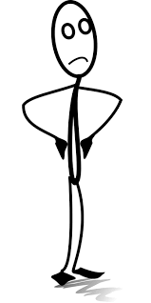
Sometimes the way people look makes us think about them in a certain way
He’s too short to play basketball
Notes:
Read slide with students. Talk about how sometimes we may make judgments about people based on the way they look. Ask students if they’ve ever done that before.

Slide 9
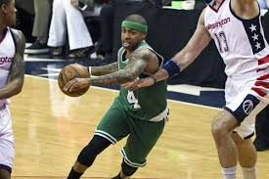
Isaiah Thomas is one of the shortest basketball players in the NBA – and he is a star of the Boston Celtics!
Notes:
Read slide with students. Talk about how even though Isaiah Thomas is only 5 feet 9 inches – much shorter than any of his teammates and other pro basketball players, he’s still a great ball player and a star of the team. Discuss what might have happened if people judged him based on his height: would he have been drafted to play pro ball? Would his teammates have accepted him?

Slide 10
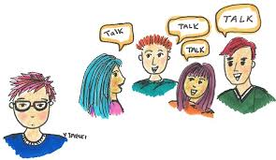
If we judge people by the way they look we could be missing out on making a new friend!
Notes:
Read slide with students. Talk about how important it is to realize that we could miss out on a potential friend if we judge them by the way they look.

Slide 11
5 things we can do to learn to accept differences
Keep an open mind
Introduce yourself
Learn more about the person
Find things you have in common
Accept your differences!
Notes:
Read slide with students. Explain that they’re going to learn 5 ways to accept the differences in others.

Slide 12
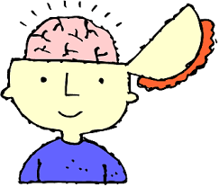
1. Keep an open mind
“open mind” means being willing to understand and accept something different
Notes:
Read slide with students. Define keeping an “open mind” and talk about the meaning.

Slide 13
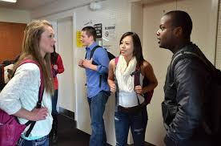
2. Introduce yourself
Hi!
I’m Shannon
Notes:
Read slide with students. Talk about the picture – an introduction can start with a greeting. Saying “hi” to someone new, even if they look different, is a great way to start a conversation.

Slide 14
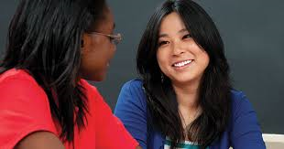
3. Learn more about the person
What was your other school like?
Notes:
Read slide with students. Talk about how you can find out more about a person by asking the right questions. Ask student for ideas of questions they could ask someone new.

Slide 15
4. Find things you have in common
Favorite:
TV shows or movies
sports
video games or apps
books or music
subjects in school
food!
Notes:
Read slide with students. Explain that by asking questions,, you can find out things you have in common. These things in common are potential things they could share in the future!

Slide 16
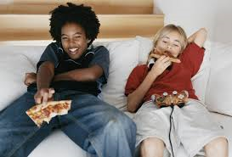
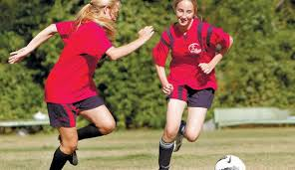
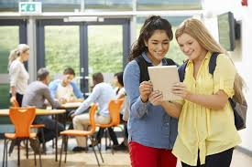
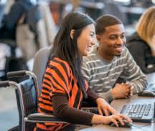
Notes:
Read slide with students. Click to bring up each picture. Discuss the photos – what are the differences and what might they have in common?

Slide 17
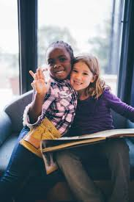
5. Accept your differences!
Notes:
Read slide with students. Ask students to share something about a friend or classmate that is different from them. How did they get to become friends with them? Emphazise that despite their differences, they found friendship with that person!

Slide 18
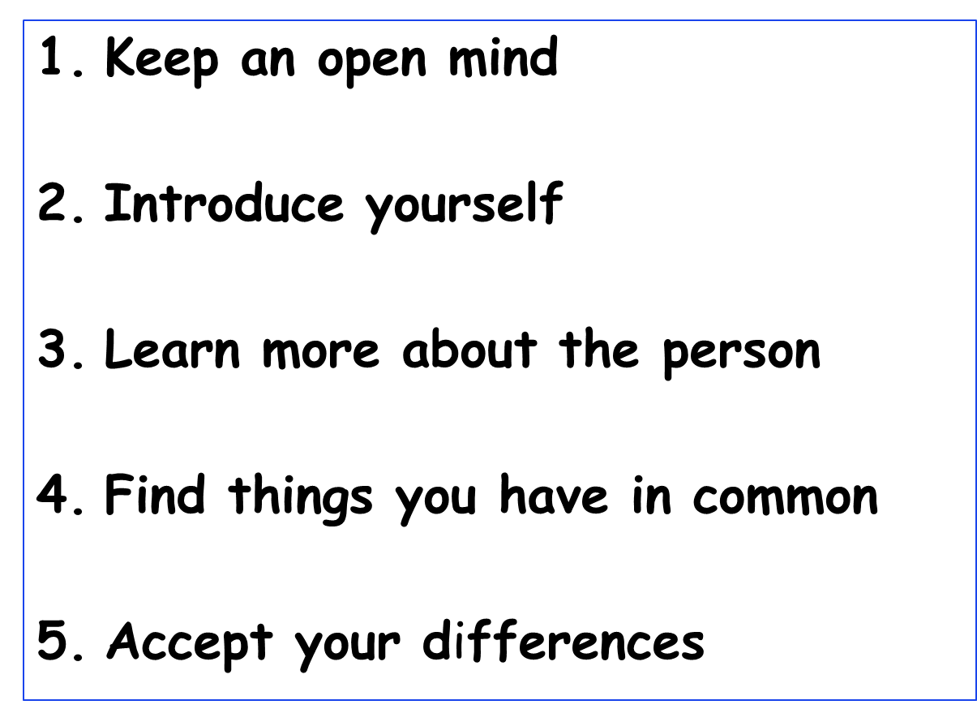
Everyone is different!
Notes:
Read slide with students. Review the 5 ways to learn to accept differences in others.

Slide 19
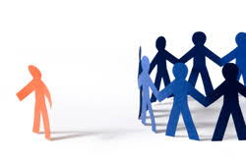
So…what do YOU think?
You want to join a club at school but you don’t know any of the other kids AND you’re afraid they won't accept you because you’re a little different from them.
What can you do?
Notes:
Read slide with students. Ask if this situation has ever happened to them – what did they do? Did it keep them from joining the club or going out for the sport? Why? Ask students what might have helped them get through that situation. Refer back to the 5 strategies they learned in the lesson.

