Slide 1
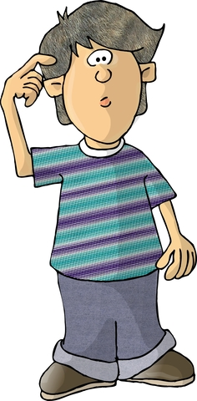
Am I a Bully?

Slide 2
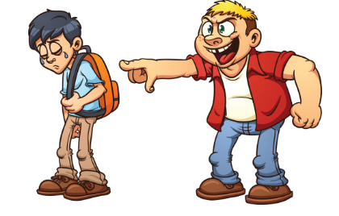
What is a Bully?
Bullying is when you keep picking on someone because you think you’re cooler, smarter, stronger, or better than them

Slide 3
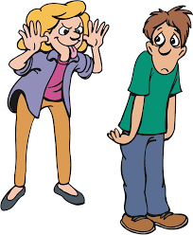
Bullying can be…
name calling
laughing at someone
leaving someone out
ignoring someone
tripping someone
unfriendly teasing
Bullying is hurting someone on purpose
adapted from pacer.org

Slide 4
Are you a bully and don’t know it?
maybe you don’t realize the things you say or do are hurting someone
maybe it’s hard for you to think about how someone else might feel when you say or do something to that person
maybe you’re just used to saying and doing whatever pops into your head

Slide 5
Quick bully quiz!
You’ve teased kids, been mean to them, made fun of the way they look or speak
You’ve spread nasty rumors about a kid at school
You’ve called kids names in front of other people
You’ve repeatedly hurt another kid at school in a physical way
adapted from stompoutbullying.org

Slide 6
Okay – maybe I am a bully. What do I do now?
Good news- You can fix it!

Slide 7
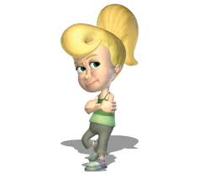
3 Steps to Take to Stop Being a Bully
Close your eyes and think back to when someone hurt you. How did it feel?
Now think about your behavior towards someone else:
what you did
who you hurt
why it hurt him or her – were you being helpful or hurtful?
what you can do differently next time so no one gets hurt
Ask an adult to help you
google images

Slide 8
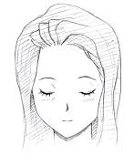
Step 1. Close your eyes and think back to when someone hurt you. How did it feel?
When she called me ‘stupid’ I just wanted to cry…
google images

Slide 9
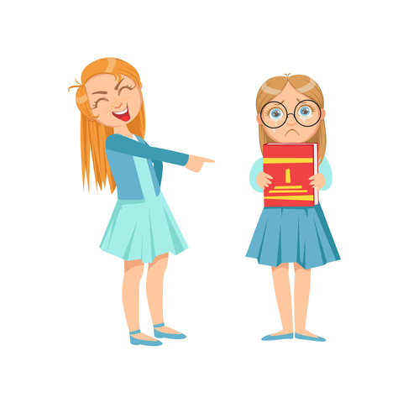
Step 2. Think about your behavior towards someone else
That’s a really ugly shirt you are hiding. How come you always dress like a baby?

Slide 10
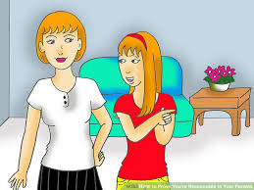
Step 3. Ask an adult to help you
Sometimes I say things that hurt people’s feelings.
Can you help me?

Slide 11
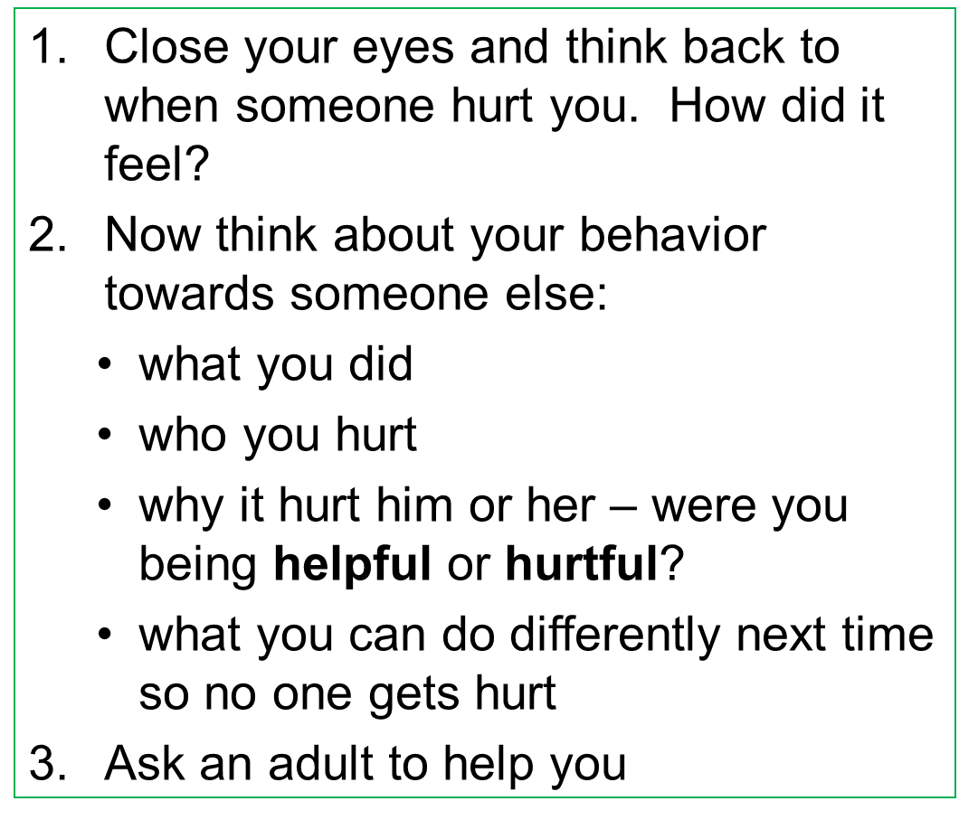
3 Steps to Take to Stop Being a Bully
Bullying stops with me!

Slide 12
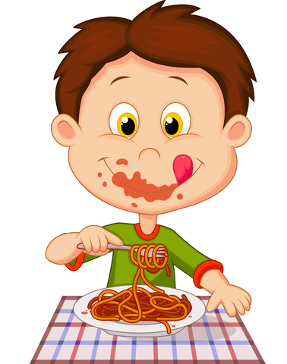
So…what do YOU think?
There’s a kid in school who chews with his mouth open and stuffs his face in the cafeteria. It’s so gross! You really want to say something, but what?

