Slide 1
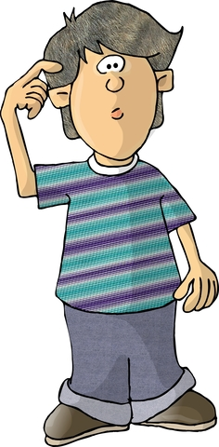
Am I a Bully?
image: megapixel.com
Notes:
Introduce topic to students. Remind them that they’ve already had a lesson on being bullied and what to do about it. This lesson is about being the bully. Ask students to define “bully” in their own words.

Slide 2
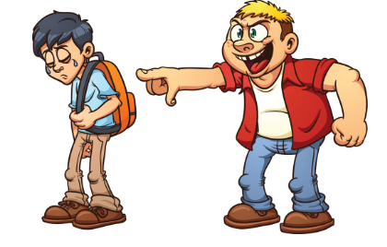
What is a bully?
Bullying is when you keep picking on someone because you think you’re cooler, smarter, stronger, or better than them
google images
Notes:
Read slide with students. Compare the students’ definitions with the slide.

Slide 3
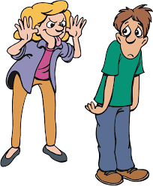
Bullying can be…
name calling
laughing at someone
leaving someone out
ignoring someone
tripping someone
unfriendly teasing
Bullying is hurting someone on purpose
adapted from pacer.org
Notes:
Read slide with students. See if students can add any other bully behaviors to the list. Summarize the slide by pointing out that bullying is hurting someone on purpose.

Slide 4
Are you a bully and don’t know it?
maybe you don’t realize the things you say or do are hurting someone
maybe it’s hard for you to think about how someone else might feel when you say or do something to that person
maybe you’re just used to saying and doing whatever pops into your head
Notes:
Read slide with students. Talk about how sometimes we might not realize that the things we say and do are hurting someone. Explain that sometimes it’s hard to know how others feel about the things we say and do. Discuss how sometimes we just say or do whatever pops into our heads at the moment.

Slide 5
Quick bully quiz!
You’ve teased kids, been mean to them, made fun of the way they look or speak
You’ve spread nasty rumors about a kid at school
You’ve called kids names in front of other people
You’ve repeatedly hurt another kid at school in a physical way
adapted from stompoutbullying.org
Notes:
Read title with students and go through each bullet point. Tell them that this quick quiz can help them figure out if they may be bullying someone – even without realizing that these behaviors are bullying.

Slide 6
Okay – maybe I am a bully. What do I do now?
Good news- You can fix it!
Notes:
Read slide with students. Click to bring in talk balloon. Let them know that even if they have been bullying someone, they can turn around their behavior and fix it! Before moving on, ask students for their ideas about how they can change their behavior.

Slide 7
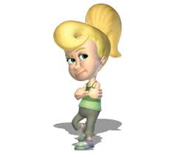
3 Steps to Take to Stop Being a Bully
Close your eyes and think back to when someone hurt you. How did it feel?
Now think about your behavior towards someone else:
what you did
who you hurt
why it hurt him or her
what you can do differently next time so no one gets hurt
Ask an adult to help you
google images
Notes:
Read slide with students. Explain that they’ll learn 3 easy steps to take to stop being a bully.

Slide 8
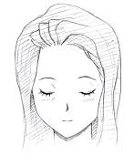
Step 1. Close your eyes and think back to when someone hurt you. How did it feel?
When she called me ‘stupid’ I just wanted to cry…
google images
Notes:
Read slide with students. Have students close their eyes and really think about a time when someone hurt them. Ask them to share what happened if they’re willing, and how it made them feel. If necessary, give one of your own examples to start things off. Try to get at least a few examples from different students.

Slide 9
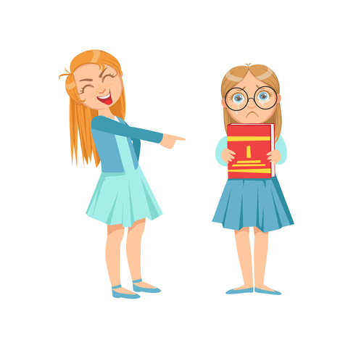
Step 2. Think about your behavior towards someone else
That’s a really ugly shirt you are hiding. How come you always dress like a baby?
Notes:
Read slide with students. Talk about the picture and how the smaller girl looks. Ask students how she must be feeling. How do they know? Point out her facial expressions and body language if necessary. Walk students through each of the questions from Slide 7:
what she did
who she hurt
why it hurt – helpful or hurtful?
what she could do differently next time so that no one would get hurt
Really delve into the last point: What could the girl have done differently next time? (i.e. keep her thoughts to herself; just say ‘hi’ and move on; compliment her haircut; offer to go shopping with her; etc.)

Slide 10
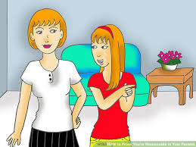
Step 3. Ask an adult to help you
Sometimes I say things that hurt people’s feelings.
Can you help me?
Notes:
Read slide with students. Talk about how important it is to find someone to help you when you’ve realized you might be bullying someone. Get students to list adults who might be helpful (i.e. teachers, guidance counselor, parents, principal, other family members, etc.)

Slide 11
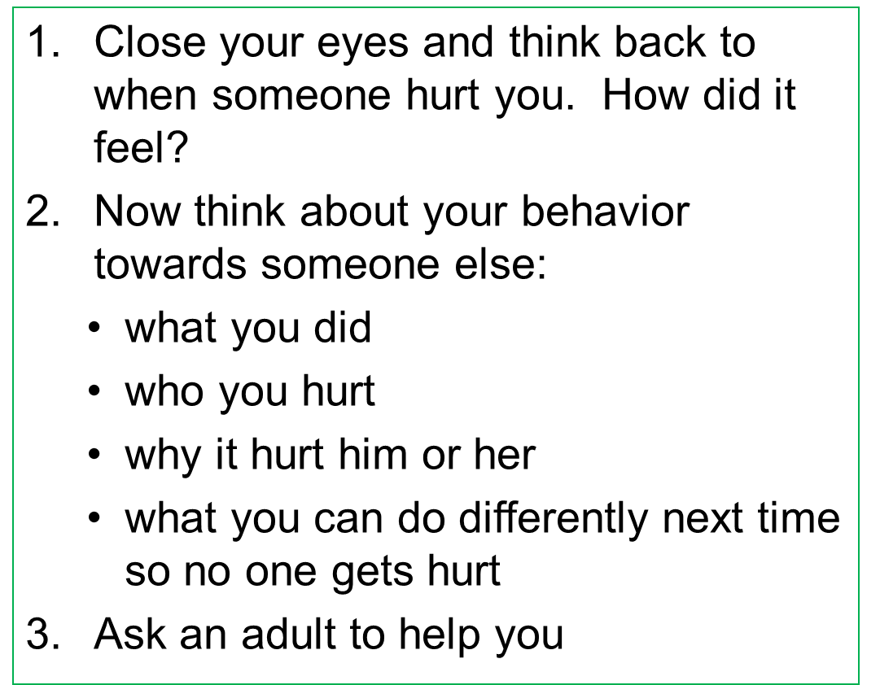
3 Steps to Take to Stop Being a Bully
Bullying stops with me!
Notes:
Review the 3 Steps to Take to Stop Being a Bully with students.

Slide 12
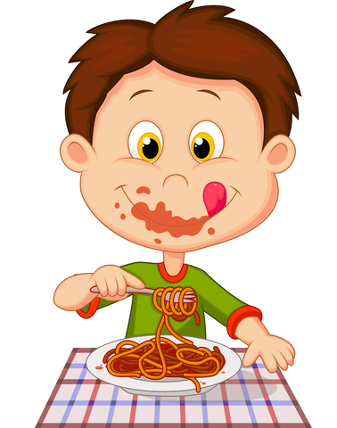
So…what do YOU think?
There’s a kid in school who chews with his mouth open and stuffs his face in the cafeteria. It’s so gross! You really want to say something, but what?
Notes:
Read slide with students. Ask for their input about how to handle the situation. Lead a discussion about how sometimes there’s no easy way to say something. See if they can come up with ideas of things to say that won’t be hurtful to the boy. Make sure to remind them about the difference between being helpful and hurtful to guide their responses.

