Slide 1
Notes:
Read slide with students to introduce the lesson.

Slide 2
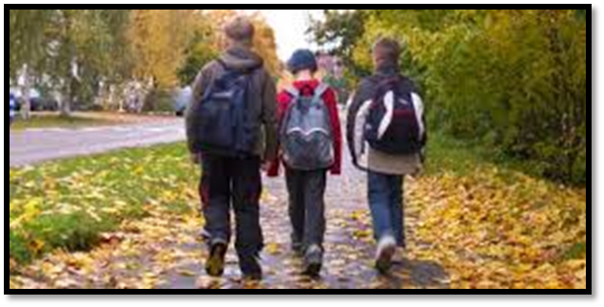
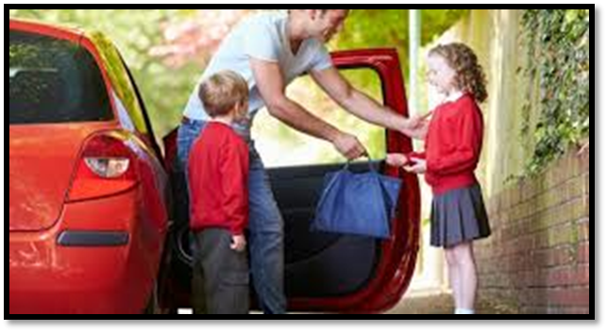
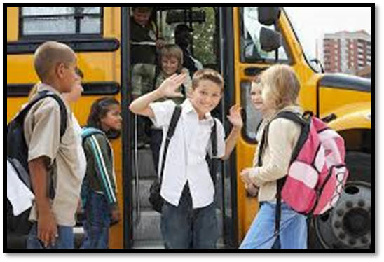
We all get to school in different ways…
Notes:
Read slide with students Click to bring in each picture. Ask students how they come to school each day. Count to see how many walk, ride in cars, or ride the bus. Talk about how kids stay safe when walking to school (i.e. staying on the sidewalk; not running; crossing at the crosswalk/corners; waiting for the green light; listening to the crossing guard’s directions; etc.) Talk about how kids stay safe when riding in a car to school (i.e. fastening seat belt; not distracting the driver by yelling, arguing, or playing loud music; etc.) Lead into school bus safety by asking again for students to raise their hands if they ride a bus to school.

Slide 3
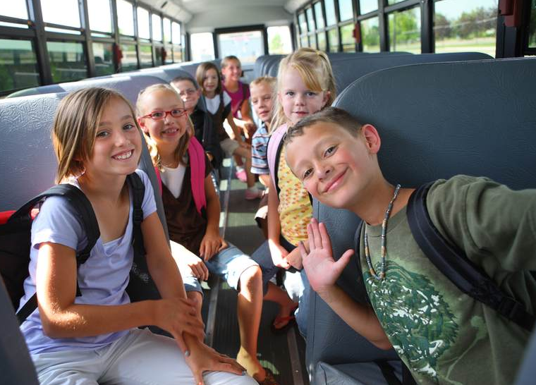
Have you been on a school bus before? How do YOU stay safe?
Notes:
Read slide with students. Ask them for their ideas on how to stay safe on the school bus. List these on the board or on paper.

Slide 4
Even if you don’t ride a bus to school, you might ride a bus on a field trip sometime…
We have to stay safe!
Notes:
Read slide with students. Talk about the fact that while some may walk to school or ride in a car with family members, there may be times when they ride a school bus to a field trip. Keeping safe while on a school bus is important!

Slide 5
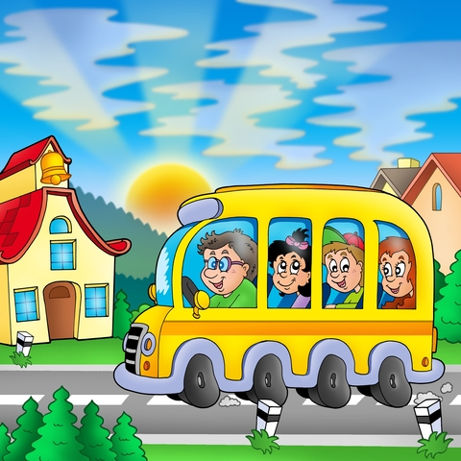
Notes:
Read slide with students. Talk about how the rules at school are there to keep us safe. The same is true for the rules on the school bus.

Slide 6
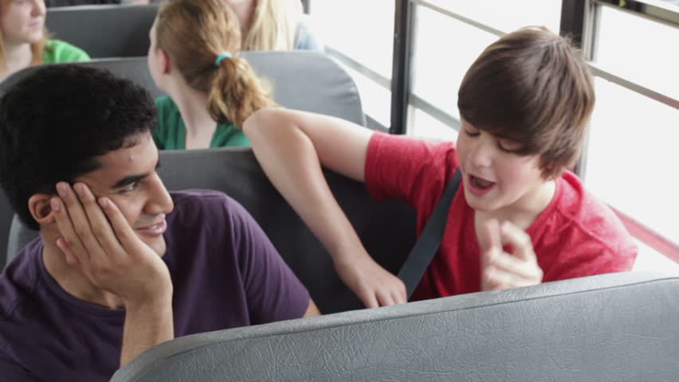
1. Talk quietly
Notes:
Read slide with students. Introduce Rule #1: TALK QUIETLY. Ask students why they think this is important. If they don’t seem to know, lead them in a discussion about what would happen if everyone on the bus was yelling, talking loudly, etc. What might happen to the driver? (i.e. he/she could get distracted; could miss a red light; might not hear a siren; might miss a vehicle coming at them, etc.) End by asking if this would be keeping safe on the bus.

Slide 7
2. Stay in your seat
Notes:
Read slide with students. Introduce Rule #2: STAY IN YOUR SEAT. Ask students why this rule is important. Talk about what might happen if kids were moving about while the bus was in motion. (Again, the driver might be distracted, kids could get hurt if the bus stops suddenly, etc.)

Slide 8
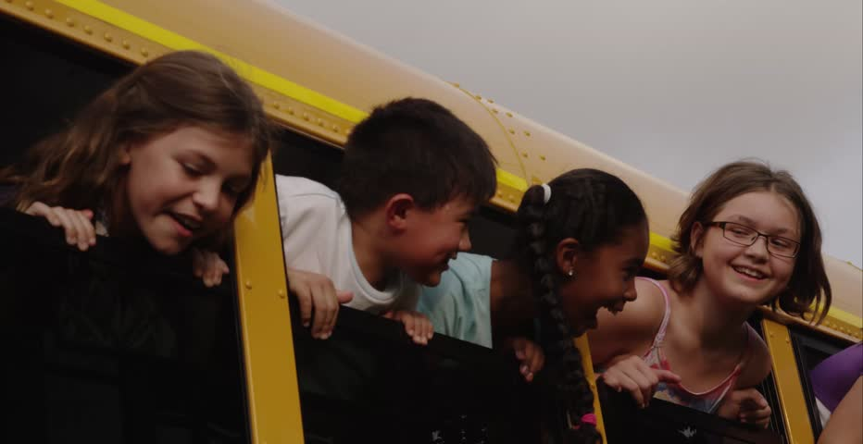
3. Don’t put anything out of the window!
Notes:
Read slide with students. Introduce Rule #3: DON’T PUT ANYTHING OUT OF THE WINDOW. Talk with students about the dangers of putting their heads, arms, hands, legs, out of the bus window. What might happen? Also talk about not throwing anything out of the window either. Ask why this is dangerous also (i.e. it could hit and hurt another vehicle or person; it could damage something or cause an accident; etc.)

Slide 9
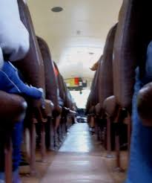
4. Keep the aisle clear
Notes:
Read slide with students. Introduce Rule #4. KEEP THE AISLE CLEAR. Talk about why this is so important in keeping the bus safe. (i.e. no one will trip getting on/off the bus; if the bus stops suddenly, loose items won’t go flying and possibly hurt someone; in an emergency, students need to get off the bus quickly so they need a clear path to do so; etc.)

Slide 10
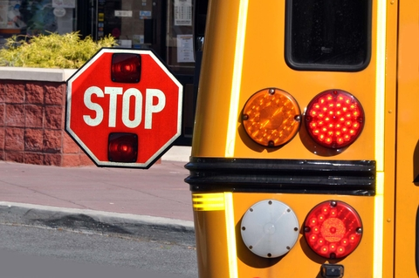
5. Wait for the bus to stop before getting up
Notes:
Read slide with students. Introduce Rule #5: WAIT FOR THE BUST TO STOP BEFORE GETTING UP. Talk about why this rule is important for safety: what might happen if students stand up while the bus is still moving? Remind them of rule #2 (STAY IN YOUR SEAT) and talk about how it’s understandable that they might be anxious to get home and off the bus when they see their bus stop approaching but they still need to remain in their seats until the bus comes to a full stop. What could happen? The bus might need to stop suddenly and the student could fall and get hurt; the driver could be distracted; etc.

Slide 11
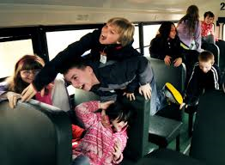
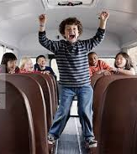
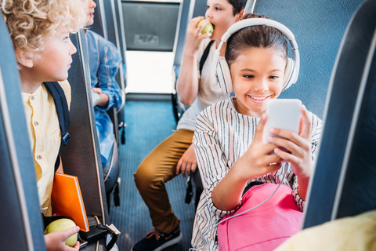
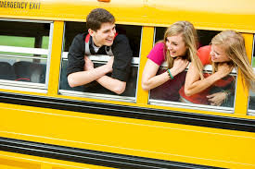
Who is being safe on the school bus?
Notes:
Read slide with students. Click to bring up each picture one at a time and discuss who is being safe on the school bus – why or why not. Remind students to use the previous bus safety rules to guide their answers.

Slide 12
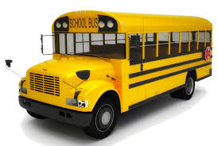
I Can Stay Safe on the School Bus!
Talk quietly
Stay in my seat
Don’t put anything out of the window
Keep the aisle clear
Wait for the bus to stop before getting up
Notes:
Read slide with students. See how many rules the students can remember before clicking to bring up the list. Review all rules with the students.

Slide 13
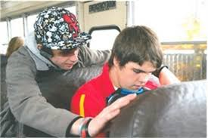
So…what do YOU think?
The boy who sits behind you on the bus is always teasing and making stupid jokes. Sometimes it’s funny, but sometimes it’s really annoying. Seats on the bus are assigned, so what can you do?
Notes:
Read slide with students. Talk about how sometimes seats on school buses are assigned. What can you do when you don’t along with your seatmate, or when the person who sits behind you constantly bugs you? Discuss options like ignoring him, joking back with him, asking him to stop, talking with the principal or driver to request a seat change, etc. Talk about how each option can have a consequence (i.e. your seat could be changed but you might not like your new seatmate either; joking back with the other boy might make things worse, etc.) Talk about how to choose the best option but to also be prepared for possible outcomes.

