Slide 1

I Can Show What I Know
When I Gotta Go!
(…to the Bathroom)
Notes:
Read title slide with students to introduce lesson. Talk about how today’s lesson will give the students some rules for using the school bathroom the right way – rules that will keep them safe, healthy and out of trouble!

Slide 2

What do you do when you need to use the bathroom at school before you even leave the classroom?
raise hand to ask permission?
sign out?
use a bathroom pass?
use a “secret signal”?
Notes:
Read slide with students. Ask students what their teacher(s) expect them to do to request permission to use the bathroom. Click to bring up each option. Talk about how different teachers in the school might have different expectations before they even leave the classroom to use the bathroom. Ask students if there are any other

Slide 3

We all know we have to walk in the hall – even when we’d rather run to the bathroom!
it’s probably okay to walk quickly – but only
when it’s an emergency…
Notes:
Read slide with students. Talk about how we still have to follow the school rules in the hall by walking but that sometimes it’s hard to hold it when we really have to go. Then it’s okay to walk quickly to the bathroom. We can always politely explain that it’s an emergency to anyone who questions us.

Slide 4

Just like in the classroom, there are rules for the bathroom too…
What might happen if we didn’t have bathroom rules?
Notes:
Read slide with students. Lead a discussion about possible problems that would arise if we didn’t have bathroom rules (i.e. people could get hurt, germs could get spread, bathroom would be a mess, etc.)

Slide 5
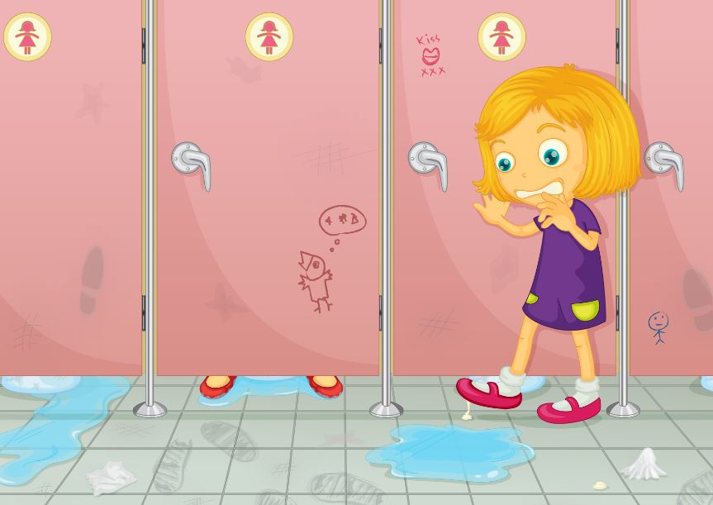
Would you want to use this bathroom? Why or why not?
Ewwwww!
Notes:
Read slide with students. Ask students to point out all of the things they see in the picture (i.e. water on the floor, graffiti, trash on the floor). Ask them why these things might make them not want to use this bathroom. Lead a discussion about safety concerns (slipping in the water on the floor; tripping over trash; germs; etc.)

Slide 6
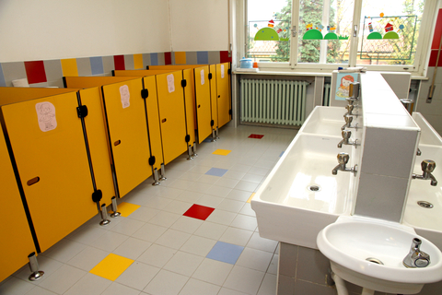
How about this bathroom?
Notes:
Read slide with students. Talk about what they see in this picture: clean sinks, floor, etc. Why would they prefer to use this bathroom over the other one? Talk about how they think a bathroom is kept this way. (RULES!)

Slide 7

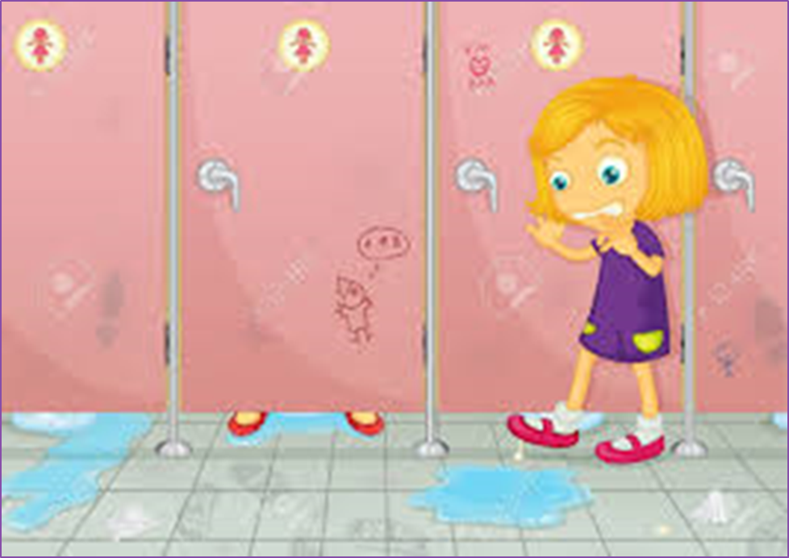

So what’s it gonna be?
This one
PLEASE!!
Notes:
Read slide with students. Let them vote on which bathroom they’d prefer to use – tally their responses. Lead into the next slide by explaining that rules help us to keep our bathrooms clean and safe.

Slide 8

4 School Bathroom Rules
Take care of myself
Respect others
Respect bathroom property
Get back to class
Notes:
Read slide with students. Explain that you’ll go over each point in a little more detail, but kick things off by asking the class what they think it means to “take care of myself” in the bathroom.

Slide 9
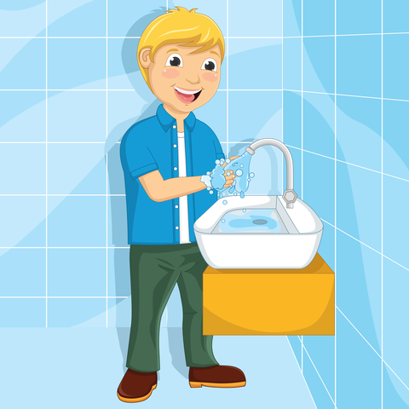
1. Take care of myself
wash hands with warm water and soap
dry hands
throw away towel in trash or use air dryer
check face in mirror after breakfast and lunch; wipe off if needed
Notes:
Read slide with students. Lead a discussion about proper bathroom hygiene (i.e. wiping [depending on the students you have], handwashing and drying, looking in the mirror to clean face after lunch, etc.) Ask students if there is anything else to add to the list.

Slide 10
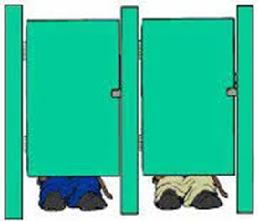
2. Respect others
stay quiet
respect the privacy of others
keep hands, feet, and belongings to yourself
FLUSH!!!
Notes:
Read slide with students. Talk about how important it is to respect the “rights” of others using the bathroom too. List ways to do this and ask students to add their ideas.

Slide 11

3. Respect bathroom property
turn off water
take care of bathroom equipment
put trash where it belongs
Notes:
Read slide with students. Ask students if they’ve ever tried to use something in a bathroom and it wasn’t working (i.e. the paper towels were stuck; the toilet was clogged, etc.) How did they feel? What did they do about it? What should they do if they use the bathroom and find something not working properly? (tell their teacher or the custodian, etc.)

Slide 12


4. Get back to class
when you’re done – you’re done!
not time for you to hang around
finish up and get back to class quickly
Notes:
Read slide with students. Talk about the importance of using the bathroom quickly and returning to class. What might happen if you don’t? (you might miss important things in class; your teacher might be angry that you took so long; you might lose bathroom privileges; etc.)

Slide 13
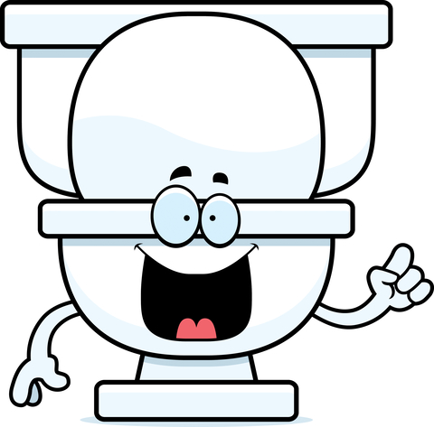
Can you remember the
4 School Bathroom Rules?
That’s it!
So Show What You Know
When You Gotta Go!!
Take care of myself
Respect others
Respect bathroom property
Get back to class
Notes:
Read title with students. Ask students if they can list the 4 school bathroom rules they just learned. Click to bring up the 4 rules.

Slide 14




So…What do YOU think?
You walk into the bathroom where a couple of kids are goofing around, throwing water and soap at each other. The floor is a mess and you can’t get past them to get to the bathroom stall.
What can you do?
Notes:
Read slide with students. Talk about the possible responses to the situation but also possible repercussions: They could leave and try another bathroom (but what if there’s not enough time to get to another one?); they could say “excuse me” and try to get past the boys (but what if it’s dangerous and they slip? or what if they get drawn into the fight? or what if they become a target?); they could go tell an adult (but then they could be labeled a tattletale and they still haven’t been able to go to the bathroom); etc. Lead a discussion about how every action they take will have a consequence so they need to think through their plan and be prepared to handle the outcome.

