Slide 1

Saying “I’m Sorry”
(and meaning it!)
Notes:
Introduce the lesson – read title slide with students. Ask if they know the difference between just saying “I’m sorry” and really meaning it. Explain that today’s lesson will show them how to apologize to someone when they’ve made a mistake or done something wrong that hurt/upset someone else.

Slide 2
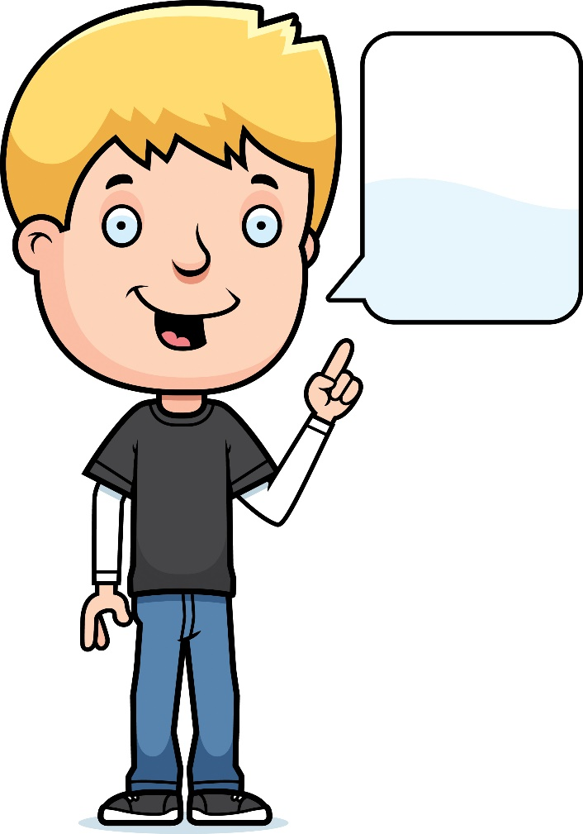
Did you ever make a mistake?
Like what?
Notes:
Read slide with students. Ask them what kind of mistakes they’ve made. You might want to narrow it down to the past week or so. You may even need to start off the conversation with an example of your own.

Slide 3
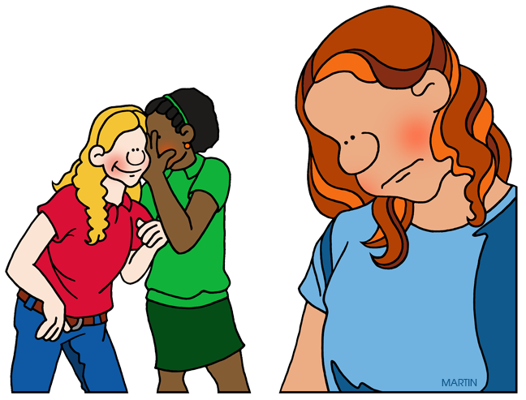
Did your mistake hurt someone’s feelings?
That was a secret!!
Notes:
Read slide with students. Ask students about the picture and what they think is happening. Talk about the fact that the girl told her friend a secret that the friend is now telling someone else. Emphasize the look on the girl’s face. What is she feeling? (sad, hurt, upset…)

Slide 4
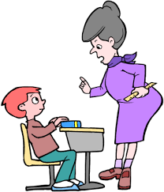
Did your mistake make someone mad?
This is the third time this week you didn’t do your homework!
Notes:
Read slide with students. Talk about the teacher’s body language – how can they tell she’s mad? Ask students if they’ve ever been in this situation before and what happened as a result. (i.e. they had to stay in at recess to finish homework; they got a bad grade; etc.)

Slide 5

We all mistakes. It’s what we DO about the mistakes that matter!
Uh-oh….
Notes:
Read slide with students. Click to bring in conversation balloon. Talk about the fact that we all make mistakes but what’s most important is what we do NEXT. Ask students what they think should be done next.

Slide 6
When we make a mistake that hurts someone’s feelings or makes someone mad, the right thing to do is…
APOLOGIZE
Notes:
Read slide with students. Talk about the word APOLOGIZE – what does it mean? Can they give some examples?

Slide 7
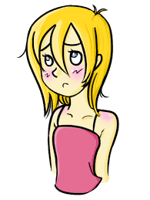
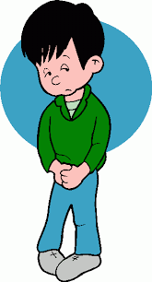
There are different ways to apologize…
I’m so sorry…
I didn’t mean to hurt your feelings
“face-to-face” or “in person”
Notes:
Read slide with students. Explain that one way is to apologize face-to-face or in person. Talk about what each person is saying and what their faces and body language looks like.

Slide 8
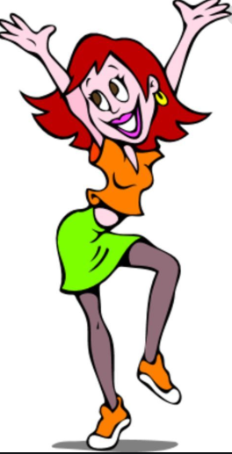
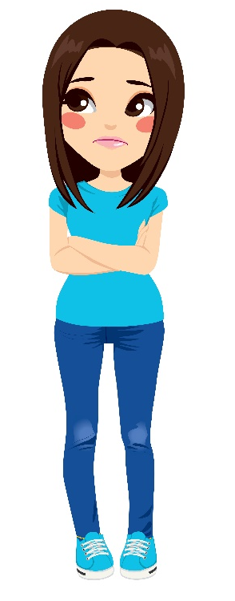
Your face and your body language helps the other person know that you mean what you are saying
I don’t think she means it
I’m like, so sorry. You know??
Notes:
Read slide with students and talk about the picture. Does the girl really mean what she’s saying? How can they tell from her face and her body language? If someone apologized to them like this girl is doing, would they believe that she meant it? Why or why not?

Slide 9
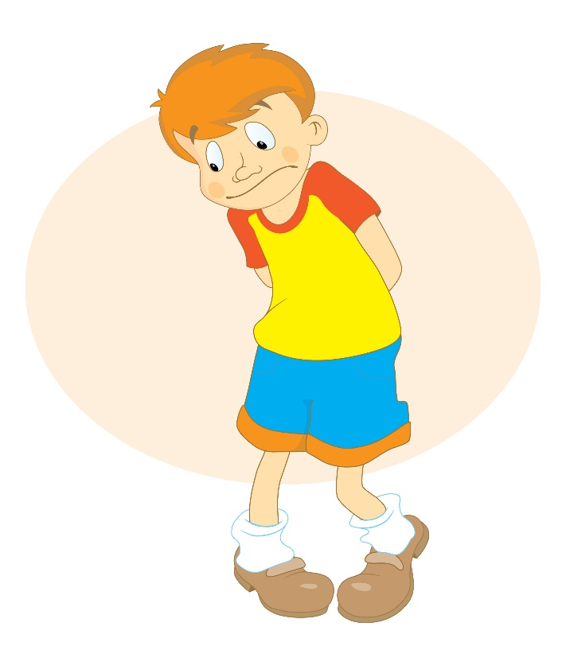
When your face and your body language match what you are saying, you are being SINCERE.
Sincere means saying what you honestly feel.
I am so sorry…
Notes:
Read slide with students and introduce the new word SINCERE. Emphasize how important it is to be SINCERE when we apologize so that the other person believes your apology. Our face and body language helps the other person to believe us.

Slide 10
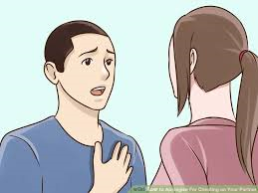
A face-to-face apology is best because the other person can see how sincere you are and might believe you more easily.
I’m sorry I hurt your feelings. It won’t happen again.

Slide 11
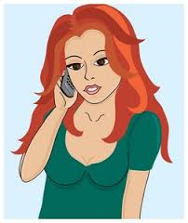
If it’s too hard for you to face the person, you can try calling them on the phone…
I shouldn’t have told her your secret – I’m so sorry.
Notes:
Read slide with students. Explain that sometimes it is hard to talk to someone in person. The important thing to remember is that they want to apologize – so if calling is more comfortable for them, it’s better to do that than nothing at all.

Slide 12


You could also text them – but ask to talk in person too!
I want to apologize – can we please talk at lunch time?
Notes:
Read slide with students. Click again to bring up emoji on phone. Explain that this is a good way to start, but it’s not enough to just text the other person. A face-to-face apology would also be necessary. Remind them that this is the only way for a person to see your face and body language to help them know that you are sincere.

Slide 13
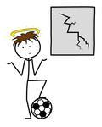
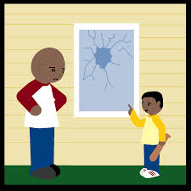
Who is being sincere?
I don’t know who broke your window.
I’m sorry Mr. Jones. I broke your window – I’ll pay for it.
Notes:
Read slide with students. Ask them which boy is sincerely apologizing. How do they know?

Slide 14





A good apology has 4 parts:
apologize
take responsibility
say how you’ll fix it
wait for response
Notes:
Read slide with students. Click to bring up each part of the apology. Explain that you’ll talk about each part next…

Slide 15


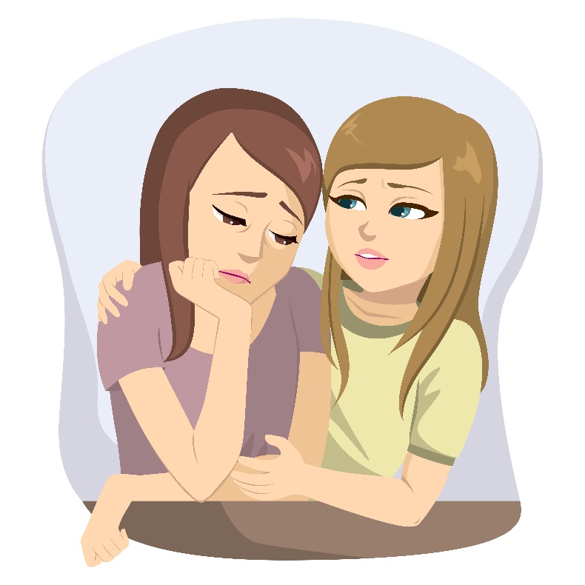
I’m sorry
Notes:
Read slide with students. Talk about the fact that these girls are usually good friends, that’s why it’s okay for her to put her hand on the other girl’s shoulder. Sometimes we make a mistake and say or do something that hurts one of our good friends The first thing this girl did was say she was sorry.

Slide 16


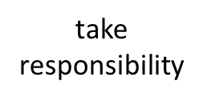

I’m sorry that I told you to ‘shut up’ in group today
Notes:
Read slide with students. Talk about the 2nd part of a good apology – taking responsibility for the mistake. Ask how girl took responsibility in this instance.

Slide 17


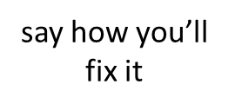

I’m sorry that I told you to ‘shut up’ in group today. Next time I’ll listen to you and wait until you’re finished.
Notes:
Read slide with students. Talk about the 3rd part of a good apology – saying how you’ll fix it. How did the girl say she’d fix her mistake next time?

Slide 18


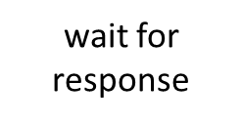


That’s okay I guess…
Notes:
Read slide with students. Talk about the girl’s zipped lips – that means she’s waiting for the other girl to respond. so she stopped talking. Explain that sometimes it takes awhile for someone’s hurt feelings to go away so they might not be too chatty at first. Encourage them to give it a little time for the friendship to mend.

Slide 19

Remember:
A good apology has 4 parts:
apologize
take responsibility
say how you’ll fix it
wait for response
Notes:
Read slide with students.

Slide 20
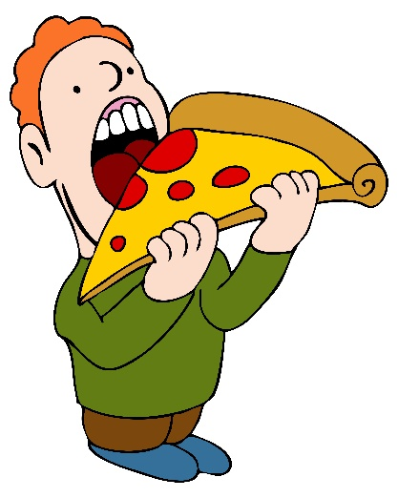
So…what do YOU think?
Another student pushes ahead of you in the cafeteria line and ends up getting the last slice of pizza. Now you have to have the cold sandwich lunch instead. He takes a big bite, then turns to you and says he’s sorry. What can you say?
Notes:
Read slide with students. Talk about the situation and brainstorm possible solutions for accepting the apology. Remind students about body language and sincerity to help them determine if the other guy really meant the apology. The students will have to guess based on the limited information they have BUT you can lead them to talk about different scenarios – he’s sincere because he didn’t know it was the last slice; he’s not sincere because he doesn’t care that you have to eat something else for lunch, etc. Each scenario will have a different response and outcome, so explore these carefully with the students.

