Slide 1
I Can Tackle Test-Taking!
Notes:
Read title slide with students. Ask how they feel when they have to take a test. You can start them off if necessary with words like nervous, anxious, worried, etc. Write their answers on the board.

Slide 2
How Do You Feel When You Take a Test?
nervous
worried
anxious
like I’m going to be sick
Notes:
Read heading with students. Ask how they feel when taking tests. Click to bring up each feeling on slide.

Slide 3
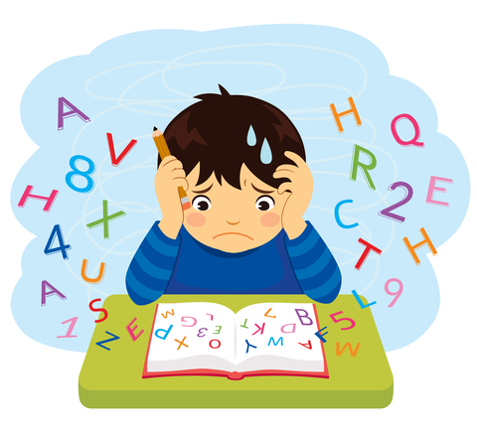
How We Feel Affects How We Do
What happens when we’re nervous
(or anxious or worried…)?
it’s hard to concentrate
we tense up
we start to doubt ourselves
we can’t do our best
Notes:
Read slide with students. Click to animate picture. Talk about how our feelings can affect how we do on the test. Ask students if this has ever happened to them. What did they do?

Slide 4
Of course, we need to study before the test…
Notes:
Read slide with students. Remind students that studying before the test is obviously important.

Slide 5
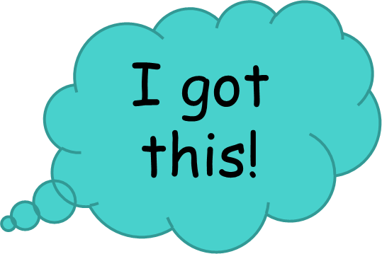
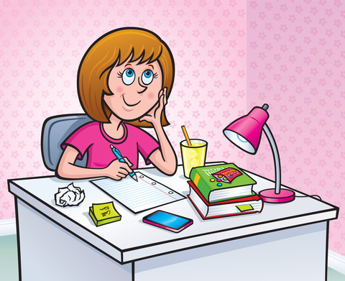
We Need to Get Our Feelings Under Control
Say to yourself:
I studied
I know the material
I’m ready!
Notes:
Read slide with students. As a group, practice saying the words together. Explain that we can make ourselves more confident by saying these words to ourselves before we start the test.

Slide 6
Okay – you’re ready to start the test. Now what?
Let’s talk about some tips for taking tests!
Notes:
Read slide with students. Explain that they’ll be learning some test-taking tips that can help them on their next exam.

Slide 7
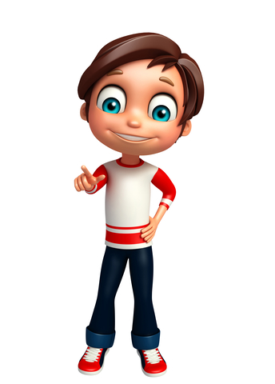
What test-taking tips do YOU have?
Notes:
Read slide with students. Ask them to share any test-taking tips they might have with the group. List these on the board.

Slide 8
5 Test-Taking Tips
1. Read the directions
adapted from www.pbskids.org
Notes:
Read slide with students. Talk about how reading the directions can help us understand what to do on the test and can keep us from making mistakes. Also talk about the fact that sometimes there aren’t written directions so they’ll have to listen carefully to the teacher’s directions.

Slide 9
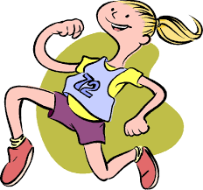
2. Pace yourself
adapted from www.pbskids.org
Notes:
Read slide with students. Explain that the test will probably be timed and that students should check to see how many questions are on the test. That way they can figure out how quickly they’ll have to move through each one to finish before the time is up.

Slide 10
3. Read the whole question and all the choices
adapted from www.scholastic.com
Notes:
Read slide with students. Talk about how important it is to read the whole question to make sure what is being asked, then read all of the possible answers on multiple-choice tests. Explain that sometimes one answer seems like the right one at first, but reading all of the choices can make you more certain about your answer.

Slide 11
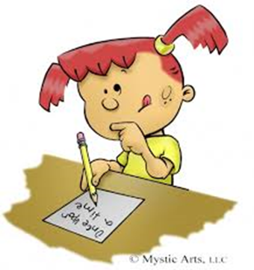
4. Focus on the stuff you know
adapted from www.pbskids.org
Notes:
Read slide with students. Remind them that because the test is timed, it’s okay to skip a question that is stumping them and move on to the next question. Then they can go back to those questions once they’ve completed all of the other questions on the test.

Slide 12
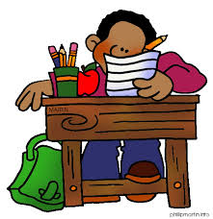
5. Check your work
Notes:
Read slide with students. Talk about how important it is to go back over the test to check their answers before turning it in. Remind them not to dwell on the answers too much because then they might start to second-guess themselves. Just look everything over before handing in the test.

Slide 13
We may not ace every test but we can try our best on every test!
We did it!!
Notes:
Read slide with students. Encourage students to feel proud of themselves when they know they tried their best on the test. Remind them that they might not ace every test, but they can try their best on every test.

Slide 14
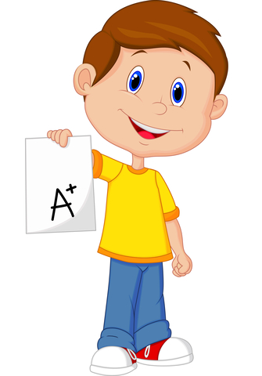
5 Test-Taking Tips
Read the directions
Pace yourself
Read the whole question and all the choices
Focus on the stuff you know
Check your work
Notes:
Summarize the lesson for the students. See if they can tell why it’s so important to do each of the 5 test-taking tips.

Slide 15
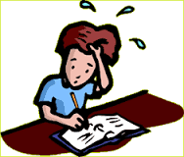
So…what do YOU think?
You’re taking a multiple-choice test in social studies class. You get to a tricky question where some of the answers look like they could be right, but you’re just not sure.
What can you do?
Notes:
Read slide with students. See if they can apply some of the test-taking tips they just learned in the lesson. Then add: If you’re not sure about an answer on a multiple-choice question, try crossing out all of the answers you know aren’t correct. Then choose from the remaining ones.

