Slide 1
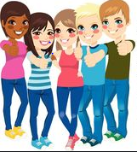
I Can Handle Put-Downs
Notes:
Read slide with students. Introduce the topic of “put-downs” and ask students to define the word. Let them come up with their own meanings, then go to the next slide.

Slide 2
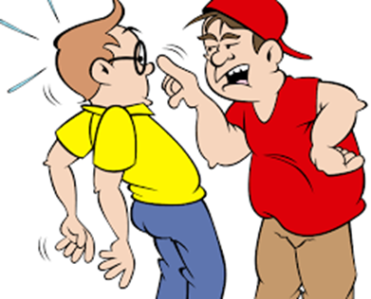
What is a “put-down”
something someone says to you on purpose to make you feel bad
it can be an insult or a criticism about you that can be hurtful to you or make you mad
Nice glasses
four-eyes…did you get ‘em from your granny?
Notes:
Read slide with students and define “put-down”. Explain “criticism” and “insult” also. Ask students for other examples of put-downs (too tall, too short, too fat, too skinny, weird hair, etc.) Ask students if they’ve ever had someone say a put-down to them. Share your own examples to start things off.

Slide 3
Sometimes it’s just friendly teasing…
Did you really think the capital of Pennsylvania was Pittsburgh?
I know – I can’t believe I said that!
Notes:
Read slide with students. Have a student read the boy’s words in a friendly way. Point out that you can tell by both children’s faces that they are friends and the boy wasn’t saying anything to hurt her feelings. And you can tell by the girl’s face and words that she knew he was just teasing. She thought it was funny too!

Slide 4
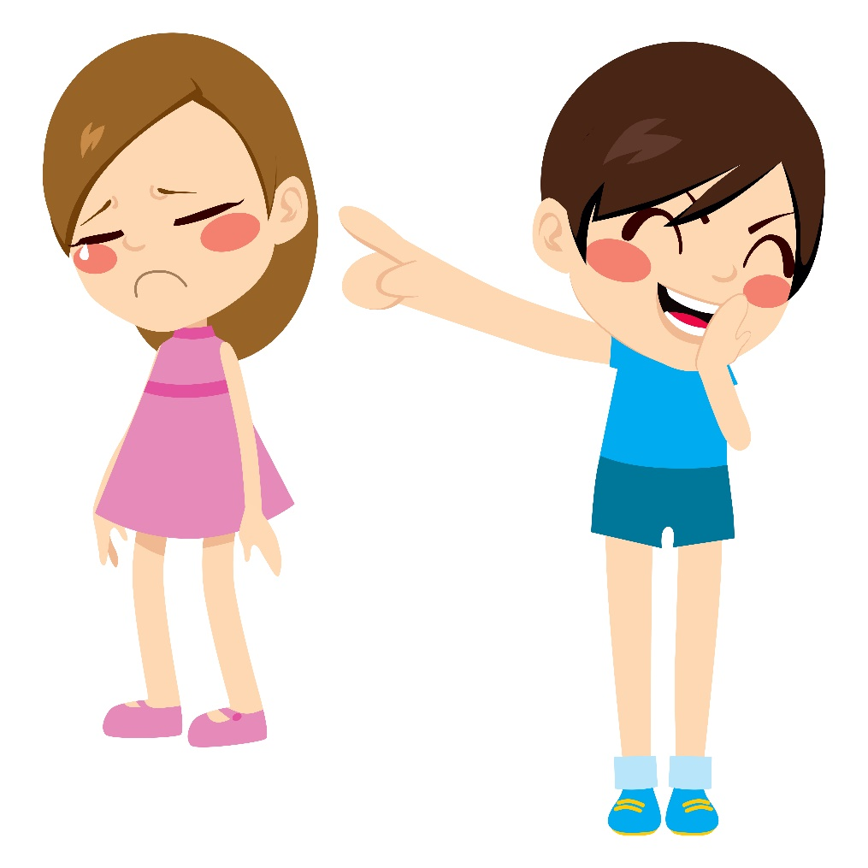
But sometimes it’s mean and it hurts your feelings…
She thinks the capital of Pennsylvania is Pittsburgh – what an idiot!!
Notes:
Read slide with students. Talk about the girls’ faces first – one girl is laughing and pointing at the other girl. That girl is very sad and looks embarrassed. Then read what laughing girl is saying about the other one. Ask if calling the girl an idiot is friendly teasing or a mean put-down.

Slide 5
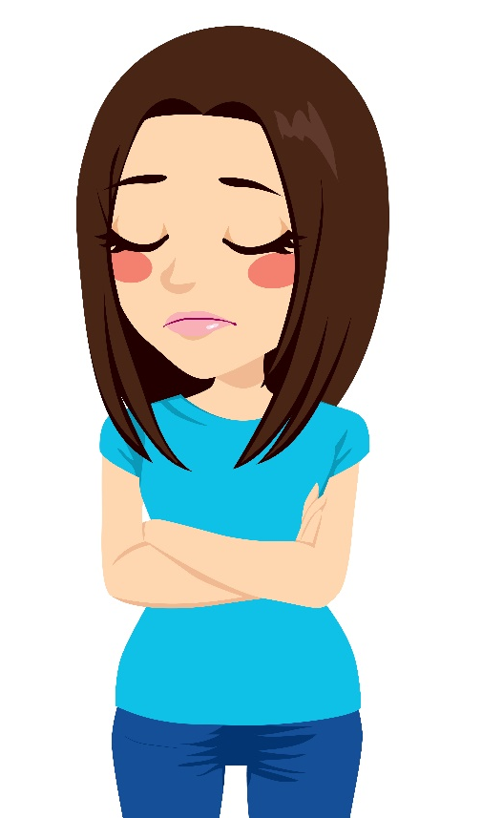
Or it makes you mad…
That was hilarious when you fell – you are so clumsy!
Notes:
Read slide with students. Talk about the girls’ faces and body language. One is laughing and pointing at the other – and she looks mad (arms folded, no smile on face).

Slide 6
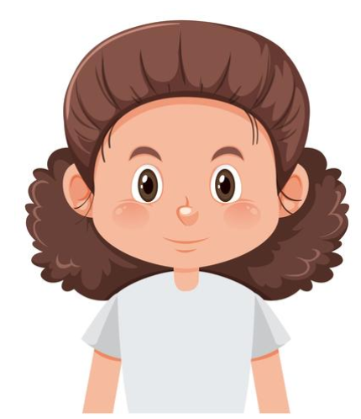
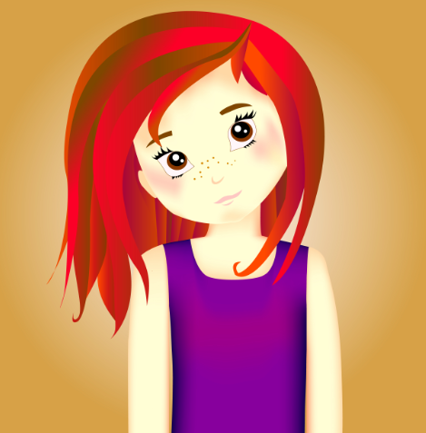
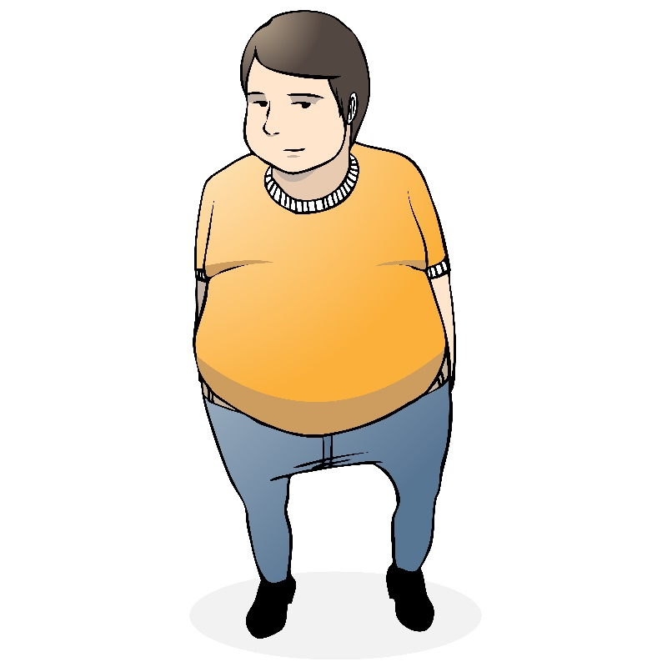
Sometimes someone might say something about the way we look…
Notes:
Read slide with students. Click to bring in each picture (3). Ask the students what other people might say as a put-down to each of these kids. (i.e. freckles, fat, frizzy hair) Ask how it might make that person feel to hear those things.

Slide 7
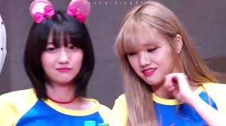
or something we do…
You’re so weird – why would you wear those stupid ears?
Notes:
Read slide with students. Talk about how sometimes someone might put down something we wear, or something we say. Point out the other girl’s face – ask students how she might be feeling hearing that put-down. (sad, embarrassed, hurt, etc.)

Slide 8
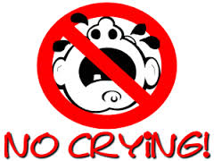
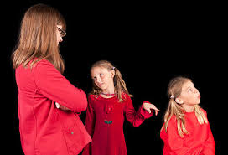
It’s important to react the right way so the put-downs might stop!
NO TATTLING!
Notes:
Read slide with students. Ask students what might happen if we cry or tattle when someone gives us a put-down. The put-downs might continue – or get even worse – because the person got a big reaction out of us!

Slide 9
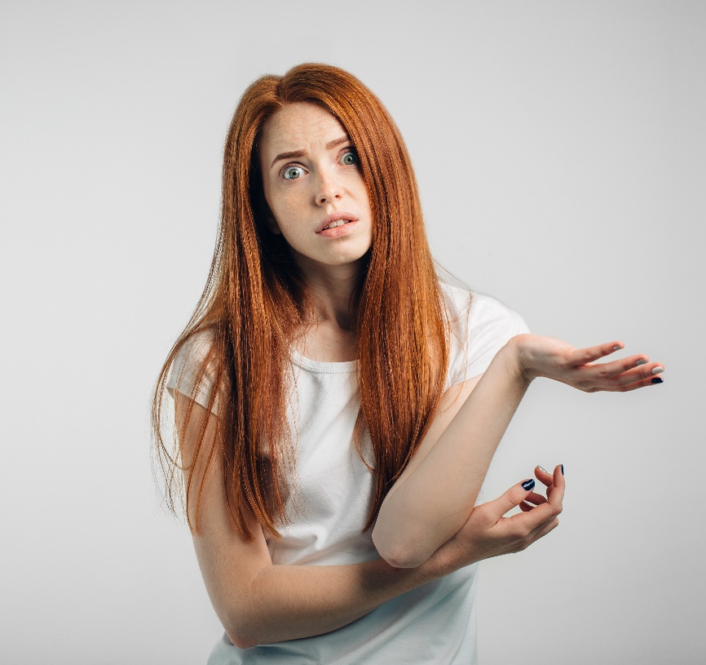
Let’s learn some ways to handle put-downs with comebacks
Question it
Why would you want to tell me I’m dumb and hurt my feelings?
adapted from Nobody Likes Me, Everybody Hates Me, M. Borba, 2005
Notes:
Read slide with students. Tell them they’ll learn 4 different ways to respond to put-downs. These responses are called COMEBACKS. The first comeback is to question the other person.

Slide 10
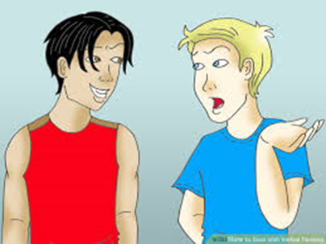
Turn it into a compliment
Nice of you to notice my new haircut – thanks!
Your hair looks stupid
Notes:
Read slide with students. Talk about how turning a put-down into a compliment can surprise the other person and they might stop saying mean things. Emphasize that it’s important for the students to respond and then walk away to prevent further interaction.

Slide 11
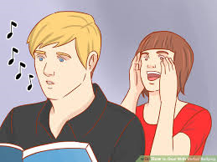
Ignore it – and walk away
Hey loser!!
Notes:
Read slide with students. Talk about how the boy is whistling and ignoring the person saying the put-down. Tell the students that this is a good strategy to use If they're not comfortable with a verbal response. Explain that this comeback works best when you can keep walking away from the other person, like on the playground or in the hallway at school. It’s not so great to do this on the bus or in the classroom.

Slide 12
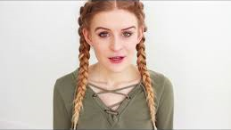
Be amazed!
Really? I didn’t know that – thanks for telling me.
Notes:
Read slide with students. Talk about the response and how this works best when you sound like you really mean it. Get the students to practice this comeback with you.

Slide 13
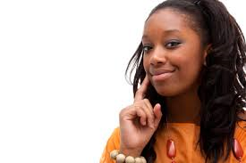
Stay calm and confident!
It’s important to stay calm and be confident when you’re using any of these comebacks
Okay…I got this.
Notes:
Read slide with students. Talk about the importance of being calm and confident so that the person saying the put-downs realizes you mean it. When they see they’re not getting a big reaction out of you, they may leave you alone after this!

Slide 14
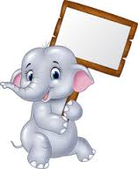
Remember: 4 Comebacks for Put-Downs
Question it
Turn it into a compliment
Ignore it
Be amazed!
stay calm and confident!
Notes:
Read summary slide with students. Ask students to demonstrate each comeback for practice. Emphasize making a calm, confident response.

Slide 15
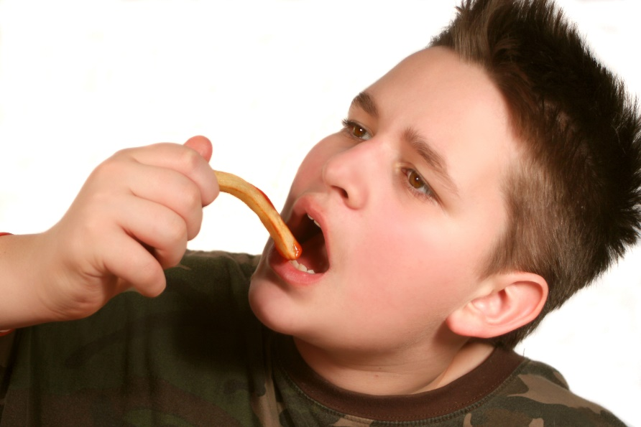
So…what do YOU think?
You and your friend are hanging out at lunch time when someone tells your friend he shouldn’t eat the french fries because he’s already too fat. What can you do?
Notes:
Read slide with students. Talk about the situation and ask for solutions to the problem. Help students realize they can share the comebacks they’ve learned with others so that their friends can handle put-dpwns too.

