Slide 1
I Can Be Helpful – Not Bossy
Notes:
Read title slide with students. Ask what they thing HELPFUL and BOSSY mean. Write their descriptors on the board.

Slide 2
There’s a difference between being…
Helpful
Bossy
politely reminding someone what the ADULT needs them to do
telling someone what YOU want them to do
adapted from www.cornerstoneforteachers.com
Notes:
Read slide with students. Talk about the difference between HELPFUL and BOSSY. Ask students for examples before moving on to next slide.

Slide 3
There’s a difference between being…
Helpful
Bossy
Coach wants me to pitch first, then it’s your turn
Get off the mound – I’m pitching first!!
Notes:
Read slide with students. Talk about the difference between HELPFUL Lucy and BOSSY Lucy. Ask students to really look at the pictures. See if they notice Lucy’s facial expressions and body language. If not, point this out to them.

Slide 4
Sometimes we might be bossy instead of helpful
4 Things to Watch:
our tone of voice
the words we say
what our face is doing
what our body is doing
Notes:
Read slide with students. Explain that there are 4 things we need to watch to make sure we’re being helpful, not bossy.

Slide 5
Tone of Voice
Inside voice – not yelling
Notes:
Read slide with students. Define tone of voice and talk about how our tone of voice can either help people listen to us OR make them not want to listen to us, or be around us, or play with us. Ask students how they feel when someone is yelling at them.

Slide 6
The Words We Say
Move – you’re in my way!
Mrs. Smith told us to stop at the door and wait for her
You’re not supposed to be playing with those - I’m telling!
Notes:
Read slide with students. Click to bring up each conversation balloon and let a different student read each one. Ask students to pay attention to tone of voice when reading the quotes. Let the students practice rephrasing the quotes to make the bossy quotes into helpful ones.

Slide 7
What Our Face is Doing
Helpful or Bossy?
Notes:
Read slide with students. Ask students to look at the picture and tell what they see. Is the boy smiling? Look at his eyes and eyebrows – does he look helpful or friendly?

Slide 8
Helpful or Bossy?
Notes:
Read slide with students. Ask them to look at the picture and tell whether they think the girl is being helpful or bossy. Why? (If necessary, call their attention to her eyes and mouth.)

Slide 9
What Our Body is Doing
Notes:
Read slide with students. Ask them to look at the picture and decide if the girl is being helpful or bossy. Why? If necessary, point out her body language – hands on hips as well as her facial expression

Slide 10
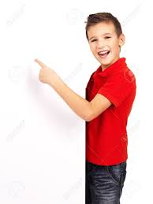
Helpful or Bossy?
Notes:
Read slide with students. Ask them to look at the picture and decide if the boy is being helpful or bossy. Why? If necessary, point out his relaxed body language and his smiling face.

Slide 11
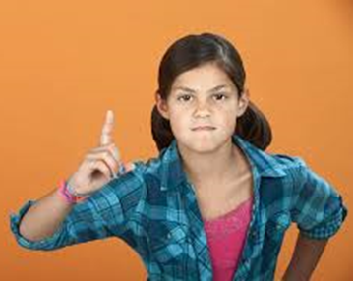
Helpful or Bossy?
Notes:
Read slide with students. Click to bring up each picture and discuss them one at a time. Are the girls being helpful or bossy in each picture? Why? What are their faces and body language telling us?

Slide 12
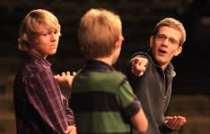
That’s stupid! We’re not doing it that way!!
The teacher said we only need to answer the first 3 questions.
Notes:
Read slide with students. Have students look at the first picture and tell whether the boy is being helpful or bossy just by looking at his face and body language. Now click to bring up the conversation balloon and ask a student to read it in a bossy tone of voice. Now have students look at second picture and tell whether the girl is being helpful or bossy just by looking at her face and body language. Now click to bring up the conversation balloon and ask a student to read it in a helpful tone of voice. What would it sound like if the girl was really being bossy instead?

Slide 13
I Can Be Helpful – Not Bossy
4 Things to Watch:
my tone of voice
the words I say
what my face is doing
what my body is doing
Notes:
Read slide with students. Review the 4 things we need to watch to make sure we’re being helpful,, not bossy.

Slide 14
So…what do YOU think?
Your teacher assigns your class to work in small groups on a project. You have a great idea to make your group’s project really stand out but everyone is talking at once. You want your classmates to listen to you.
What can you do?
Notes:
Read slide with students. Discuss the situation presented and ask students for different ways to solve the problem. Remind them of the 4 Things to Watch to make sure they’re being helpful, not bossy.

Slide 15
