Slide 1
Words and Actions Can Hurt
Sometimes I say things and do things when I am frustrated or mad.
Sometimes those things can make another person feel sad and tired and just not want to be with me.

Slide 2
Sometimes I want help and I yell over and over to the person to help me out. This yelling can feel like a sharp pain to the person. They start to feel frustrated too. They think, ‘Why can’t he wait, I always help him.”
Why can’t you wait! I always help you out!

Slide 3
Sometimes I want my school work changed. Sometimes the adult works so hard to make things OK for me and then I don’t like it or I keep changing it.
This makes the adult feel frustrated and tired. The person feels like they want to help but I never help them out.
I worked so hard to help and he still doesn’t want to do what I gave him.

Slide 4
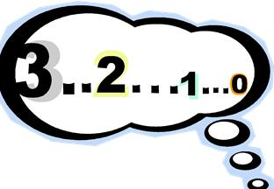
I think I am going to try VERY hard to make the people who like me and want to help me feel good.
I can do things when I feel frustrated and want to yell.
I can: In my head count to 5 then count backwards BEFORE I say anything. Then I can say something quietly about how I feel.

Slide 5
I can try as hard as I can to do the activities adults give me. It really is probably easier than I think.
This will make them feel so happy AND want to do things with me a lot!
I want to be with _____! He makes me feel great!

Slide 6
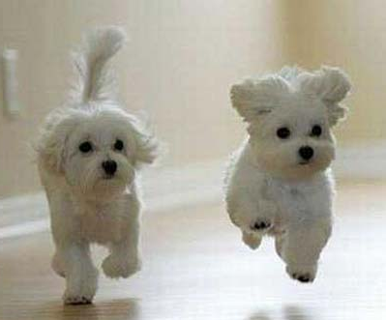
Let’s get _____! He never yells at us!

Slide 7
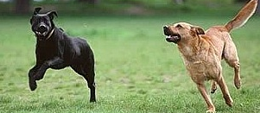
Yeah, he doesn’t make us keep changing them!
Let’s get _____. When we teach him new tricks he DOES them!

Slide 8
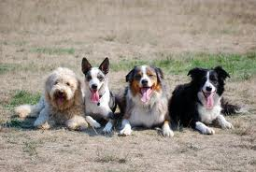
_____ tries to count to 5 and backwards when he is frustrated!
_____ tries to do what we show him!
_____ makes me happy!
_____ tries not to yell at us!

