Slide 1
When Someone is Talking

Slide 2
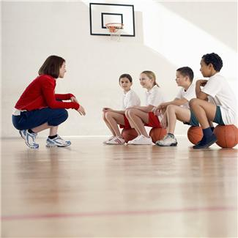
Sometimes in school I have something important to tell an adult.
Oh I really need to tell her something…but she is talking…

Slide 3
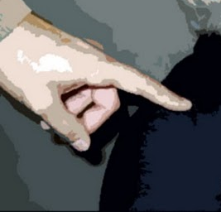
When I want to talk to an adult I go to them, tap them and start talking.
Google images: classicnewwordpress.com

Slide 4
Sometimes it may not be a good time.
Sometimes the adult may be talking to someone else.
I’d like to ask her something but she is talking to Carol right now. I have to wait.

Slide 5
Sometimes it may not be a good time.
Sometimes the adult may be working.
I have to get these papers graded, I hope no one interrupts me

Slide 6
Sometimes it may not be a good time.
Sometimes the adult may be teaching.
He is in the middle of explaining something, I better wait until he asks if there are any questions.

Slide 7
If the adult is talking, working, or teaching they cannot hear me. That is when my words bump into their words or thoughts and they cannot understand anything.
Hey I want to talk to you….excuse me can you hear me?!
What, What, What? Someone has to stop talking until I am finished!

Slide 8
When I want to talk to an adult I have to go up and look first.
Are they talking to someone?
Are they working?
Are they teaching?

Slide 9
If they are doing any of these things I can count to 10 in my head.
2
4
2
1
5
8
10
6
3
7
9

Slide 10
Then I can look to see if they are still doing these things. If they are then I can raise my hand without talking and count to 10 in my head.
Still busy…1..2..3..4..5..6..7..8..9..10

Slide 11
If nothing happens, then I can quietly tap them on the shoulder and say, “Excuse me”.
Usually the adult will answer then or let me know if I should wait.
Google images: classicnewwordpress.com

Slide 12
I’m going to try my “observation” skills. “Observation” means to watch closely and see what is happening. I’m going to observe to see if someone is talking, working, or teaching. Then I will know what to do.

Slide 13
Is the person talking, working, teaching?
NO
Observe
Ask or tell
YES
Count to 10
If finished, talk
Still busy, raise hand & count to 10
Tap shoulder, excuse me
Still busy

