Slide 1

Sticky Thinking
Sometimes I get a thought stuck in my mind.
I think about it over and over!

Slide 2
Sticky Thinking
I try to start my work but I keep thinking about the same thing. This is called Sticky Thinking.
I can’t stop!

Slide 3
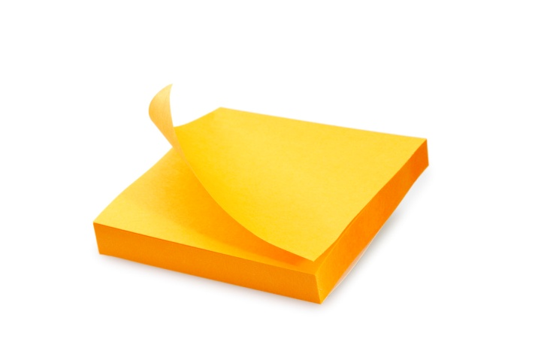
Sticky Thinking
The good news is that I have control over my sticky thinking. I will try to look at my sticky thought as a yellow post it note.

Slide 4
Sticky Thinking
Some people call post-it notes “Stickies”. The note is hanging on the wall in my mind.

Slide 5

Sticky Thinking
I can pull the note down and throw it in the trash. Now my Sticky Thought is ALL GONE!
I can get back to work!
I HAVE CONTROL OVER MY STICKY THOUGHTS!

Slide 6
Sticky Thinking
One more cool thing:
I could even write my thought on a REAL sticky note and throw it away in the REAL trash!

Slide 7

Sticky Thinking
I can’t wait to throw my sticky thoughts AWAY!!!!!

