Slide 1
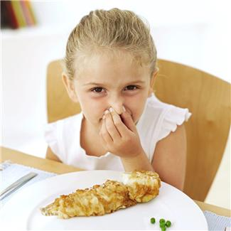
Smells in the Cafeteria
Sometimes the smells in the cafeteria bother kids.

Slide 2
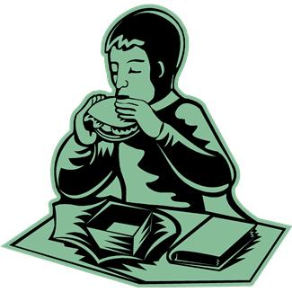
There are adults in my school who help me solve this problem.
There are things I can do:
I can sit right outside the cafeteria and eat.

Slide 3
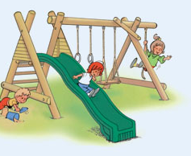
I can think about what I am going to do at recess.

Slide 4
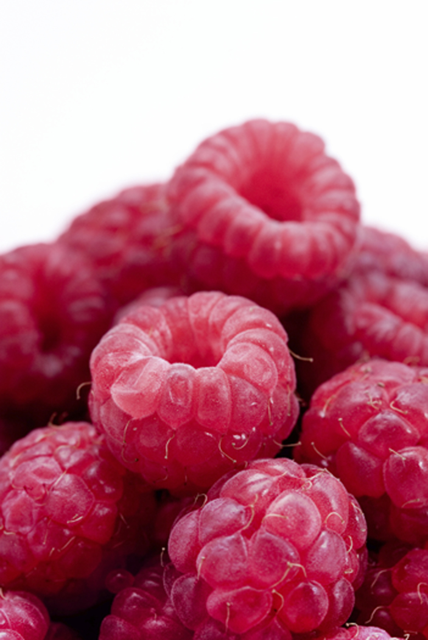
And I can take something else with me that has a smell I like!

Slide 5
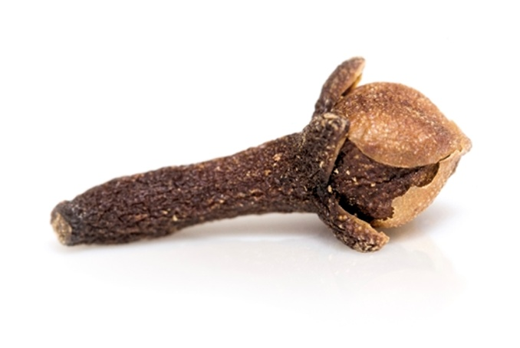
People sometimes make apples or oranges with cloves to make things smell good.
I’m going to try and do that!

Slide 6
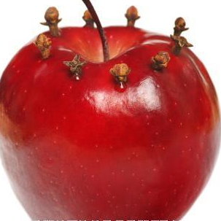
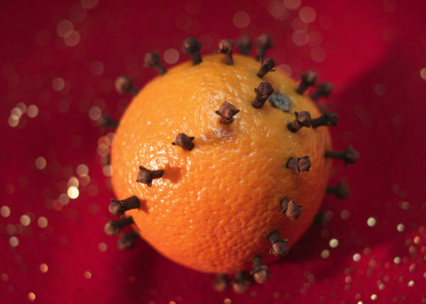
I can make my own clove apples or oranges and keep it ____________.
When I go to lunch I can smell it and feel great! Sometimes clove apples are used at Thanksgiving or Christmas. This will be fun to think about while I eat my lunch.

