Slide 1


School and the Holidays

Slide 2
During the Fall and the Winter…
There are many holidays. At my school some of the holidays we celebrate are
.
Kwanzaa
Valentine’s Day
Christmas
Halloween
Thanksgiving
Chanukah

Slide 3
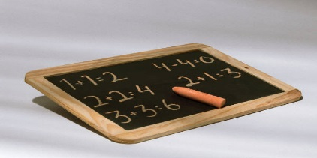
Holiday Time Schoolwork
When a holiday is coming up our papers might have a holiday theme like “Pumpkin Math”, or “Turkey Word Search”
These are changes – but it is a fun change and the work is the same. The change is just pictures!

Slide 4
Holiday Activities
Also around Holiday time, there are lots of special activities in my classrooms and throughout my school. There are parties, assemblies, movies, fun sheets and special guests.

Slide 5

Holiday Activities
These can be fun too, but they also change my schedule.
Sometimes an activity is a surprise, and I don’t know what to expect.
Usually I like it better when I know what to expect, and what my schedule will be.

Slide 6
That’s the key
When an activity is planned I can ask that I have a schedule. Then I can look at it and be OK because I know what is coming and when!
When we are done here, may I have a schedule please?

Slide 7
Another Key
I think it is a good thing to try to be flexible. Even if an activity was not in my plan for the day, it might be really fun.
Hey, I make my body flexible, you can make your mind flexible…have fun today!

Slide 8
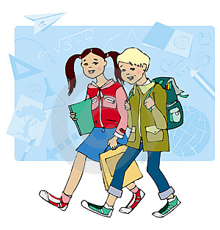
I will try…
When a surprise comes up during the day, I will try to relax and think about it. I will try to think, “this might be fun, I’ll give it a try”.
I think our day can be fun, let’s relax and go with the changes!
Finishingtouchesgroup.org

Slide 9
A final key….
If I just can’t get used to the change, I will let my teachers know in a calm way, and ask nicely to do something different..
Yes! And thank you for asking so nicely and calmly!
When this part is done, may I do something else? This change is getting hard for me.

Slide 10
What Flexibility Can Do for Me
When I am flexible and stay calm, I feel much better. I might be surprised at how much fun new things can be. Also, my parents and my teachers are impressed with me!
This way, the Holidays will be SUPER at school this year!!!
Hey! This change turned out to be tasty and fun!

