Slide 1



Questions, Questions, Questions

Slide 2


I like to ask questions. I can ask questions to learn new things.

Slide 3

I can ask questions if I’m not sure what to do.

Slide 4

I can ask questions when I don’t understand something.

Slide 5
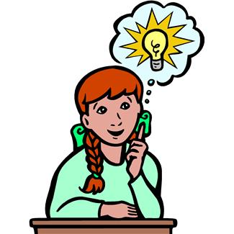
There are three people I can ask when I have a question. The first person is …….ME!!!

Slide 6

Before I ask a question I have to think very hard, to see if I already know the answer. Instead of raising my hand right away, I can think very quietly to myself…..
“Do I already know the answer to my question?”

Slide 7
The second person I can ask is a friend. I can ask a friend in my class if it’s a time when we are allowed to talk.
“I have a question. Can you help me?

Slide 8
The third person I can ask is a teacher or other adult. When the teacher is talking, I have to raise my hand and wait until the teacher calls my name before I ask a question.

Slide 9

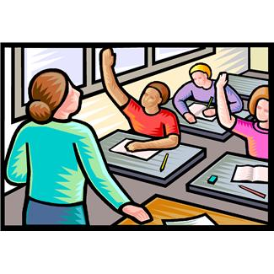
There might be a lot of kids that want to ask questions, so I’ll have to be patient.
Wwow lots of kids have questions, I’ll have to wait…

Slide 10
So I will try to remember 3 steps:
1. Ask myself…think hard, do I know the answer?
2. Ask a friend… (if we’re allowed to talk)
3. Ask an adult….raise my hand to ask the teacher

