Slide 1

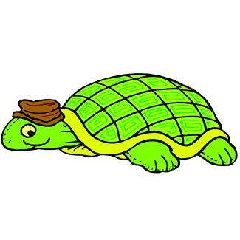

Moving Fast – Uh Oh – Too Fast – SLOOOW Down and Be Like My Friends

Slide 2
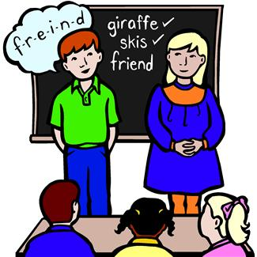
I like my school. I like the kids in my room. I like to be like them.

Slide 3

I am a good student at my school. I work hard. I work fast.
Working fast, working fast….

Slide 4
But- working fast might not be a good thing. When you work TOO fast things can happen.
Things Like:
Missing directions
Uh oh I started too fast-I missed what the teacher said!

Slide 5



Doing assignments wrong
Doing assignments messy
I did it wrong because I worked too fast
What a mess! I wrote way too fast!

Slide 6

Getting confused when the teacher calls on me.
I really want to be like my other 2nd grade friends.
Umm I don’t know the answer. I was working ahead

Slide 7

Second graders do 3 things so they get it right and neat!

Slide 8


They all wait until the teacher gives directions.

Slide 9

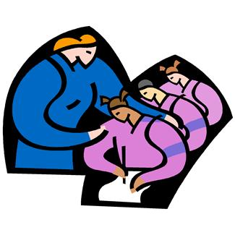
They all try to work with the class.

Slide 10
They write slowly so their writing looks good.
I have to write slowly so the teacher can read

Slide 11
I am going to try NOT TO:
Work Ahead
Write fast

Slide 12
  I’m going to try to:
          Wait for directions
          Work with the class
          Write slowly

Slide 13
Remember:
Wait for directions
Work with your class
Write slowly
Be a 2nd grader!!
Go for it Dude!!!!

