Slide 1
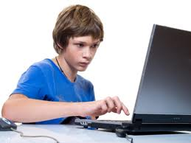

I Can Stay Safe Online!
Notes:
Read the title slide with the students or have the group read it aloud. Introduce the lesson by saying that we can use the computer to do many things…

Slide 2
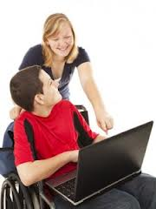
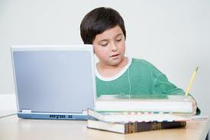
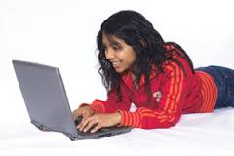
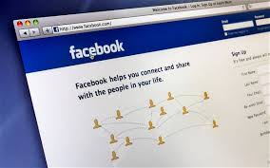
We can use the computer to…
Notes:
Click to bring in pictures. Ask the students about what the computer helps us do in each picture: 1. do schoolwork/homework 2. play games 3. surf the Internet 4. connect with friends on social media.

Slide 3

What do YOU like to do on the computer?
Notes:
Read slide with students and lead discussion. (You might need to start them off by sharing something you like to do.) Maybe jot down some of their ideas on the board.

Slide 4
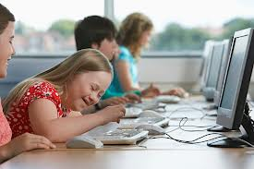
When we go online, we can find lots of things to do on the computer.
Notes:
Talk about how you need to go ONLINE (connect to the Internet) to do some things on the computer (i.e. Internet surfing, Facebook, etc.)

Slide 5

It’s fun to do all of these things online
BUT we have to stay safe.
Notes:
Read slide with students. Click to bring in picture. Ask students if they can think of things that might go wrong when they go online.

Slide 6

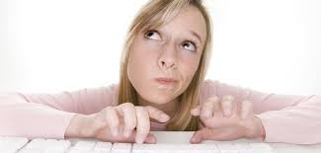
What do YOU do to stay safe online?
Notes:
Read slide with students. Talk about some of the things they know about staying safe online and write these on board.

Slide 7
There’s an easy way to help us stay safe online…
Just remember the word
SMART
adapted from www.childnet.com
Notes:
Read slide with students. Explain that each of the letters in the word SMART stand for reminders of what to do to stay safe on the Internet.

Slide 8
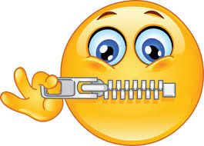

S – keep SAFE
NEVER tell someone on the Internet your full name, address, or telephone number to keep safe.
Notes:
Read slide with students. Talk about why they should never give out personal information like this. What can happen?

Slide 9

M- don’t MEET
NEVER meet an online “friend” in person without telling an adult.
Hi! My name is Rachel and I’m in 6th grade too!!
Notes:
Read slide with students. Talk about how online, people might not be who they say they are. What can happen??

Slide 10
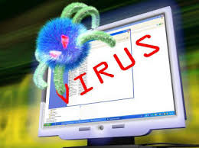

A – Never ACCEPT
NEVER accept emails or text messages from people you don’t know.
Notes:
Read slide with students. Talk about the possibility that a strange email might contain a virus. Ask students if they know what happens to a computer when it gets a virus. If they need some help, explain that it’s very much like when they get a virus/get sick and need to “get fixed” with medicine and bed rest to feel better and be able to go to school again. Until they’re “fixed”, they’re contagious, and can spread their sickness to others. The same thing can happen to a computer that gets sick with a virus. It can spread its sickness to other computers and then they all need to get fixed to be able to work again.

Slide 11
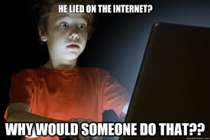
R – is it RELIABLE?
Not everything we see online
is reliable. That means it’s
not always true.
Notes:
Read slide with students. Talk about what “reliable” means and give examples. (i.e. A “reliable watch” always tells the correct time; A “reliable friend” is someone you can always count on to be there for you; etc.) Discuss why people might lie/not tell the truth online (i.e. they can get away with it because they’ll never meet you in person; they make up things to seem “better” than they really are; etc.) Ask students if this ever happened to them.

Slide 12
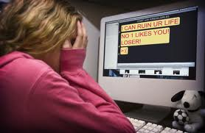

T- always TELL
ALWAYS TELL an adult if something or someone upsets you online.
Notes:
Read slide with students. Talk about the picture and how the girl must feel after she read the message on her computer. This is a good time to mention the word CYBERBULLYING and briefly explain what it is. Make sure to follow up with a specific lesson about Cyberbullying at another time. Redirect back to why it’s important to tell an adult when the student sees something upsetting online (i.e. an adult can help you figure out what to do; an adult can help you set up privacy blocks, etc.)

Slide 13
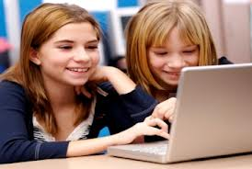
Let’s remember:
We can have lots of fun online as long as we stay
SMART
Notes:
Read slide with students. See if they can remember what the letters stand for.

Slide 14

Stay SMART online!
S – stay SAFE
M – don’t MEET
A – never ACCEPT
R – is it RELIABLE?
T – always TELL
Notes:
Check students answers with this slide. This will also become their take-home magnet.

Slide 15
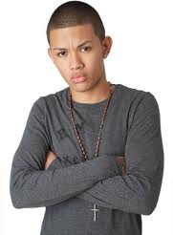
So what do YOU think?
You had a fight with your best friend at school. You know you’re right, but you want to tell others about the situation. Who would you share it with and how?
Notes:
Read slide with students. Ask the students to come up with different ways to handle the situation (i.e. talk it over with your best friend, even though you’re fighting, talk to your parents, talk with a teacher, talk with a guidance counselor, etc.) Ask if anyone thinks they should post the argument online to share with other friends at school. If they do, what can happen as a result?

