Slide 1
I Can Read Body Language!
Notes:
Read slide with students. Introduce topic of Body Language and ask students to define. Explain that today’s lesson will be about learning to look at what people are doing with their bodies to help us understand how they are feeling. Also explain that this lesson will help them figure out what they’re bodies are saying to others.

Slide 2
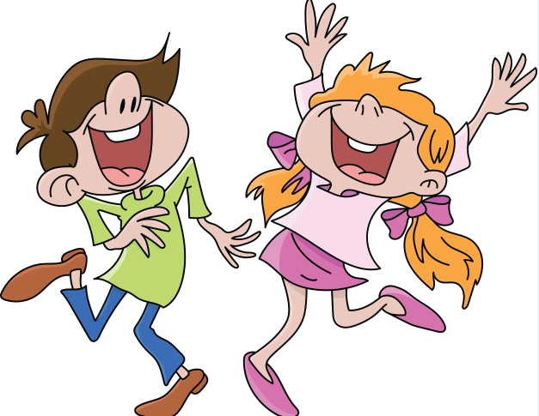
What is Body Language?
A way to communicate without using any words using…
Facial expressions – eyes and mouth
Posture – head, back and shoulders
Gestures – hands
Stance – arms and legs
Notes:
Read slide with students. Explain that there are certain things people do with parts of their bodies that say a lot (communicate) without them saying any words at all! Say that another way to think about communication is to think about what the other person is telling us. Talk about the picture and ask students to tell you what these people might be feeling (i.e. happy, excited, etc.) Ask them to explain their answers by pointing out what they see these people doing with parts of their bodies.

Slide 3
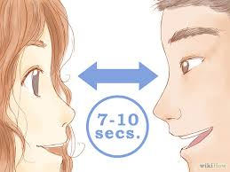
Facial Expressions – Eye Contact
Notes:
Read slide with students. Ask students why they think eye contact is important. Talk about how someone looking at your eyes means they are communicating that they are listening to you and want to hear what you say. Discuss how sometimes eye contact might not be comfortable for some people. If a student has difficulty with eye contact, suggest he find a place on the person’s face to look at (i.e. forehead) so that he’s looking at the person’s face. This still shows/communicates that he’s paying attention.

Slide 4
Facial Expressions – Eye Contact
Notes:
Read slide with students. Ask them to describe what they see in the picture. Make sure to emphasize the eye contact and ask students what the two people in the picture might be communicating to each other without using any words. (i.e. they’re interested in each other; they like each other; they’re good friends; etc.)

Slide 5
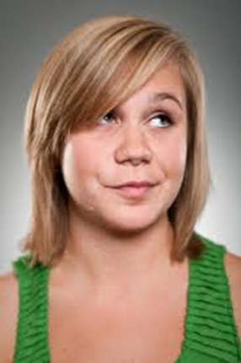
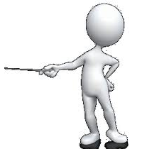
Facial Expressions – The Big Picture
Look at the eyes and the mouth…
What is her face telling us?
Notes:
Read slide with students. Tell students to pay close attention to her eyes – what are they doing? (looking away). What might this mean/what is she communicating? (i.e. she’s thinking of something else; she’s bored; she doesn’t believe you) What about her mouth? (lips pressed together; some might think she’s smiling). Talk about how important it is to look at the whole face and put the expressions together. This is called looking at the “BIG PICTURE” If you only focused on the eyes or the mouth, you might miss the overall message. Practice this facial expression with the students.

Slide 6
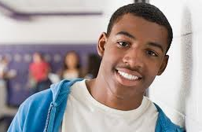
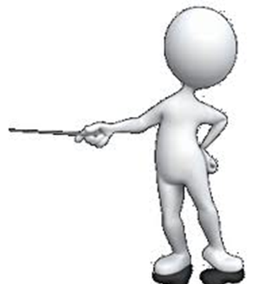
Facial Expressions – the Big Picture
Look at the eyes and the mouth
What is his face telling us?
Notes:
Read slide with students. Ask them how the boy might be feeling based on his facial expressions. What is he communicating to us? How can they tell he’s happy? (Eyes are open and eyebrows are relaxed; mouth is smiling) Practice this facial expression with the students.

Slide 7
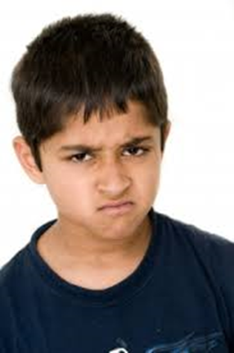
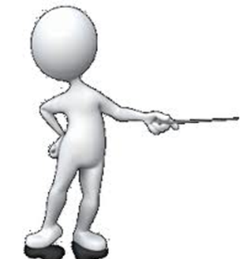
Facial Expressions – The Big Picture
Look at the eyes and the mouth
What is his face telling us?
Notes:
Read slide with students. Ask students what they think the boy is feeling based on his facial expressions. What is he communicating to us? Remind them to look at both his eyes (eyebrows are pulled together) and his mouth (frowning). Together, what is his face telling us? Practice this facial expression with the students.

Slide 8
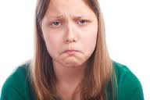
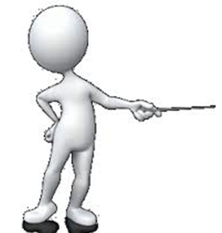
Facial Expressions – The Big Picture
Look at the eyes and the mouth
What is her face telling us?
Notes:
Read slide with students. Ask students what the girl might be feeling based on her facial expressions. What is she communicating to us? Point out how both her eyes and mouth are turned downwards, meaning she’s feeling sad or unhappy. Practice this facial expression with the students.

Slide 9
Posture – head, back and shoulders
Look at the
head, back and shoulders
What is his posture telling us?
Notes:
Read slide with students. Talk about how our head, back and shoulders say a lot about how we’re feeling. Ask students to look at the picture and say how the boy is feeling. What is he communicating to us? (sad; depressed; tired, etc.) Talk about how a slumped body posture indicates that a person could be feeling sad or depressed. Discuss what to do if they see a friend whose posture looks like this (i.e. ask if they’re okay; ask if they want to talk; etc.) Also, emphasize how it can be tricky to figure out how someone is feeling if you can’t see their face. That’s why it’s so important to look at the big picture (face AND posture) whenever possible.

Slide 10
Posture – head, back and shoulders
Look at the head, back and shoulders
What is her posture telling us?
Notes:
Read slide with students. Ask students to look at the picture and say how the girl might be feeling/what is she communicating to us? (i.e. happy, proud, confident, etc.) Point out how her head is up, shoulders back and back straight vs. slumped. For fun, ask the students to imagine why she might be feeling happy, proud, or confident and share with the group. Practice this posture with the students. Explain that sometimes just straightening up and holding your head up and shoulders back can actually make you feel better!!

Slide 11
Gestures - hands
Look at the hands
What is this gesture telling us?
What is this gesture telling us?
Notes:
Read slide with students. Ask students to make the thumbs up gesture and explain what it means/what it communicates to us. (i.e. good work; good job; way to go; etc.) Then ask students to make the thumbs down gesture and explain what it means (i.e. no; bad; no way; etc.)

Slide 12
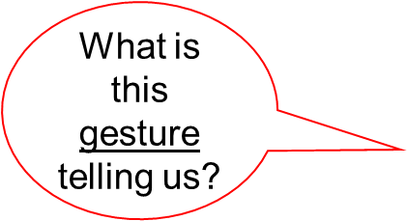
Gestures - hands
Look at the hands
Notes:
Read slide with students. Talk about the one hand reaching out to the other and ask students what it means/communicates to us. (this person wants to shake hands) Ask students what they should do if someone reaches out to shake their hand. Talk about when someone might want to shake your hand (when first meeting you; when saying goodbye; to congratulate you; etc.) For fun, have students shake hands with each other and practice greetings.

Slide 13
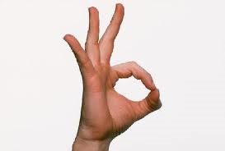
Gestures - hands
Look at the hands
Notes:
Read slide with students. Have students make this gesture with their fingers and talk about what it means/communicates to us. (okay) Explain that people use this gesture to tell others that everything’s okay. Ask for their examples of when they’ve used this gesture with others OR when someone used it with them. Add that a teacher or parent might use this gesture to let them know that everything is okay or that they’re doing the right thing.

Slide 14
Gestures - hands
Look at the hands
Notes:
Read slide with students. Ask students what this gesture means/communicates to us. Explain that it could mean “hi” or “bye”, depending on when it’s done. Ask students for examples of the different meanings.

Slide 15
Stance – arms and legs
Look at the arms and legs
What is this stance telling us?
Notes:
Read slide with students. Explain how the position of someone’s arms and legs can say a lot without them using words. Ask students to imitate the boy and talk about what their arms and legs are doing. How do they feel when they’re standing like this? Ask what they think the boy might be feeling/communicating to us in this picture. (i.e. anger; defiance; challenging you; not believing you; etc.)

Slide 16
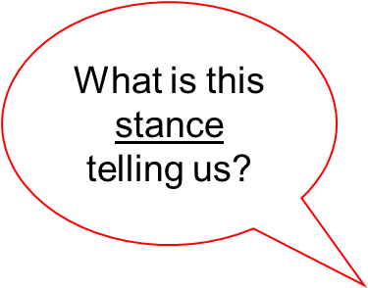
Stance – arms and legs
Look at the arms and legs
Notes:
Read slide with students. Ask students to imitate the teacher in the picture. Have them pay attention to their arms (hands on hips) and feet (together). Also point out that they need to look at the “big picture and look at her facial expression too. How do they feel when they stand like that? Ask what they think the teacher might be feeling/communicating to us. (anger; frustration with the boy). Talk about how you really need to look at the big picture to make sure you’re not missing any important information. Lead into next slide…

Slide 17
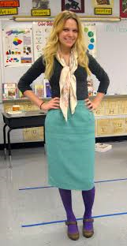
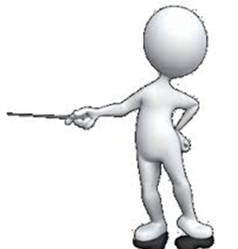
Stance – arms and legs: What’s the difference?
Look at arms, legs – and FACE!
Look at the
“Big Picture”
Notes:
Read slide with students. Ask them to imitate the teacher in this picture – arms, legs and FACE. How do they feel when they stand like this? Now what’s the difference between this picture and the one before? (she’s smiling). Point out that that’s why we need to look at the “big picture” to make sure we’re not missing any important information!

Slide 18
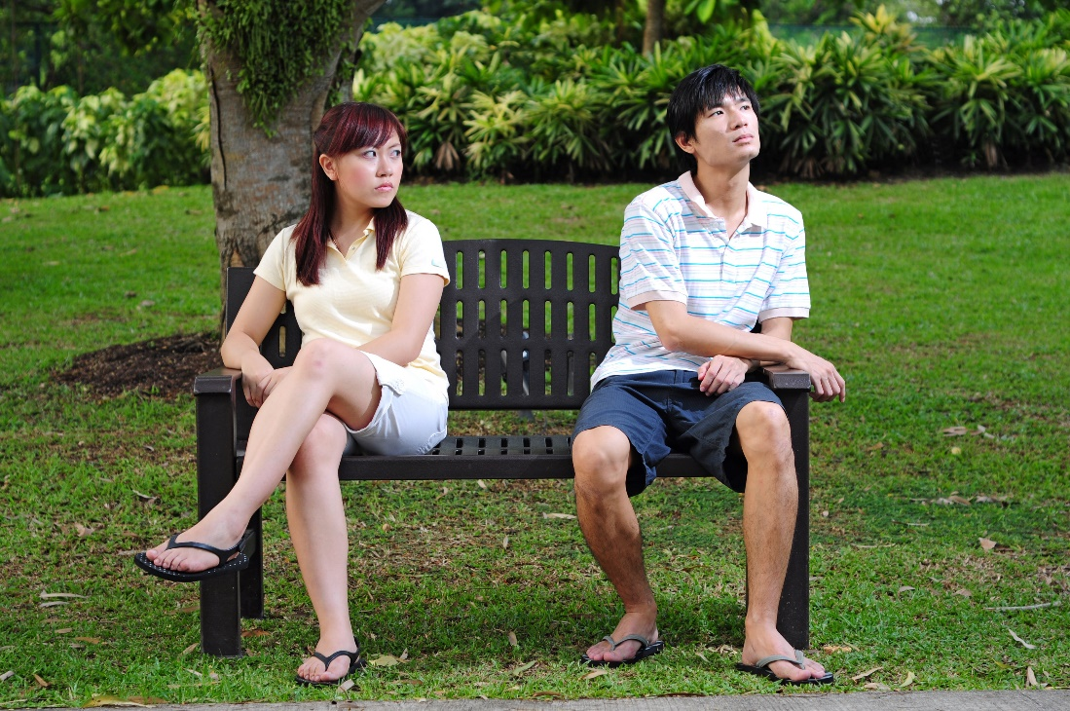
Stance – arms and legs
Look at the arms and legs
Notes:
Read slide with students. Talk about the boy first. Point out how his legs are away from the girl. His arms are pointed away from her. What could this stance communicate? He looks sort of relaxed. But he could also be upset because he is looking away from the girl. Now look at the girl and point out legs are crossed not relaxed and her arms are pulled away. She could be curious. We can look at the head and face to give us additional information. The way she is looking at the boy and the way he is looking away might tell use something else. What could that be? All this body language might tell us they are upset with each other.?

Slide 19
Remember: We can read Body Language by looking at:
Notes:
Read heading with students. Before clicking, see if students can remember the 4 things to look at in order to read body language. Click to bring up list.

Slide 20
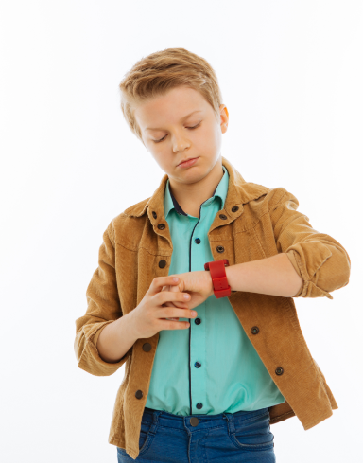
So…what do YOU think?
You are telling a classmate about your recent camping trip but he keeps looking at his watch. What is his
body language communicating to you
and what should you do?
Notes:
Read slide with students. Ask them to pay attention to his eyes and what his hands are doing. Lead discussion about possible ways to make this situation better. (i.e. ask him if he ever went camping; ask about his weekend; ask what he likes to do with his family, etc.)

