Slide 1
I Can Feel Good About Myself! Developing Healthy Self-Esteem
Notes:
Read slide with students. Introduce the words self-esteem. Ask students if they know what these words mean.

Slide 2
What is Self-Esteem?
how you think about yourself
how you feel about the things you can do
how much you value yourself
how important you think you are
adapted from www.kidshealth.org
Notes:
Read slide with students. List each point and ask students to share their thoughts and feelings. You may need to get things started by talking about something you’re good at. You can also add why you think you’re important: It could be because you’re a teacher and you think it’s important to help students learn.

Slide 3
What Self-Esteem is NOT
not about bragging
not about thinking you are perfect
not about thinking you are better than everyone else
Notes:
Read sllde with students. Talk about each point:
Give a few examples about bragging and demonstrate “theatrically” to drive the point home. Discuss how students feel when they hear someone brag.
Explain that nobody’s perfect, so we shouldn’t think that. Also talk about how it might seem that someone else is perfect because they’re so good at so many things (like getting good grades, having a lot of friends, and being good at sports.) But there are things that are challenging for them too.
Talk about the fact that we all have things we’re good at and things we struggle with. That means no one is better than anyone else – they just might be able to do some things better than us, but we may be able to do some things they find difficult.

Slide 4
So, Self-Esteem means…
seeing yourself in a healthy, positive way
being honest about the things you’re good at AND the things you’re not so good at
WHILE
Notes:
Read slide with students. Talk about the importance of thinking positively about yourself BUT still being truthful and realistic. Ask students to share something they’re good at. (You can list these on the board if you like.) Then ask students to share something that isn’t easy for them, or something they feel they’re not good at. Again, you may need to kick things off by sharing your own strengths and “needs”.

Slide 5
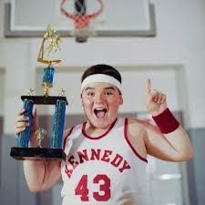
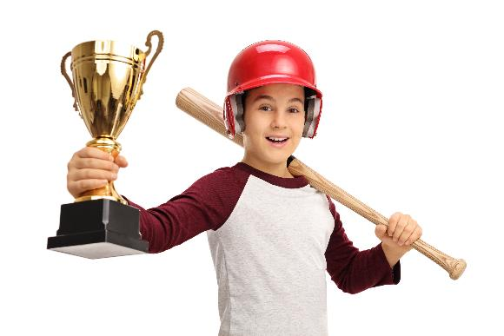
Bragging or Self-Esteem?
I’m the BEST basketball player on the team. No one can shoot hoops like me!
I worked hard for this trophy – I’m proud of myself and my team.
Notes:
Read heading with students. Explain that you’re going to look at some pictures of kids talking about things they’re good at. Let the students decide who is bragging and who is showing healthy self-esteem.

Slide 6
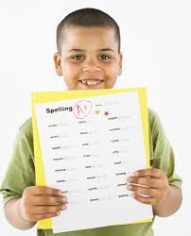
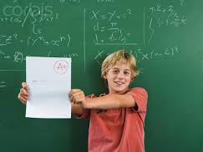
Bragging or Self-Esteem?
I thought I might get an A+ because I really studied for this test and Spelling is my best subject.
Who’s the smartest kid in class? ME!!
Notes:
Read slide with students. Again, ask the to decide who is bragging and who is showing healthy self-esteem. Talk about how the first boy is being honest about his strengths (spelling is his best subject) AND point out that he also studied for the test! The second boy sounds like he thinks he’s better than everyone else. Remind students that while this boy might be very good at math, that doesn’t mean he’s smarter than everyone else. Other students might be better at other subjects.

Slide 7
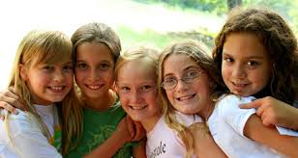
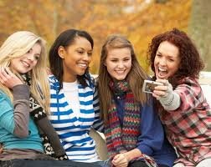
Bragging or Self-Esteem?
I think I have a lot of friends because I try to be nice to everybody
I’m the most popular girl in school – that’s why everyone wants to hang out with me!
Notes:
Read slide with students. Who is bragging and who is showing healthy self-esteem? Remind students that being honest about yourself – your skills, your talents, your strengths AND the things you’re not so good at – all contribute to a healthy, realistic self-esteem.

Slide 8
Why is having healthy Self-Esteem so important?
helps us feel good about the things we can do, even when other things aren’t going so well
gives us courage to try new things
lets us get over making mistakes
helps us to believe in ourselves
helps us be proud of ourselves
Notes:
Read slide with students. Talk about each point and discuss with group. Sum up by explaining that all of these things contribute to healthy self-esteem.

Slide 9
Things that can mess with our healthy Self-Esteem…
people that put us down or are mean to us
feeling or looking different
having differences in the way we learn
having trouble making friends
dealing with body changes in puberty
These things can give us low self-esteem
Notes:
Read slide with students. Talk about each point and discuss with group. Ask for their experiences with any of these situations. (This might be another time when you’ll need to start things off with a story of your own.) Explain how any of these situations can give us low self-esteem.

Slide 10
Low Self-Esteem can…
make you feel bad about yourself
make you sad
keep you from trying new things
make it hard for you to make friends
keep you from trying hard at school
Notes:
Read slide with students. Talk about how having low self-esteem can affect you. Ask students to share a time when they were down on themselves. Maybe they failed a test at school, or they didn’t make a sports team, etc. Share your own experiences if you like. Sum up by saying something like “When we feel bad about ourselves, everything seems harder. We don’t want to try anything new. We’re sad a lot of the time. We have trouble making friends… But it doesn’t have to stay that way – we can turn it around!”

Slide 11
How to boost your Self-Esteem:
make a list of what you’re good at
give yourself compliments
your body is yours – be proud of the things it can do
some things you can change; some things you can’t
turn negative thoughts into positives
Notes:
Read slide with students. Talk about each point and provide Negative to Positive Worksheet
MAKE A LIST – encourage students to share the things they’re good at. You can list on board if you want
COMPLIMENTS – encourage students to compliment themselves on the things they do well, or that are helpful/kind to others. Aim for at least 3 a day!
YOUR BODY – talk about how there are things we may not like about our bodies but our bodies are still amazing and can do amazing things
SOME THINGS CAN CHANGE/ SOME CAN’T – talk about how there are certain things we can change if we’re not happy with them – like our weight, hairstyle, etc. But there are other things we have to learn to accept – like our skin color, height, etc. Accepting these things AND changing what we’re able can help to boost our self-esteem
NEGATIVES INTO POSITIVES – talk about how we can turn our thinking around so that it doesn’t damage our self-esteem. (i.e.” Yeah, Math is hard for me, but I’m really good at Reading and Spelling. Maybe I can study with Joe – he’s really good at Math.”)
Review the example page of the ‘changing Negative Self-Talk to Positive’ worksheet. Then have students complete the blank page and discuss their responses.

Slide 12
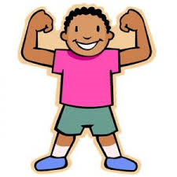
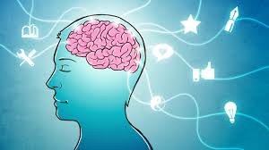
I Can Feel Good About Myself!
List my strengths
Self-compliments
Have Pride
Think Positive!
I helped my friend when he was upset today!
Change what’s changeable
Notes:
Read slide with students. Emphasize that these are the points to remember when they start feeling badly about themselves.

Slide 13
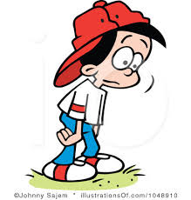
So…what do YOU think?
Your friend has been really down on himself lately. He’s always talking about how he got a bad grade on a test, or how he messed up in gym class, or how he wanted to make the baseball team but he didn’t.
What can you do?
Notes:
Read slide with students. Ask them what they could do to help their friend. Remind them of the 5 points they just learned and ask how they could use these strategies with their friend.

