Slide 1
Don’t Be a Rude Dude (or Dudette)! Good Manners and Being Polite
Notes:
Read slide with students. Introduce the topic of good manners and ask students what they think good manners are. Explain that being polite and using good manners keeps us from being rude.

Slide 2
What are Good Manners?
A way of behaving that shows politeness towards others.
Things we say and do that show respect for others.
Notes:
Read slide with students. Talk about what they see in the picture: What is the boy doing that shows politeness/respect to the other boy? Talk about how offering to help others when they need it is showing good manners.

Slide 3
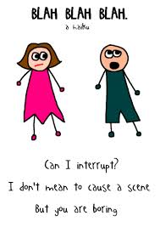
What does “rude” mean?
Not being polite
Not using good manners
How rude…
BLAH
BLAH
BLAH
BLAH
BLAH
BLAH
BLAH
BLAH
BLAH
BLAH
BLAH
BLAH
Notes:
Read slide with students. Ask for their definitions of “rude”. Click to bring up words. Talk about what the students see in the picture. Help them understand how talking a lot without letting someone else say anything is not using good manners, which is rude.

Slide 4
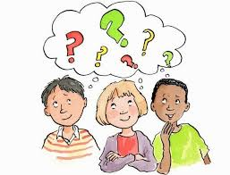
What good manners should we ALL use?
Notes:
Read slide with students. Ask students to name some good manners they use. List on board. Explain that today they’ll learn 10 good manners they can use to show politeness/respect.

Slide 5
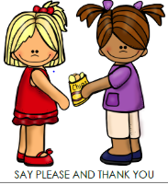
1. Say “please” and “thank you”
Please may I have some?
Thank you!
Notes:
Read slide with students. Click to bring up the picture and ask students what they see. Explain that we should always say ‘please’ when we are asking for something. That shows respect. Also, we should always say ‘thank you’ when we get what we asked for. That shows appreciation.

Slide 6
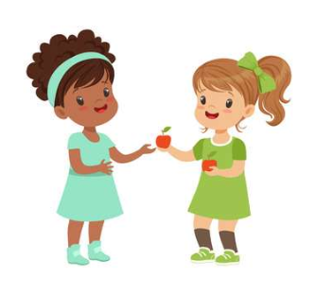
2. Say “you’re welcome”
Thank you!
You’re welcome!
Notes:
Read slide with students. Talk about how it’s good manners to say “you’re welcome” after someone says “thank you”. That means that you’ve heard them and it’s a polite way to acknowledge their politeness.

Slide 7
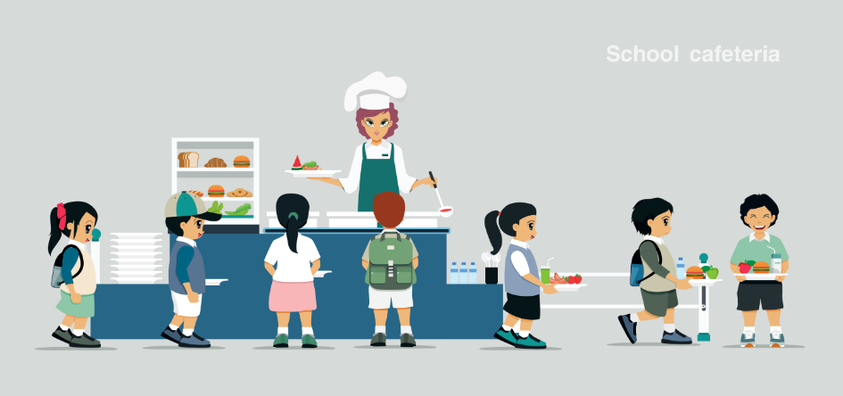
3. Wait your turn
Notes:
Read slide with students. Click to bring up picture and talk about what the students see. What are the kids doing? (waiting their turn in lunch line) Talk about how it’s good manners for everyone to wait their turn. It shows respect for your classmates!

Slide 8
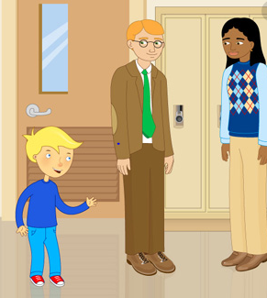
4. Say “excuse me” but don’t interrupt
Excuse me Mr. Smith…
Notes:
Read slide with students. Click to bring up picture. Ask students what they think is happening in the picture. Talk about how it shows good manners to say “excuse me” when two people seem like they are done talking. This could also lead into a discussion about waiting to make sure people are done talking so that you don’t interrupt. See if the students can come up with other situations when saying “excuse me” is important: For example: when bumping into someone; burping; trying to get by someone in the hall; etc.)

Slide 9
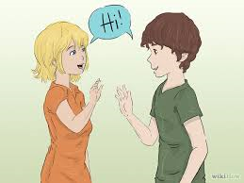
5. Say “hi” and “bye”
Hi!
Hi!
Notes:
Read slide with students. Click to bring up picture. Talk about what the students see the people doing – they’re waving and saying “hi” to each other. Talk about how it’s good manners to say “hi” back when someone says “hi” to you. It’s also good manners to say “bye” when you’re leaving.

Slide 10
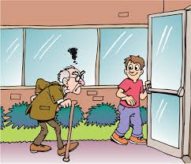
6. Hold the door
Thank you!
Notes:
Read slide with students. Talk about what they see in the picture. Explain that holding the door for others – especially older people – is showing good manners/respect. Ask student what they should say if someone holds the door for them?

Slide 11
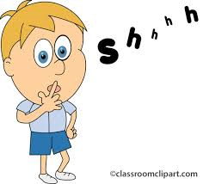
7. Use a quiet voice
Notes:
Read slide with students. Click to bring up picture. Talk about why it’s good manners to speak quietly rather than shout (i.e. so you can hear someone else speaking/answering you; so that people don’t think you’re mad [loud voices = anger sometimes]; so that you don’t disturb others; etc.)

Slide 12
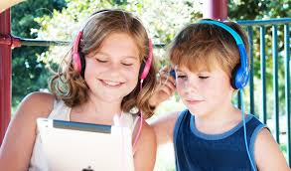
8. Share
Notes:
Read slide with students. Ask they what they see in the picture. Talk about how sharing certain things is good manners – like how it would be rude to watch and listen to the movie by yourself while your friend is sitting there with nothing to do.

Slide 13
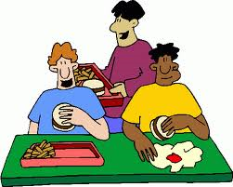
9. Use good table manners
Notes:
Read slide with students. Talk about what “good table manners” means. If you’ve already done the module on Mealtime Manners with the students, see if they can remember points from that lesson. (i.e. chew with mouth closed; don’t stuff; use napkin; eat your own food; clean up after yourself; etc.)

Slide 14
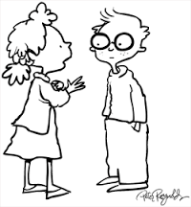
10. Say “I’m sorry”
I’m sorry
That’s okay
Notes:
Read slide with students. Talk about how it’s good manners to apologize/say “I’m sorry” when you’ve hurt someone. Whether it’s someone’s feelings that have been hurt, or if you accidentally hurt them physically, it’s important to say “I’m sorry.”

Slide 15
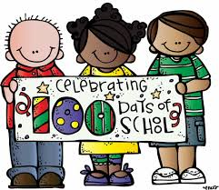
Using good manners shows other people that we respect them and their feelings!
We can use good manners!
Notes:
Read slide with students. Before advancing to next slide, see if they can list the manners they just learned about.

Slide 16
Top 10 Good Manners
Say “please” and “thank you”
Say “you’re welcome”
Wait your turn
Say “excuse me”
Say “hi” and “bye”
Hold the door
Use a quiet voice
Share
Use good table manners
Say “I’m sorry”
Notes:
Review the top 10 manners with the students. Role play to practice each one.

Slide 17
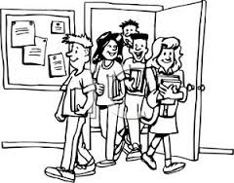
So…what do YOU think?
You get to the classroom door just as other kids are coming out. What should you do?
Notes:
Read slide with students. See if they can apply some of what they’ve learned in the lesson to this different situation. Help them arrive at the answer that they should let others exit the classroom before trying to enter.

