Slide 1
I Can Take Care of My Body
Keeping Clean and Healthy
Notes:
Read slide with students to introduce today’s lesson.

Slide 2
How Do I Take Care of My Body?
Notes:
Read title of slide with students. Ask for their ideas of how they take care of their bodies. Click one at a time to bring up pictures; discuss each one. (1. Eat healthy foods 2. Exercise 3. Getting enough sleep 4. keeping clean )

Slide 3
Let’s Talk About Keeping Clean!
How do YOU keep clean?
Notes:
Sum up previous slide with a statement: “Those are all good ways to take care of our bodies. Today we’re going to talk more about keeping our bodies clean and healthy.” Read slide with students. Ask for their examples of how they keep clean and list on white board.

Slide 4
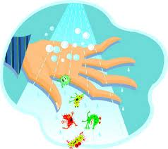
Keeping Clean = Staying Healthy
Notes:
Read title with students. Ask them how keeping our bodies clean can help us to stay healthy. (i.e. washing away dirt and germs) Talk about how germs can make us sick. Ask students to think about times when they were sick and how it felt. Wouldn’t we all like to not get sick? Keeping clean can help us stay healthy.

Slide 5
Things to Remember to Keep our Bodies Clean:
brush
wash
wear
Notes:
Read title of slide with students. Tell them that there are three things to remember that will help them keep clean and healthy. Click to bring in each star and read with students. Explain that you’ll be talking about what each star means next.

Slide 6
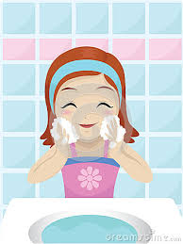
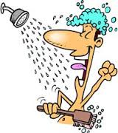
1. Wash!
face body hands & feet hair
Notes:
Read title of slide with students. Ask “What should we wash?” Click each picture to emphasize different parts of body to make sure we wash.

Slide 7
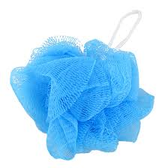
What things do we need to wash with?
Notes:
Read title of slide with students. Ask them for ideas of things we need to wash with. (i.e. soap, shampoo, wash rag/sponge/pouf, towel, warm water, etc.) Click to bring up each picture. Ask students if they can think of anything else to add.

Slide 8
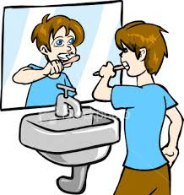
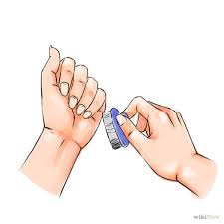
2. Brush!
hair
teeth
nails
Notes:
Read title of slide with students. Ask “What things do we need to brush?” (hair, teeth, under nails)

Slide 9
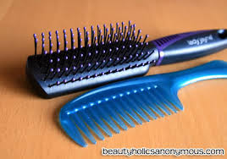
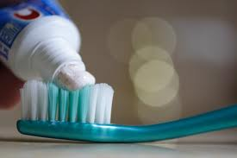
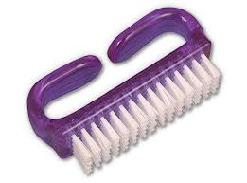
What things do we need to brush with?
Notes:
Read title of slide with students. Ask Ask them for ideas of things we need to brush with. (i.e. brush or comb, toothbrush and toothpaste, nailbrush etc.) Click to bring up each picture. Ask students if they can think of anything else to add.

Slide 10
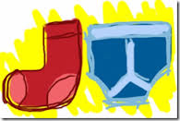
3. Wear!
clean clothes
deodorant
clean socks and underwear
Notes:
Read title of slide with students. Ask “What should we wear?” (clean clothes, clean underwear, clean socks, deoderant/antiperspirant, etc.)

Slide 11
What things do we need to keep our clothes and bodies smelling clean?
Notes:
Read title of slide with students. Talk about how washing our clothes keeps them clean and smelling fresh. Also talk about how using deodorant/antiperspirant keeps our underarms from smelling when we sweat. Explain that students might use a stick form of deodorant or a spray version – both work!!

Slide 12
When we keep our bodies clean and healthy, other people might like to be around us more!
Notes:
Read slide with students. Check to see if students remember the 3 ways to stay clean and healthy.

Slide 13
So remember: To stay clean and healthy, we need to:
Notes:
Read slide with students. Check to see if they can remember the things they need to wash, brush and wear, as well as the tools they need to do the job.

Slide 14
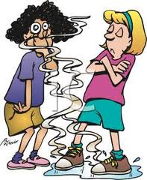
So…What do YOU think?
Your friend has been smelling and looking pretty bad lately. She doesn’t seem to notice that others are avoiding her. What can you do to help?
Notes:
Read slide with students. Talk about how important it is to help a friend without hurting their feelings. Discuss ways to help the friend clean up their act. Refer back to the 3 ways to keep clean and healthy.

