Slide 1
What Should I Do About Worries?
Notes:
Introduce today’s lesson. Tell the students that you’ll be talking about worries and some ways to handle them.

Slide 2
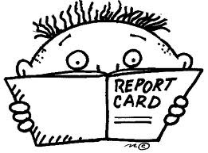
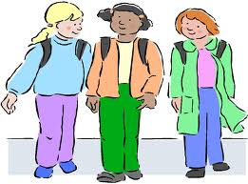
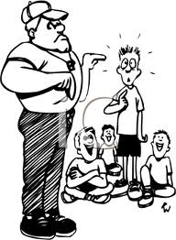
Sometimes it seems like there are lots of things to worry about.
grades
having friends
bad weather
gym
Notes:
Read the headline/ask student to read it. Click slide each time to have caption arrows fly in and talk about each picture. Ask the students whether any of these worry them.

Slide 3
What do YOU worry about?
Notes:
Read the headline/have student read it. Ask students to name some of the things that worry them. List on board.

Slide 4
What do YOU do when you are worried?
Did it work?
Notes:
Read headline and ask students what they do when they are worried. If necessary, share a strategy that you use to help you when you are worried to get them started. List their ideas on board. Ask students if their strategies worked. If they are “acceptable” strategies (i.e. talked to someone about the worry) then circle it or put a star by it.

Slide 5
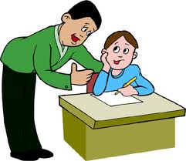
Let’s think of some things you can do when you’re worried…
Talk to an adult
Is everything okay Sam?
I’m worried about the spelling test.
Notes:
Read slide information/have student read it. Click to bring up conversation balloons. Discuss some situations when students might want to talk with an adult (teacher, counselor, parent, peer buddy). Talk about what they could say to get an adult’s help.

Slide 6
Make a Worry Box
worries
It can be real or imagined!
Notes:
Read slide with students. Some students might not feel comfortable talking to someone about their worries. Instead, they might make a worry box to hold their concerns. It can either be a real box and paper slips with their worries written on them OR they can try imagining a worry box where they can “put their worries” until they are able to address them when they feel calmer (either independently or with help from an adult).

Slide 7
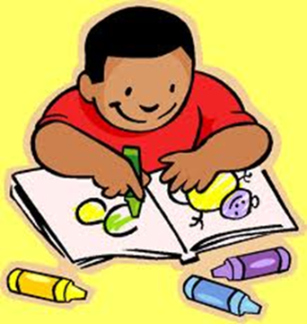
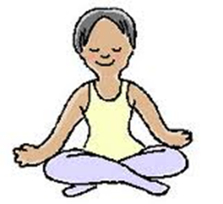
Do something that makes you feel good
read a book
color a picture
think about something happy
Notes:
Read slide/have student read it. Go over each picture, then ask students what they like to do to feel better. List these on board.

Slide 8
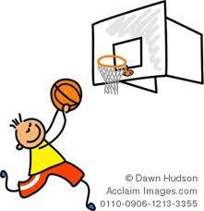
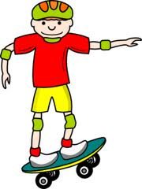
Try a little exercise!
Notes:
Read slide and talk about pictures. Talk about how some people find that exercising can really help calm them down. Ask students what types of exercise they like to do.

Slide 9
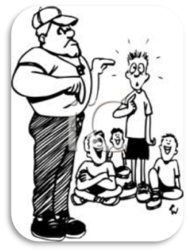
Figure out how to solve the problem
If I’m worried about grades, I can try to study more.
If I’m worried about having friends, I can try to make a new friend.
If I’m worried about bad weather, I can learn more about storms
to understand them better.
If I’m worried about gym class, I can keep practicing to get better.
Notes:
Read slide with students. Refer back to the board where you listed some of their worries (problems) and solutions.

Slide 10
But sometimes, you just can’t solve the problem. What can you do?
Notes:
Read slide with students. Explain that there are some things that we can’t change. When that happens, we just have to let it go so that we can focus on other things in our lives. Ask the students what are other important things in their lives they can be thinking about.

Slide 11
It can be hard to “let it go” but it helps us move on so that we don’t get stuck and dragged down by our worries.
worries
Notes:
Talk about how “letting it go” helps us to move on so that we don’t get stuck thinking about our worries over and over. Review previous strategies with students that can help them move past worries.

Slide 12
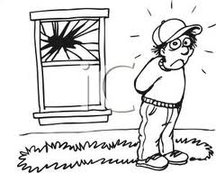
So…what do you think?
You’re worried because you accidentally
broke your neighbor’s window.
What can you do?
Notes:
Read slide with students. Lead discussion about options. Refer students back to the strategies they just learned. Role play possible responses.

Slide 13
What Should I Do About Worries?
Talk to an adult
Make a Worry Box
Do something that makes me feel good
Try a little exercise
Figure out how to solve the problem
Let it go!

