Slide 1

What to Do About Gossip and Rumors
Notes:
Introduce lesson: Explain that rumors and gossip are always floating around school and that’s pretty typical. Sometimes rumors and gossip are harmless, but sometimes they can be very hurtful. Today you’ll learn more about rumors and gossip and find out ways to handle them.

Slide 2

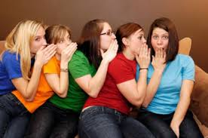
What do we know about rumors and gossip?
Your Subtopics Go Here
Notes:
Read slide with students. Ask the group what they know about the subject: Without naming names, can anyone give an example of a rumor or piece of gossip that they’ve heard around the school? You can also ask if they’ve heard any gossip about celebrities or music stars recently. Did it end up being true? How do they know?

Slide 3
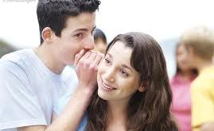
Rumors and gossip:
are spread from one person to another
can change each time the story is told
may be all true, a little bit true, or not true at all
can be very hurtful!
Notes:
Read slide with students. Click to bring up each of the four points and discuss with the students. Refer back to the celebrity gossip example and talk about whether it was true or untrue. Again, ask how they know. (Did they see it on TV? Read about it on the Internet? Hear it from a friend? – what’s reliable and what isn’t??)

Slide 4

How can gossip or rumors hurt someone?
Notes:
Read slide with students. Ask the group to think about different ways a rumor/gossip can hurt someone (i.e. cause them to fight with a friend; cause them to break up with their girlfriend/boyfriend; get them in trouble with a teacher/principal, etc.) List these on the board.

Slide 5

Here’s what happened to Joe…
Notes:
Read slide with students. Use this example to illustrate what can happen when rumors are spread. EXAMPLE: Let’s say Joe dropped his pencil in science during a test and his neighbor Matt thought he peeked at his paper when he sat back up. By lunchtime, Matt told a bunch of kids that Joe cheated on the science test. What could happen?

Slide 6
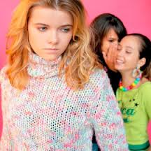
Here’s what happened to Shayna
Notes:
Read slide with students. Use this example to illustrate what can happen when rumors are spread. EXAMPLE: Let’s say a guy asked Shayna for her notes from History class. A girl from her class saw this and started telling people that Shayna was flirting with this guy. What might happen if Shayna’s boyfriend hears this? IMPORTANT: Make sure to really discuss all of the possibilities besides just the obvious one of Shayna and her boyfriend fighting and breaking up. For example, the boyfriend might pick a fight with the boy who asked for the notes, telling him to “Stay away from my girlfriend!” Other girls might call Shayna names and give her the reputation of being a flirt. Still others might threaten Shayna to stay away from their boyfriends. Point out how so many things can go wrong from just one rumor!

Slide 7
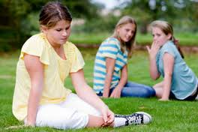
Why we shouldn’t spread rumors…
words can hurt!
adapted from http://pbskids.org/itsmylife
Notes:
Read slide with students. Talk about how words can hurt as much as a punch, sometimes more, because while a punch is painful, at least it’s over pretty fast. Spreading rumors about someone is a form of bullying. The hurtful words can’t be unsaid, and the damage can last a long time.

Slide 8
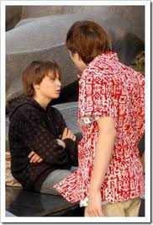
Why we shouldn’t spread rumors…
rumors can destroy trust
adapted from http://pbskids.org/itsmylife
Notes:
Read slide with students. Talk about how spreading a rumor that turns out to be untrue (a lie) can cause a friend not to believe you anymore because they can’t trust you to be telling the truth. Also, talk about how spreading a rumor about something your best friend told you in secret will mess up the trust between you two.

Slide 9

Why we shouldn’t spread rumors…
true or not, private is private!
adapted from http://pbskids.org/itsmylife
Notes:
Read slide with students. Talk about how some things – like seeing someone kissing someone else – are private and should stay private. That means we don’t go telling others that we saw Jake kissing someone that’s not his girlfriend. What might happen if we do spread that rumor?

Slide 10

Why we shouldn’t spread rumors…
believing rumors can lead to bad choices.
adapted from http://pbskids.org/itsmylife
Notes:
Read slide with students. Remind the group about how some rumors turn out to be untrue. Talk about what might happen if the rumor that there will be a snow day gets around and you don’t do your homework since you think there won’t be school tomorrow. Ask the group what other bad choices can come from believing false rumors (i.e. You heard a rumor that the substitute in P.E class doesn’t make you dress for gym so you leave your shorts and sneakers at home; Rumors about the new girl in school say she’s a snob so you aren’t friendly to her. Then you find out she’s really nice…)

Slide 11


Breaking the rumor chain…
(or Minding Your Own Business!)
1. Make the rumor stop with you!
Notes:
Read slide with students. Explain: You don’t have to pass the rumor on – it can stop with you. Others may still spread the rumor but you know that you didn’t take part in it because you made a good choice not to join in. If more people did this, the rumor would stop faster!

Slide 12

Breaking the rumor chain…
(or Minding Your Own Business!)
2. Just don’t listen
Notes:
Read slide with students. Explain: You don’t have to listen to the rumor. Just say something like “I’m not interested in listening to mean stuff, thanks.” Ask students for other things they could say in this situation.

Slide 13
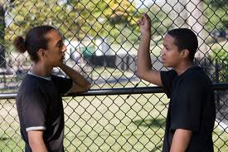
Breaking the rumor chain…
(or Minding Your Own Business!)
3. Be a peacemaker
Notes:
Read slide with students. Explain: If one of your friends want to hurt someone else by spreading rumors about them, speak up. Let them know this isn’t the right thing to do. Talk about other ways they could handle the problem rather than telling lies about the person. Ask students if this has ever happened to them. What did they do?

Slide 14
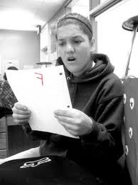

Breaking the rumor chain…
(or Minding Your Own Business!)
Remember:
private is private!
Notes:
Read slide with students. Explain: Some things really need to stay private (like your classmate failing a test.) If you don’t want other people talking about private things in your life, don’t do it to others. If you hear something about someone else, don’t worry about whether it’s true or not – just keep it to yourself. This is respecting someone’s privacy. (adapted from http://pbskids.org/itsmylife)

Slide 15
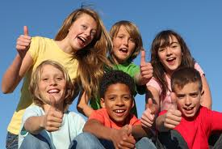
I can handle rumors!
I can make the rumor stop with me
I don’t have to listen
I can be a peacemaker
I can remember: private is private!
Notes:
Read slide with students. Review strategies with students. This slide will become their magnet card.

Slide 16



So…what do YOU think?
Someone started a rumor about you saying something bad about the most popular kid in school. You didn’t say anything!
What can you do?
Notes:
Read slide with students. Ask students if this ever happened to them and what did they do. Brainstorm ways to handle this situation (i.e. try to find out where it’s coming from and why – did you do something/say something that could have been misunderstood?, is someone trying to cause trouble for you?, can you talk to the popular kid privately and explain that you didn’t do it?, etc) adapted from http://pbskids.org/itsmylife

