Slide 1
What to Do About Cyberbullying
Notes:
Read title slide with students. Ask them if they know what Cyberbullying is.

Slide 2
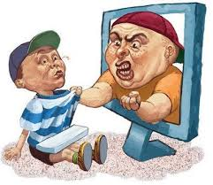
What is Cyberbullying?
Using tech devices to post things that hurt someone’s feelings or threaten someone.
Notes:
Read slide with students. Ask if they’ve ever been cyberbullied, or if they know someone who has. How did they feel?

Slide 3
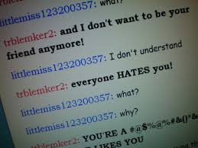
Cyberbullying can happen in …
Text messages
Messaging Apps
emails
Social media
Notes:
Read heading with students. Talk about the different forms of technology someone might use to cyberbully someone else. Can they think of others?

Slide 4
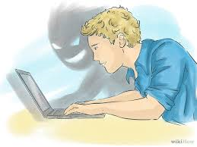
What can a Cyberbully do?
Pretend to be you online
Spread lies and rumors about you
Fool you into giving out personal information
Send threatening emails or texts
Post pictures of you to hurt or embarrass
Adapted from www.helpguide.org
Notes:
Read heading with students. Before clicking, ask if they can think of the different ways someone might cyberbully someone else. Click to bring up each way and discuss with students.

Slide 5
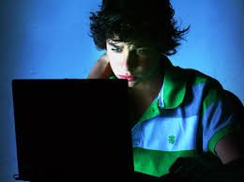
Cyberbullying can happen…
anywhere and anytime!
even in places where you’re supposed to feel safe – like at home
Notes:
Read slide with students. Talk about how cyberbullying can take place anywhere, 24/7 – so it feels like there’s no escaping it.

Slide 6
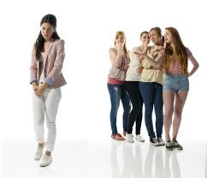
Cyberbullies can be anyone!
we don’t always know who’s doing it
this can make us feel even worse because we don’t know who’s targeting us
Notes:
Read slide with students. Lead discussion about why not knowing who’s doing the cyberbullying can make us feel like we can’t trust anyone. Give example: Is it a “friend” who pretends to like you but then starts a rumor about you through texts? If it gets back to you, you might not know how it got started or who started it. That could make it hard to think your friends are really your friends.

Slide 7
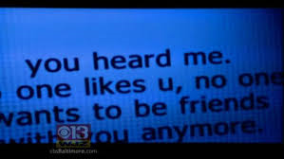
Cyberbullies may keep bullying because…
they can bully without anyone knowing who they are
they can’t see your reaction so they may say worse things than they would if they were face to face with you
Adapted from www.helpguide.org
Notes:
Read slide with students. Talk about how cyberbullies may feel “protected” by cyberspace, so the bullying might continue – and even get worse!

Slide 8
IMPORTANT!!
Don’t blame yourself!
it’s my fault
Notes:
Read slide with students. Talk about how easy it is to feel like it’s your fault when people are saying mean things about you. But then emphasize how that kind of thinking can make us feel worse, and lead us to do nothing about the problem.

Slide 9
So what can we do instead?
Any ideas??
Notes:
Read slide with students. Ask for their ideas of what to do about cyberbullying. List ideas on whiteboard or poster paper. Talk about how each might help or make the situation worse.

Slide 10
Take control of the situation!
Notes:
Read slide with students. Talk about how taking control of the situation can help you feel better because you’re doing something about the problem – not waiting for it to go away. Find the strength to face the problem – there’s no reason to ever put up with cyberbullying.

Slide 11
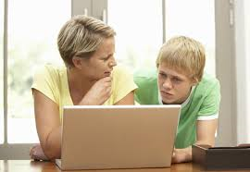
How to Handle Cyberbullying
SAVE the evidence – don’t erase
TELL a trusted adult
REPORT threats to teacher, principal, police
DON’T RESPOND or RETALIATE
PROTECT YOURSELF
BLOCK sender
Notes:
Read slide with students. Discuss each step:
SAVE the evidence – Tell students to keep hurtful messages or threats to show authorities when reporting
TELL a trusted adult – Emphasize how important it is to talk with the adult so that they can help the student handle the problem
REPORT threats – Explain that in many cases, it’s against the law to threaten and legal action could be taken against the cyberbully. The school also needs to know about the cyberbullying.
DON’T RESPOND/RETALIATE – Talk about how the cyberbully is going for a reaction and we don’t want to give them one. Also, emphasize how retaliation is cyberbullying too, so that means we would be guilty of the same thing.
PROTECT YOURSELF – Tell students to never give out personal information online OR agree to meet someone they met online. That person may not be who they say they are!Show s
BLOCK sender – Tell/how students how to use block button on instant messages or chats to block the sender

Slide 12
Remember:
You don’t have to put up with
bullying of any kind!
I can handle
cyberbullying!

Slide 13
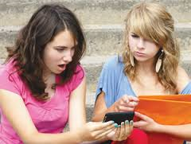
So…what do YOU think?
Your best friend seems really upset lately. When you finally get her to talk, she shows you a nasty text message she received. What can you do to help?
Notes:
Read slide with students. Discuss ways to address the problem. Lead students to recall the 6 points they just learned about how to handle cyberbullying. See if they can generate other ideas to help their friend.

