Slide 1
I Can Work in a Group!
Notes:
Read title and introduce lesson to students. Ask if they ever have to work in groups at school. Lead discussion about how they feel when working in a group. If they talk about feeling uncomfortable in group work, explain that today they’ll learn some strategies to help them feel better about group work.

Slide 2
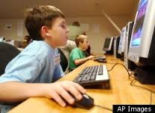
Sometimes in school, I’m supposed to work by myself
Notes:
Read slide with students. Before clicking, ask about the times they may need to work by themselves in school. Click to bring up each picture and talk about why it’s important to do these things by yourself sometimes. (1. Read book; 2. Take test; 3. Look things up on computer) Answers could be: to help with concentration/focus; to learn to find information on your own; to do your own work; etc.

Slide 3
But sometimes, the teacher wants us to work together in a group
Notes:
Read slide with students. Ask them to tell you what they see happening in the picture. (EXAMPLES: one student speaking while others listen; students looking at the speaker, everyone looks focused, etc.)

Slide 4
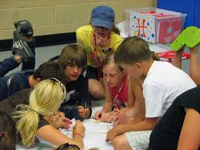
Working in a group can be fun!
What kind of fun things can happen in a group?
Notes:
Read slide with students. Lead discussion about the fun of group work: (EXAMPLE: getting to talk with classmates during class; sitting on the floor; hearing other’s ideas; laughing with friends, working together to create something, etc.) List ideas on board or paper.

Slide 5
It’s important to learn how to work as a member of a group
Notes:
Read heading with students. Click to bring in picture and ask students why it’s important to learn to work as a member of a group. Possible answers: to hear other’s ideas; to contribute ideas to the project/group’s goals; to learn how to compromise; etc.)

Slide 6
So how can we learn to work in a group?
Notes:
Read slide with students. Ask if they have ideas about how they can learn to work in a group. List their ideas on board or paper. If no one brings up rules, you can lead into the next slide.

Slide 7
Group Rules!
How about…
Get along
Respect other’s ideas
On task
Use quiet voices
Participate
Stay in your group
www.teachjunkie.com
Notes:
Read slide with students. Explain that it will be easy to remember these rules if they remember the letters in the word GROUPS.

Slide 8
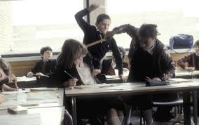
G – Getting Along
What does this mean?
OR
Notes:
Read slide with students. Ask what “getting along” means to them. Provide ideas to get them started (EXAMPLES: not arguing, listening, working together, etc.) Click to bring up pictures and ask which picture shows students getting along. Ask what they see in each picture that helped them choose the correct answer.

Slide 9
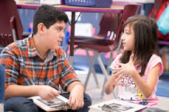
R – Respect Other’s Ideas
How are these students showing respect?
Notes:
Read slide with students. Ask what “respecting other’s ideas” means to them. Talk about the pictures and ask students what the students doing that shows respect to their classmates. (EXAMPLES: looking; listening, paying attention, trying to understand someone else’s point of view, etc.)

Slide 10
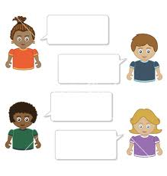
O – On Task
What does this mean?
Focus!
Work!
Pay attention!
Finish!
Notes:
Read slide with students. Talk about each on-task point and ask why these are important to group work.

Slide 11
U – Use Quiet Voices
Why is this important?
Notes:
Read slide with students. Talk about why it’s important to use quiet voices when working in a group. (EXAMPLES: So you won’t disrupt other groups; so you won’t hurt people’s ears; so you can hear what others are saying, etc.)

Slide 12
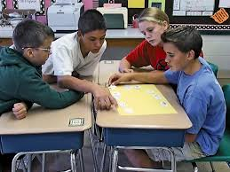
P - Participate
What does this mean?
Join in!
Help with the work!
Give your ideas!
Notes:
Read slide with students. Ask what ‘participate” means to them. Click to bring up arrows and discuss these participation points.

Slide 13
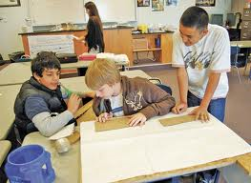
S – Stay in Your Group
Why is this important?
Notes:
Read slide with students. Ask why it’s important to stay in the group. (Possible answers: to show respect for classmates; to help the group; to finish the work; to not disrupt other groups; etc.)

Slide 14
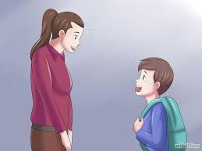
But what if I still have a hard time working in groups?
Talk to your teacher!
Can I please work with a partner instead?
Notes:
Read slide with students. Ask for ideas of things they could say to their teacher to get help when assigned to work in a group. List these on the board. Click to bring up conversation balloon. Talk about how important it is to explain why you feel you’d do better with one other person than in a group. (EXAMPLES: I have a hard time listening to so many people; I can focus better with one other person talking; I have a hard time offering my ideas when there’s more than one person around; etc.)

Slide 15
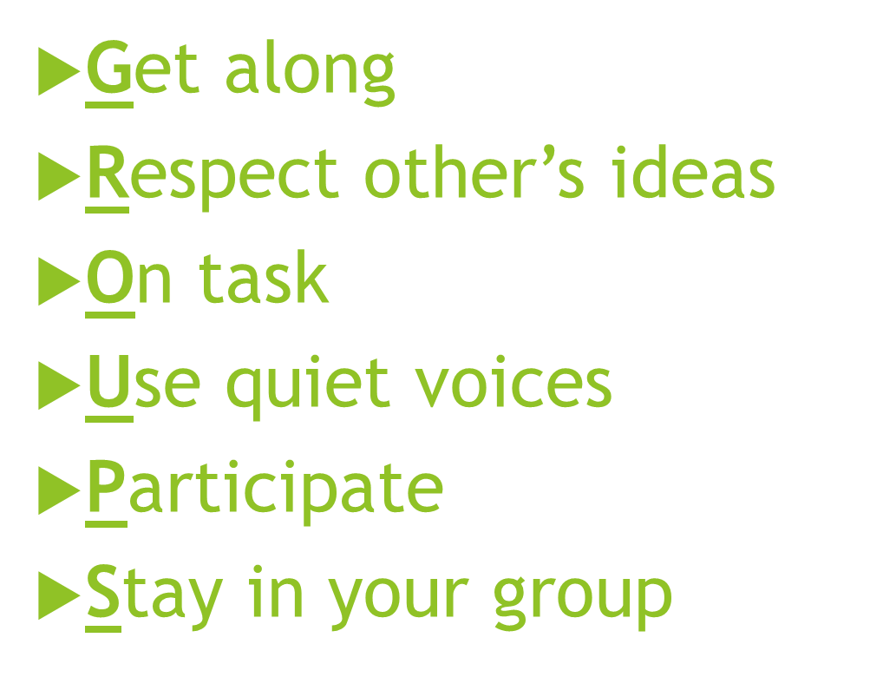
The teacher may still want me to work in a group. I can try to remember the Group Rules
Notes:
Read slide with students. Review the 6 rules for working in a group.

Slide 16
So…what do YOU think?
You’re assigned to a group with a classmate who keeps making jokes and fooling around while the rest of you are trying to get the job done.
What can you do?

