Slide 1
Building a Conversation
Notes:
Use the next 5 slides to teach the steps to building a conversation:
Greet your friend
Start the conversation – comment or question about a topic
Listen – give your friend a chance to answer or comment
Answer or comment – stay on topic
Keep it Going – ask another question, make a comment or wait for your friend to talk

Slide 2
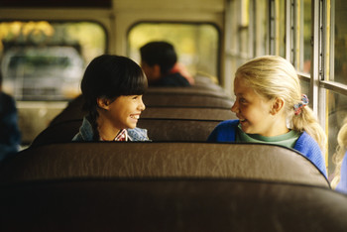
We Can Build a Conversation
How are you?
Hi!
OR
OR
What’s Up?
Step 1: Greet your friend –
Notes:
You could use the greeting sticks made for the “Hellos and Goodbyes” lesson to review this.

Slide 3
Step 2: Start the Conversation - Comment or Question about a Topic
I can’t wait to get home to see my puppy!
(Comment)
OR
What are you going to do this afternoon?
(Question)
Notes:
Discuss other topics that are good for conversation starters:
Favorites (games, toys, shows, books, foods, etc.)
What you’re going to do (this afternoon, this week, this weekend, etc.)
Your family
Your pets

Slide 4
Step 3: Listen!!
What’s your puppy’s name?
She is staying quiet and listening to her friend.
Wait – Listen – Give your friend a chance to answer or comment.
Notes:
Remind students that they need to keep eye contact and keep their bodies turned toward their friend

Slide 5
Step 4: Respond
His name is Hobbes.
Answer or Comment – Stay on Topic!!

Slide 6
Step 5: Keep it Going
Do you have any pets?
Ask another question, make a comment or wait for your friend to talk.

Slide 7
Let’s Look at That Again
Notes:
Use building blocks such as legos, wooden blocks or cardboard blocks, to illustrate the same conversation with the next 5 steps.

Slide 8
Hi!
Step 1: Greet your friend –
1

Slide 9
I can’t wait to get home to see my puppy!
(Comment)
2
Step 2: Start the Conversation - Comment or Question about a Topic
1

Slide 10
What’s your puppy’s name?
3
2
Step 3: Listen!!
1

Slide 11
His name is Hobbes.
4
3
2
Step 4: Respond
1

Slide 12
5
Do you have any pets?
4
3
2
Step 5: Keep it Going
1

Slide 13
Let’s Look at Another Conversation
Notes:
Review the steps again, using the blocks, with the next 5 slides.

Slide 14
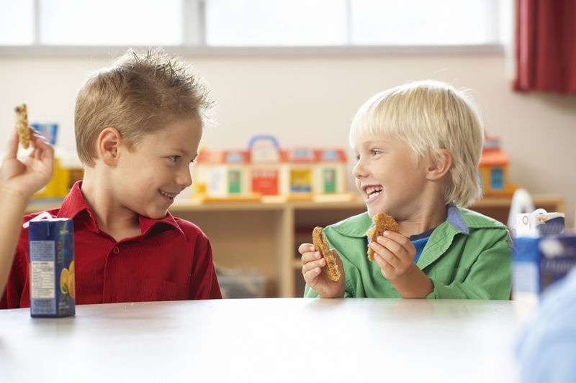
What’s Up?
Step 1: Greet your friend –

Slide 15
Do you like cookies better than chips?
Step 2: Start the Conversation - Comment or Question about a Topic

Slide 16
I like cookies better than chips – but I really love popcorn!!
Step 3: Listen!!

Slide 17
We always get popcorn at the movies. It is so delicious.
Step 4: Respond

Slide 18
What else do you like for snacks?
Step 5: Keep it Going

Slide 19
Let’s Listen To A Conversation
Notes:
If there are two adults with the group, practice building another conversation with the blocks representing each person taking a turn in the conversation.
Then, practice making some mistakes in the process such as:
Poor eye contact
Not responding
Suddenly changing the topic
Finally, show another positive example of a conversation.

Slide 20
Let’s Try Building a Conversation
Notes:
Pair students to practice building a conversation using the blocks to represent taking turns.
If the group of students still need a lot of practice, begin with student/adult pairs, then student/student pairs.
Use the next slide to help students choose a topic.

Slide 21
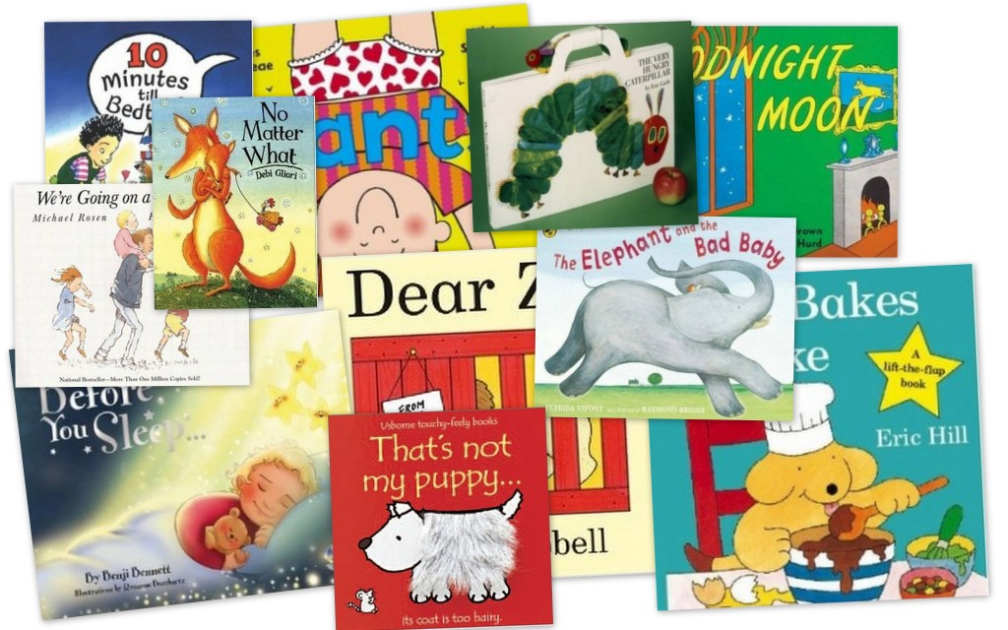
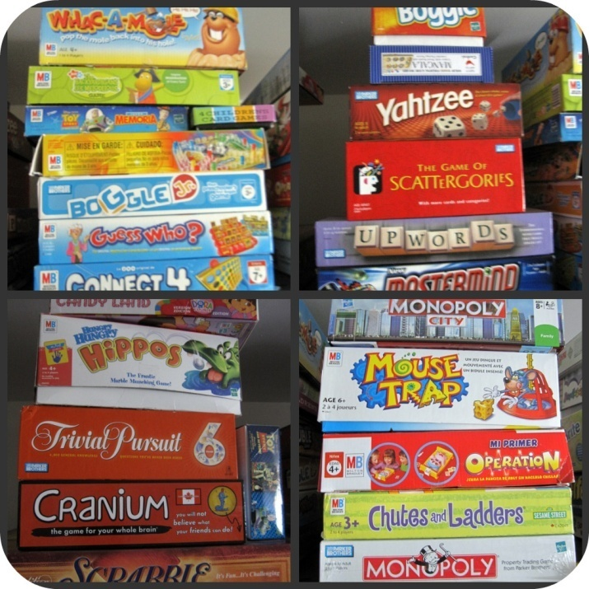
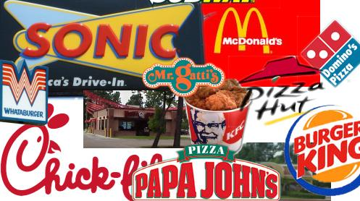
Choose a Topic
games
books
restaurants
TV shows
Notes:
Use this slide and/or the cards on Activity Sheet #1 to help students choose a topic for a practice conversation.

Slide 22
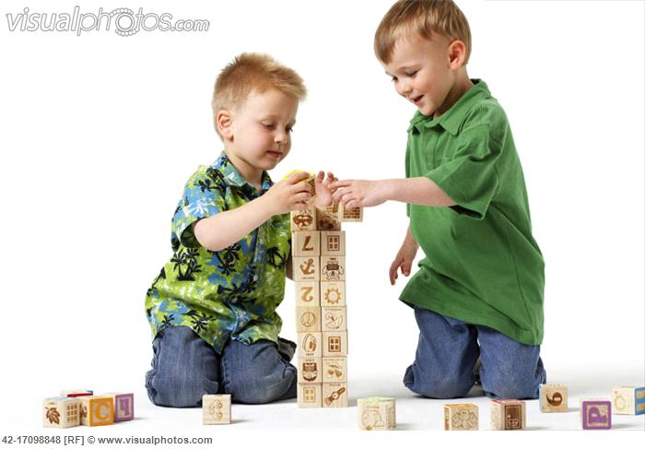
How Tall is Your Conversation Tower?
Notes:
Discuss how tall the students were able to get their conversation towers.

Slide 23
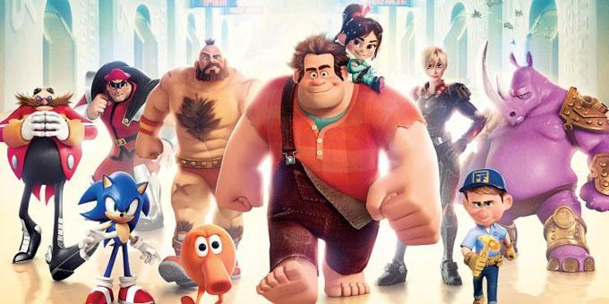
So What Do You Think?
Don’t Wreck It!
What bad habits might make your Conversation Tower fall down?
Notes:
Discuss bad conversation habits that could make their conversation towers fall down or not get very tall – illustrate these habits:
Poor eye contact
Not responding
Suddenly changing a topic

Slide 24
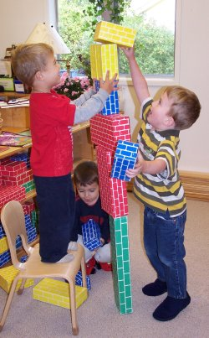
Building a Conversation
Step 1: Greet your friend
Step 2: Start the conversation with a comment or question
Step 3: Listen
Step 4: Respond
Step 5: Keep It Going
“Social Power” Point
Notes:
Pass out the “SocialPower” Point cards or magnets. Remind students to place them somewhere at home so they remember the things they went over today.

