Slide 1
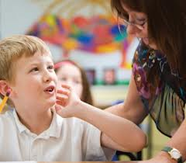

Talking About How I Feel
Notes:
Introduce the topic to the students. Talk about the Feelings lesson you may have done previously and ask the students to name some emotions to set them up for today’s lesson. Remind them that feelings and emotions are really the same thing.

Slide 2

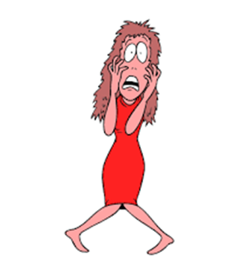
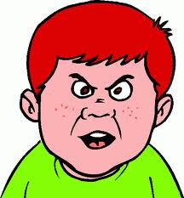
Sometimes we can tell how people are feeling by looking at them.
How are they feeling?
Notes:
Read slide with students. Click for each picture. Ask students to label the emotion (HAPPY, MAD/ANGRY, SCARED). Ask how they can tell. Briefly talk about times when they might have felt the same way.

Slide 3
Sometimes people might tell us how they are feeling. Then we don’t have to guess!
I’m so happy!
Yikes – I’m scared!
Boy, am I mad!
Notes:
Read slide with students. Talk about the fact that when we guess, we might guess wrong.

Slide 4

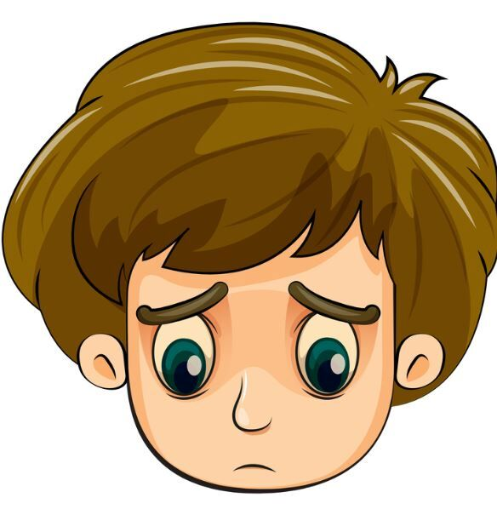
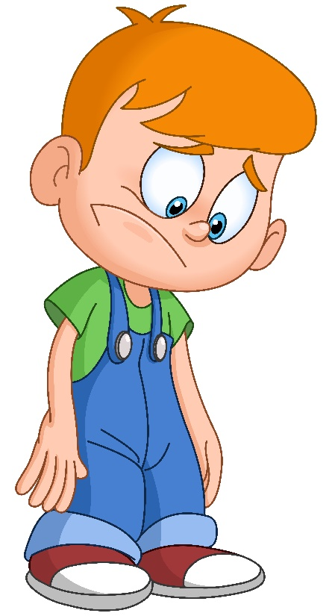
But sometimes it’s not easy to talk about how you feel.
sad
Notes:
Read heading with students. Click 3 times for pictures and ask students how they think the children are feeling. (“SAD”) Ask how they can tell. Click a fourth time for label.

Slide 5

Maybe you’re not sure how you feel…
Or am I mad?
Am I sad?
Notes:
Read slide with students. Click for thought bubbles. Talk about how feelings can be confusing. We need to try to figure out how we’re feeling so that we can talk about it.

Slide 6


How can you figure out how you’re feeling?
Write about it.
Draw a picture.
Notes:
Read heading with students. Ask what the boy is doing in the picture; click for caption. Ask what the girl is doing in the picture; click for caption. Talk about how the students could make a list – in their heads or on paper about the different things they could be feeling. Talk about how the students could draw a picture that might express how they’re feeling. This is a good way to start figuring out what they’re feeling so that they can talk about it to someone else.

Slide 7
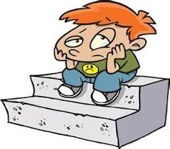
It helps to remember what happened and how it made you feel.
Then you can say…
I feel sad when no one will play with me.
Notes:
Read slide with students. Talk with them about situations when they might have felt sad. (You might want to start them off by relating a time when you felt sad.) List on board.

Slide 8
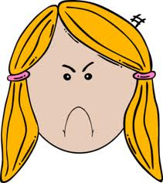
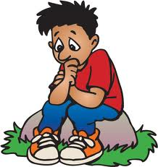
Or you might say…
I feel mad that I didn’t win the game.
I feel worried about my spelling test.
Notes:
Read slide with students. Talk with them about situations when they might have felt mad or worried. (You might want to start them off by relating a time when you felt mad or worried.) List on board.

Slide 9


This helps you figure out your own feelings.
Then you can talk about it with someone else.
Notes:
Read slide with students. Click for animation. Talk about how it’s important to figure out your own feelings so that you can give more information to the person you’re talking to.

Slide 10
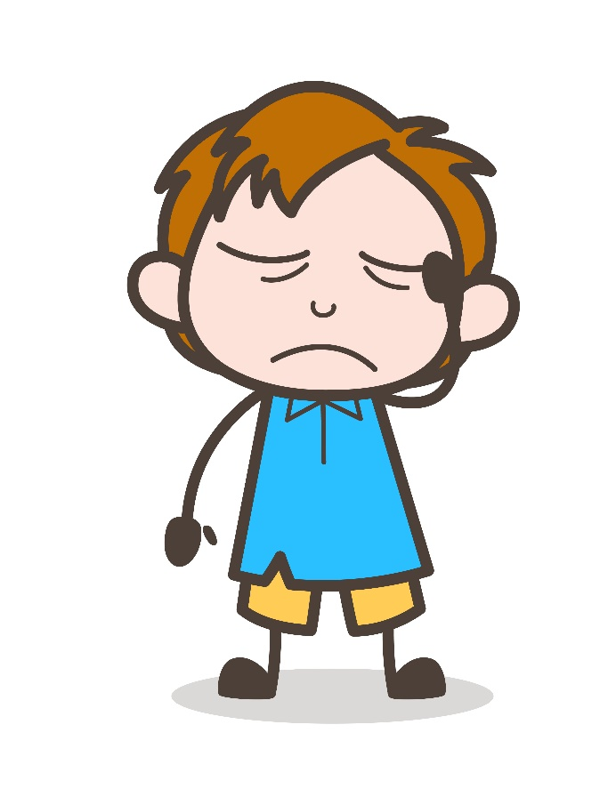

Why talk about how you feel?
Because keeping it locked up inside can make you feel worse!
Notes:
Read slide with students. Talk about how important it is to talk about your feelings with someone who cares about you. Talking about it can make you feel better!

Slide 11
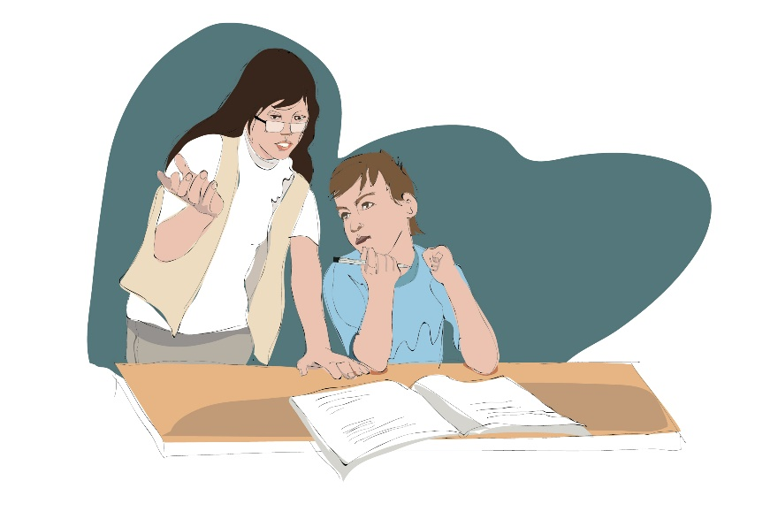
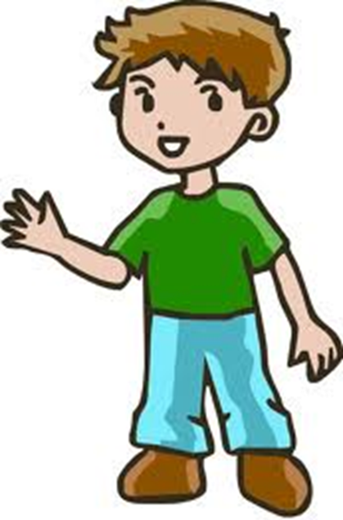

Who can you talk with to make you feel better?
your parents
your teacher
your friend
Notes:
Read slide with students. Talk about each picture and ask if they’ve ever talked with these people about how they were feeling. Ask about other people they might want to talk to. Role-play what they could say to these different people about how they are feeling.

Slide 12
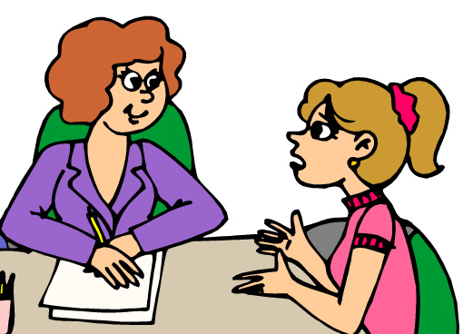
Talking about your feelings won’t make your problems disappear BUT now someone else knows and might be able to help.
Notes:
Read slide with students. Explain that talking about problems won’t make them go away BUT is a good way to start coming up with a solution.

Slide 13

They could help you:
calm down if you’re mad
think about something happy if you’re sad
come up with a plan if you’re worried
Notes:
Read slide with students. Click to bring up each point and talk about it with the students. Refer to previous lessons (if you’ve done them) about emotions and calming down strategies. AND/OR talk with students about strategies they could do to calm down, feel happier, and reduce worries.

Slide 14

Talking about your feelings can help you feel better!
Let’s talk about how we feel
Let’s talk about how we feel
Let’s talk about how we feel

Slide 15

Remember…
Think, write or draw to figure out how you feel
Remember what happened to make you feel this way
Talk to someone about how you’re feeling
Feel better!

Slide 16
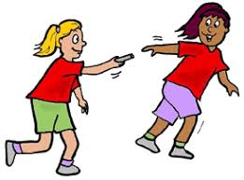
So what do YOU think?
Your class is running relay races in Gym today. You’re worried that you might slow down your team – and maybe even lose the race!
What can you do?
Notes:
Read slide with students. Talk about different strategies they can come up with to deal with their worried feelings. Refer to previous slides to remind students to think about how they feel, why they feel the way they do, talk to someone, and feel better.

