Slide 1
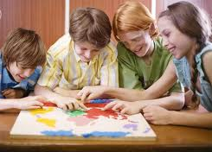
Let’s All Work Together!
Notes:
Introduce the lesson by reading the title of the first slide. Ask the students to look at and tell you about the picture. What are the children doing? What can they tell by looking at their faces? Tell the students that today you’ll be talking about easy ways to work with other people at school.

Slide 2
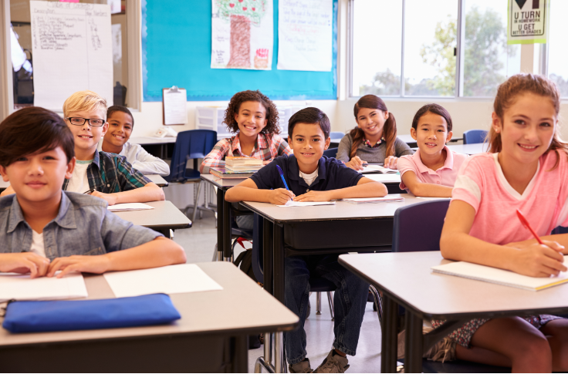
At school, there are a lot of students in each classroom.
How many students are in YOUR classroom?
Notes:
In advance, find out how many students are in each classroom from the teachers. List the group members names on the board (or dry-erase or chart paper) and let each student write the total number of their classmates under their names.

Slide 3
There’s usually only one teacher in each classroom.
What is YOUR teacher’s name?
Notes:
Let each student name their teacher. You can help them write their teacher’s name on the chart listing the number of students in each class.

Slide 4
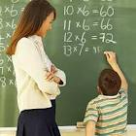
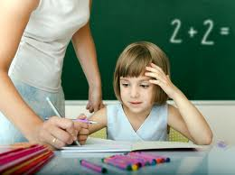
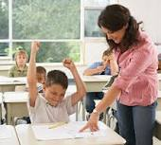
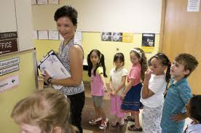
The teacher has a busy job!
What are some of the jobs YOUR teacher does every day?
Notes:
Talk with the students about all of the things their teacher does every day. Click on the pix one at a time to bring up jobs: teaches math; helps us with homework; checks our tests, reads story to us; lines us up and takes us to lunch and specials, etc.

Slide 5
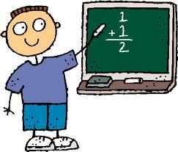
You are the student. You have a busy job too! Your job is to learn!!
What are some of the jobs YOU do
every day at school?
Notes:
Talk with the students about some of the “jobs” they do at school each day: Learn to READ, learn to WRITE, learn to DO MATH, etc.

Slide 6
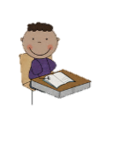
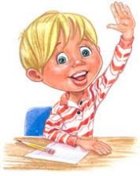
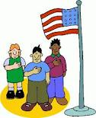
Those are some tough jobs. What helps you to do your job each day?
If I…
Look at the teacher
2. Listen to the teacher
Follow directions
Raise my hand to speak
5. Participate in class
Then I can do my job
and LEARN!
Notes:
Talk about each of the numbered points. Role-play each of the behaviors with children taking turns being teacher and student.

Slide 7
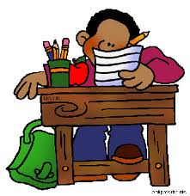
What does PARTICIPATE mean?
Raise my hand to answer a question
Take turns reading out loud
Do my work at my desk
Notes:
First ask the students for their definition of “participate”. Then click on the slide to bring up the 3 pictures: Talk about each one. Ask for other examples.

Slide 8
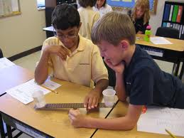
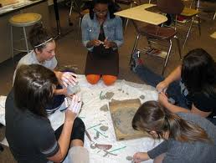
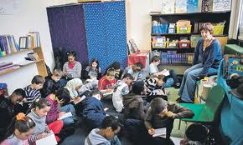
Sometimes you need to work with other students. That’s called working together!
What does working together look like?
Work with a partner
Work with a small group
Work with the whole class
Notes:
Ask the students for examples of “working together”. Click on pictures one by one and discuss their experiences with each.

Slide 9
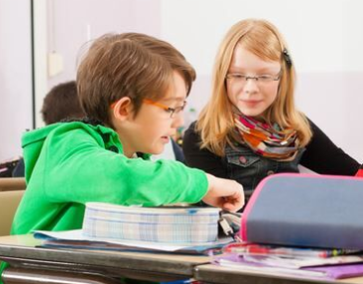
Working together takes COOPERATION
That means looking at the other person and listening to the other person so that we can do our job together!
Notes:
Talk about the picture with the students. Ask them how they know the two girls are working together and cooperating. (i.e. desks pushed together; chart spans both desks, girls look happy, etc.)

Slide 10
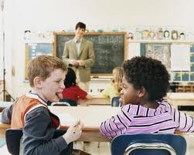
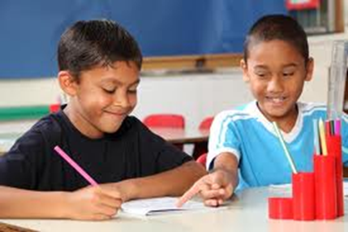
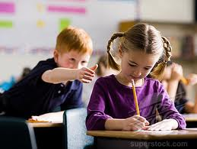
Are these students cooperating?
Notes:
Go through each picture and ask the students to talk about what they see that makes them think the kids are cooperating or not.

Slide 11
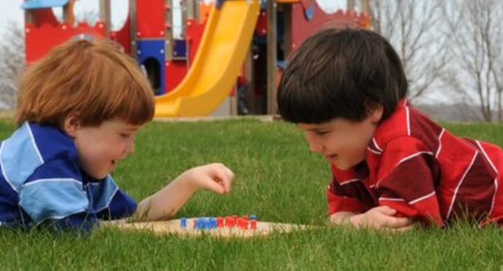
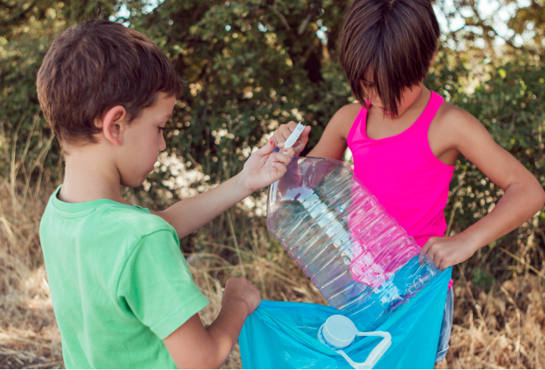
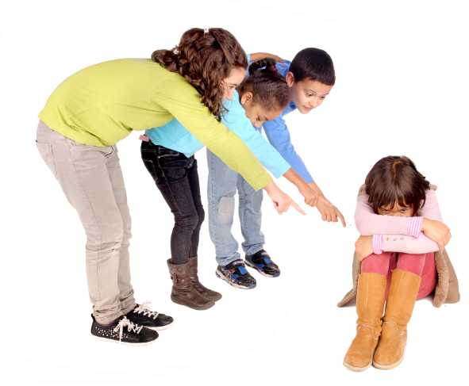
Are these students cooperating?
Notes:
Go through each picture and ask the students to talk about what they see that makes them think the kids are cooperating or not.

Slide 12
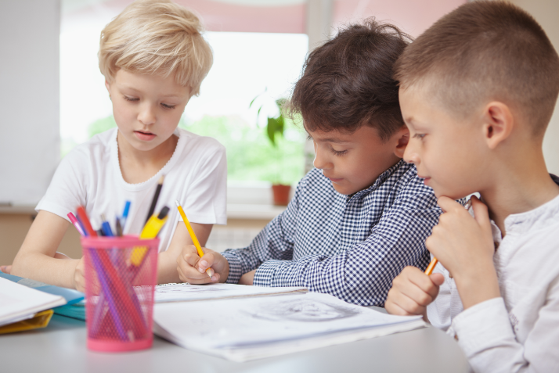
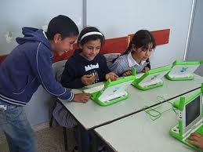
Are these students cooperating?
Notes:
Go through each picture and ask the students to talk about what they see that makes them think the kids are cooperating or not.

Slide 13
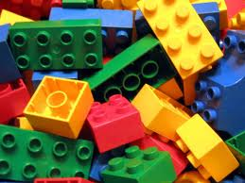
Let’s Practice!
OR
Lego Models
Travelling Turtle
Notes:
TRAVELLING TURTLE: (younger students)
Pair up students
Have students get down on all fours
Place large carpet square over their backs and explain that this is the turtle’s shell
Tell them that they must move around the room without losing their shell. Call out directions to them as they move so that they have to change directions periodically. Remind them to cooperate with each other so that they don’t lose their shell.
LEGO MODELS: (older students)
Pair up students
Give each pair a pile of Lego blocks and a picture OR actual model of a Lego structure
Tell them that they need to look at the picture/model and build what they see
Remind them to work together to finish the job

Slide 14
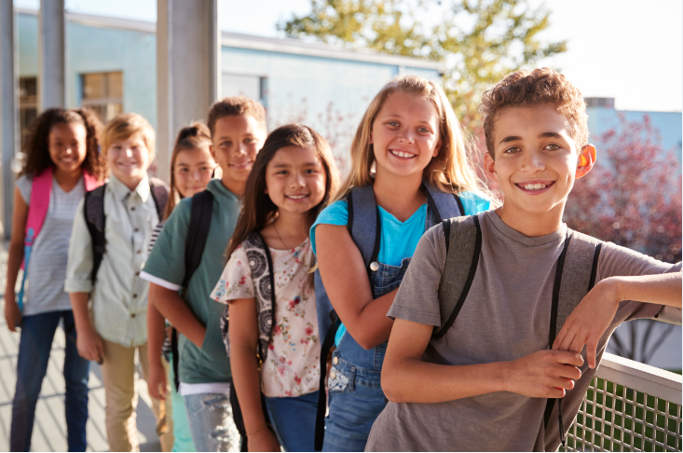
When we all work together…
The teacher can do her job and the students can do their job.
Everyone learns and has fun!

Slide 15
So what do you think…?
What could you do if you want to work with another student but he or she is already working with someone else?
Notes:
Start a discussion with the slide topic. Role play possible solutions with the students.

Slide 16
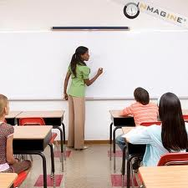
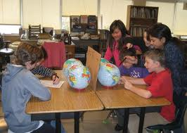
Let’s All Work Together!
Look at the teacher
Listen to the teacher
Follow directions
Raise my hand to speak
Participate in class
Cooperate with my classmates
Notes:
This visual is a good summary of the information in this lesson. This slide has been made into a format that can be printed on card stock to give to each student (Lesson Summary Card). You may also want to laminate the cards and place a magnet on the back as a visual that could be hung in the student’s home as a reminder of the lesson.

