Slide 1
I Can Learn From Losing!
Notes:
Introduce the lesson: Ask students what they know about losing – how it feels, when it happened to them, etc. List on whiteboard/chalkboard/easel pad.

Slide 2
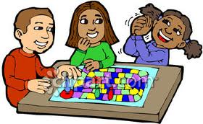
Playing games can be so much fun!
What games do YOU like to play?
Notes:
Talk to the students about the kids in the picture. What are they playing? (board game). Ask students if they’ve played board games and what their favorites are. Then ask what other types of games they like to play.

Slide 3
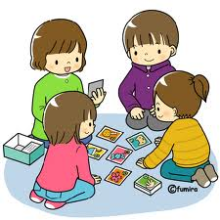
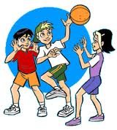
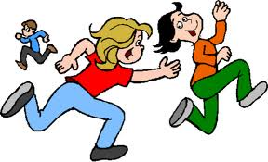
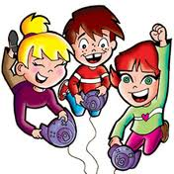
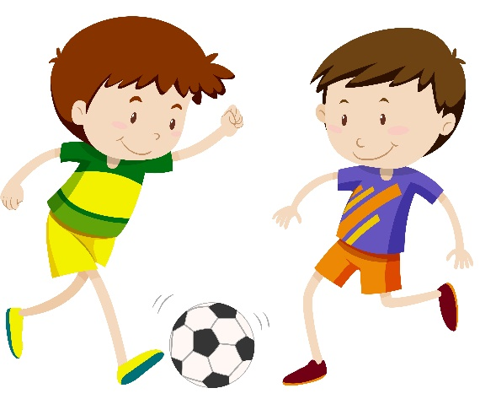
There are lots of games to play.
Do you like…?
Notes:
Click one at a time and talk about each of the pictures. What are the children doing in each? Ask students if they’ve played these games before. Did they win or lose?

Slide 4
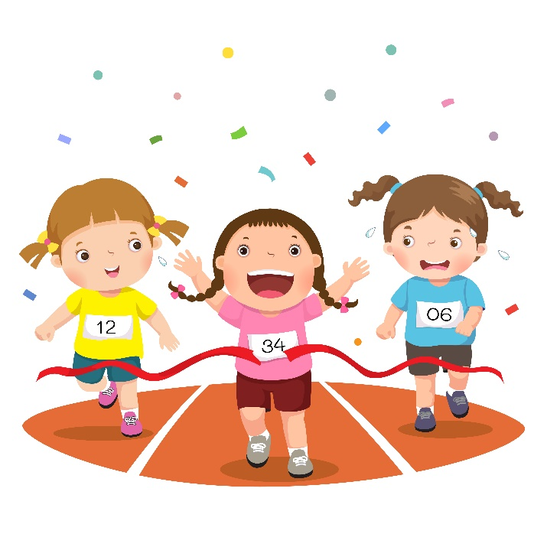
Did you win?
How did you feel?
Everyone likes to win. But usually only one person or one team can win.
That’s OK!
Notes:
Talk with the students about winning and how it feels. Then talk about how everyone likes to win but that means that somebody has to lose. Set up the next slide by telling students that it’s okay to lose because…

Slide 5
It’s okay to lose because…
We can actually learn more when we lose!
Really? What?
Notes:
Ask students what they think they can learn from losing. List their ideas on whiteboard/chalkboard/easel pad.

Slide 6
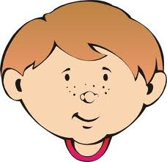
What can we learn from losing?
1. We can learn about being
nice to others.
Notes:
Tell students they’ll hear about three things they’ll learn when losing. Number one: We can learn about being nice to others. Ask students what “being nice to others” might look like. Click for picture. Talk about examples.

Slide 7
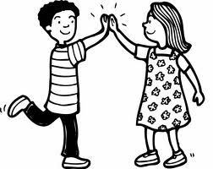
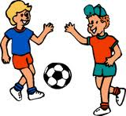
Being nice when we lose is called being a
“good sport”
How can we be a good sport?
good game!
Notes:
Ask students for their ideas about being a good sport. Click pictures one at a time and talk about good sportsmanship examples like HIGH FIVES, SHAKING HANDS, AND SAYING “GOOD GAME”

Slide 8
It feels good to be a good sport and other kids may like to play with you more!
Notes:
Ask students if they’ve been a good sport when playing. How did it feel? *You might also ask the students if they’ve ever played with someone who wasn’t a good sport and how that felt to them.

Slide 9
We can also learn “self-control”
What does that mean?
Notes:
Number two: We can also learn “self-control.: Ask students what “self-control” means.

Slide 10
“Self-control” means to act appropriately even when you are very upset.
It helps to stay calm.
How do YOU calm down when you’re upset?
Notes:
Ask students how they calm down when upset. Talk about whether their strategies work or if they’re still upset afterwards.

Slide 11
An easy way to calm down is to
take a deep breath.
breathe in…
breathe out…

Slide 12
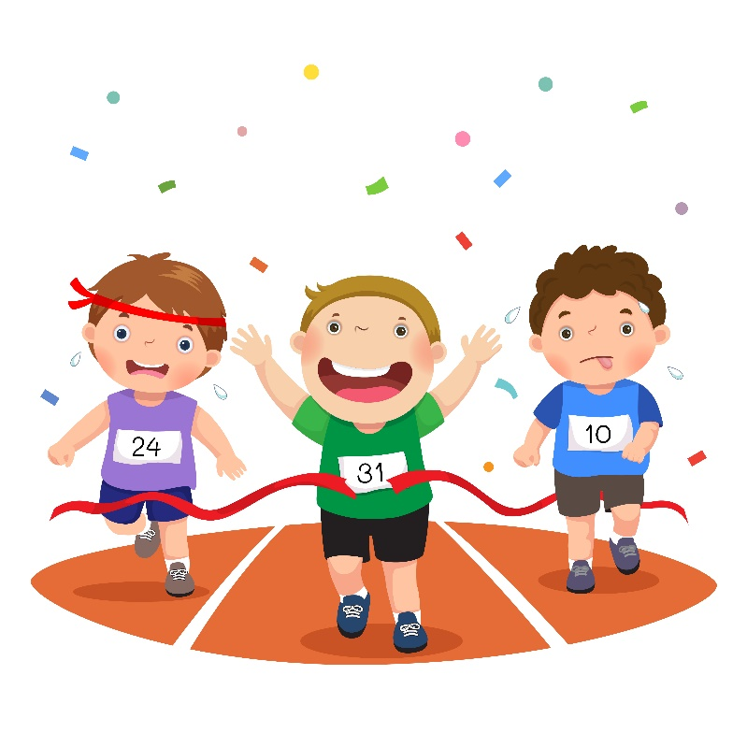
To be very good at self-control, you have to practice during real situations.
When you lose a game, that’s a great time to practice self-control!
I lost…I’ll take a deep breath and calm down.
Notes:
Practice taking a few slow, deep breaths with the students.

Slide 13
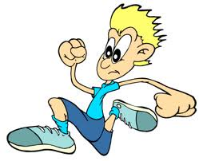
3.
Another thing you can learn from losing is to keep trying.
It’s important to not give up if you don’t win the first time. Keep trying!
I’ll keep trying. I like to run!
Notes:
Number three: We can learn to “keep trying”. Talk about not giving up. Ask students for examples.

Slide 14
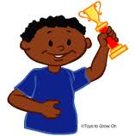
If we keep trying and do our best each time, we might win sometimes!
But if we lose, we know that we are learning too!
Notes:
Read the first sentence and click for picture. Read the last sentence and ask students: What are the three things we can learn from losing? (Prompt if necessary.)

Slide 15
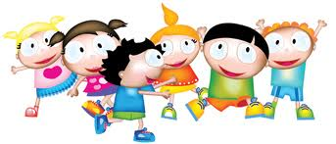
It’s important for all of us to learn from losing.
No one can win every game or contest.
It’s OK to lose because we can learn from losing too.

Slide 16
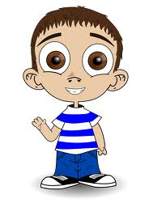
So…what do you think?
What would you do if you think someone cheated in the game?
Notes:
Read the question or have student read. Talk with the students about options: Keep guiding them back to what they learned in today’s lesson about being a good sport, using self-control, and trying again.

Slide 17
I Can Learn From Losing!
Everyone likes to win but it’s OK to lose
We can learn from losing
We can learn to BE A GOOD SPORT
We can learn to USE SELF-CONTROL
We can learn to KEEP TRYING
If we do these three things, other kids might like to play with us more

