Slide 1


Having Fun at recess
Notes:
Introduce today’s lesson: Having fun at recess. Ask the students if they like recess time. If so, why? If not, why? Explain that today they’ll be hearing about some ways to make recess more fun for them.

Slide 2
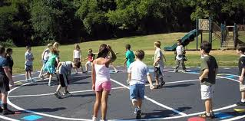
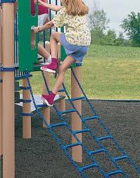
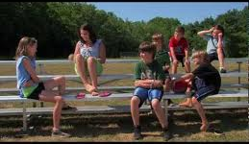
Let’s Talk About Recess…
What do kids do at recess?
play
climb
talk
Notes:
Read slide with students. Click for each picture to appear and talk about them. Ask students if they do any of these things at recess time and ask how it goes. Do they have fun

Slide 3
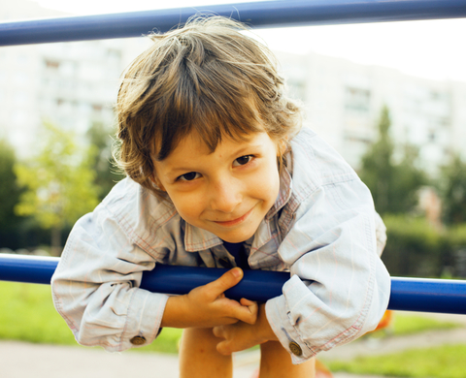
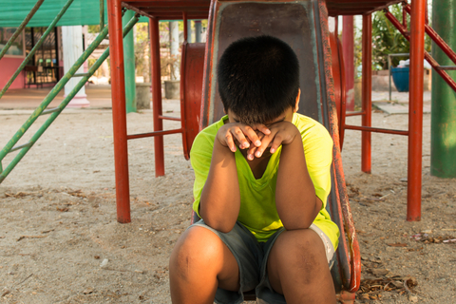
What do YOU do at recess?
I usually have fun!
I don’t have fun.
Notes:
Read slide with students and talk about the pictures. Ask students if they have fun and why. (i.e. “I have fun playing kickball.”) List on board. Ask if they don’t have fun and why. (i.e. “I don’t have fun because nobody will play with me.”) List on board.

Slide 4
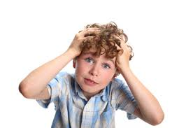
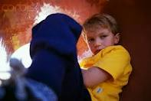
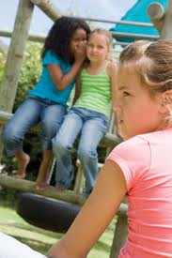
What kind of problems can happen at recess that make it not fun?
You don’t know what to play with
You don’t
know
how
to
play
They won’t let you join in
Notes:
Read slide with students. Click for each caption.
Ask students if any of these ever happened to them.
Ask how they felt.
Ask what they did.

Slide 5
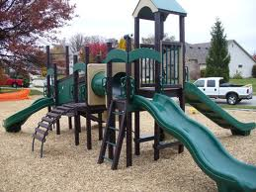
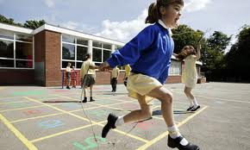
What can you do?
If you don’t know what to play with…
look around the playground
pick one thing to play first
if you like it, keep playing
if you don’t, choose another
try 1 or 2 different things to play on the playground each day
First slide
Then game
Notes:
Read slide with students. Talk about the different things on the playground and how it can be hard to choose. Then talk about how important it is to get started by picking one thing to try. Some students may be familiar with a “First-Then” format; use this to explain the order in which things can happen. Talk about how trying something different might help the student find a new favorite thing to do!

Slide 6

What can you do if they won’t let you join in?
If two kids are talking privately…
Say “hi” if you want to, then move away
Find someone else to play with
Notes:
Read slide with students. Click for text. Talk about saying a quick “hi”. Explain that sometimes that’s all it takes to be invited to join in. If not invited, look for someone else to play with.

Slide 7
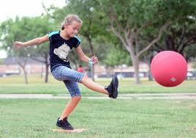
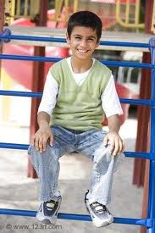
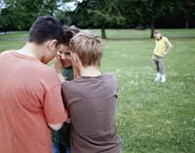
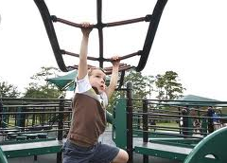
Is this a good time to try to join in?
Notes:
Read slide with students. Click for each picture and discuss whether or not it would be a good time to try to join in. Ask students how they know. Explain that sometimes kids are concentrating very hard on what they’re doing (i.e. girl kicking ball, boy on monkey bars) so that would not be a good time to ask to join in. Another time that would not be good to try to join in is when people are talking privately (i.e. boys whispering). Boy sitting along on climber and – good time to try to join in. Point out that he’s smiling and there’s no one else around so he might be looking for someone to play with.

Slide 8
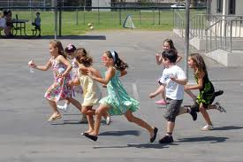
What can you do?
If you want to join a game…
watch to learn how to play
say something nice about what they’re doing – “That looks like fun!”
ask if you can play too
if they say “no”, find something else to do
Notes:
Read slide with students. Click for text. Talk about how important it is to figure out what they’re playing so that the student can join in knowing exactly what to do. Encourage students to say something nice about the play to the other kids. Explain that sometimes that’s all it takes to be invited to join in. If not invited, look for something else to do.

Slide 9

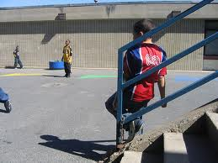
What can you do?
If you don’t know how to play…
walk over close
watch the kids play for a while to learn how
maybe ask someone to teach you how to play
when you’re ready, ask if you can play too
Notes:
Read slide with students. Click for text. Talk about moving close enough to the game/activity to really see what the kids are doing and how they are playing. Talk about asking one of the kids or an adult to teach them how to play.

Slide 10
Things you can say:
You’re a fast runner!
Can you teach me how to do that?
That was a great kick!
Can I climb with you?
What do you want me to do?
Notes:
Read slide with students. Click for each conversation balloon. Talk about situations when these comments/questions would be appropriate. Practice saying each one with students.

Slide 11
Let’s Practice!!
How can you ask to join in?
?
?
?
?
?
Notes:
Read slide with students. Role play with students: Set up different scenarios (i.e. ball game, hopscotch, two kids talking, jump rope, running game, etc.) Act out if possible with real props and practice using the strategies you’ve already discussed to enter into the groups.

Slide 12
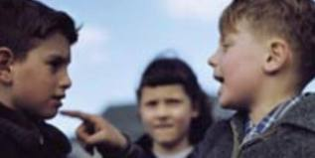
So what do YOU think?
Are there times when you should not try to join in?
How can you tell?
What can you do?
Notes:
Read slide with students. Talk about the picture and ask them what the girl might be thinking as she watches the two boys. What tells her that it’s not a good time to join in? Ask students what they see in the boys’ faces that tells them that it’s not a good time to join in. Then ask what the girl should do in this situation. (i.e. get adult help).

Slide 13
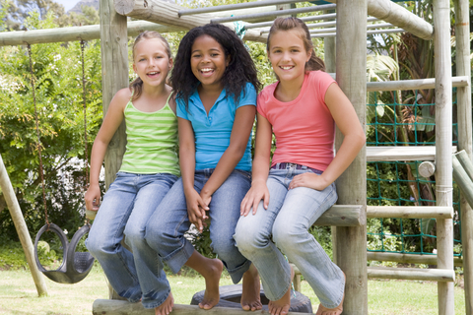
Most important of all…
HAVE FUN!!
Notes:
Read slide with students. Click andt alk about the picture. Point out that they saw these three girls earlier, except then the girl in pink was being left out. Briefly discuss what she might have done to now be part of the group.

Slide 14
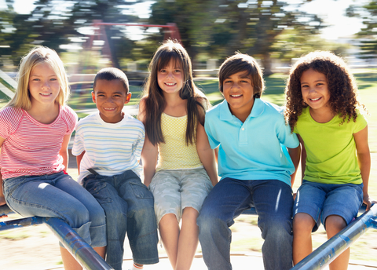
Having Fun at Recess
Pick something to play with
If kids are talking privately, find someone else to play with
If you want to join a game – watch, say something nice, ask to play
If you don’t know how to play – walk over, watch, ask someone to teach you, ask to play
HAVE FUN!!
Notes:
Read slide with students. Review key points.

