Slide 1
My friends at school

Slide 2
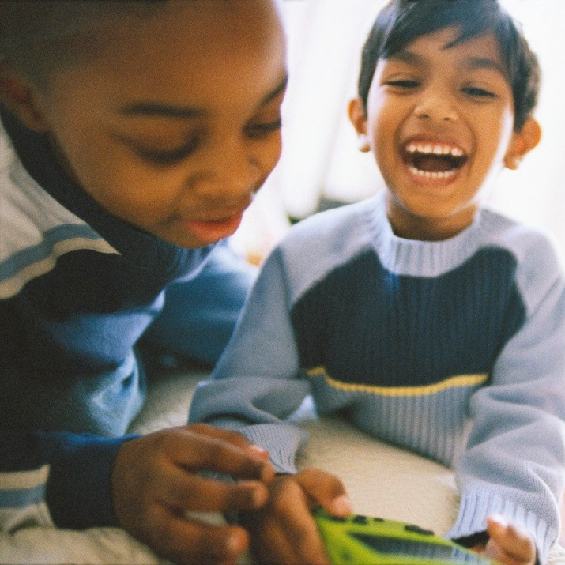
What is a friend?
A friend is someone you like to be with.
Notes:
Use this slide and the next 4 slides to point out the qualities that make someone your friend. Point out (or have children discuss) things the children in the pictures are doing that show that they are friends:
Smiling at each other
Looking at each other
Standing or sitting near each other
Talking to each other
Playing together

Slide 3
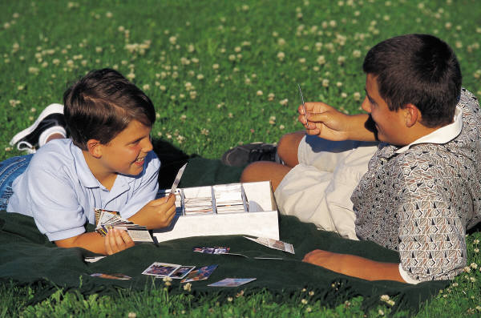
What is a friend?
A friend likes to spend time with you.

Slide 4
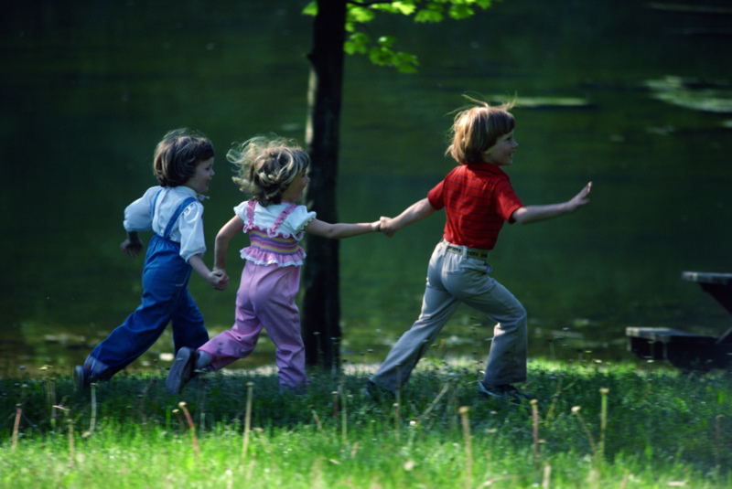
What is a friend?
A friend laughs with you and plays with you.

Slide 5
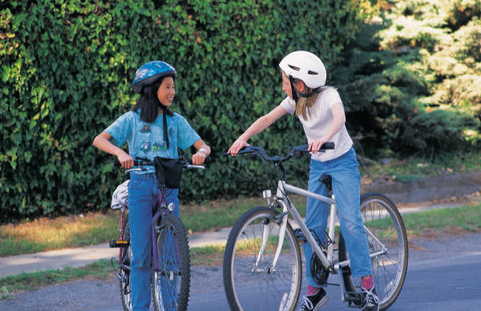
What is a friend?
A friend will talk with you and spend time with you.

Slide 6
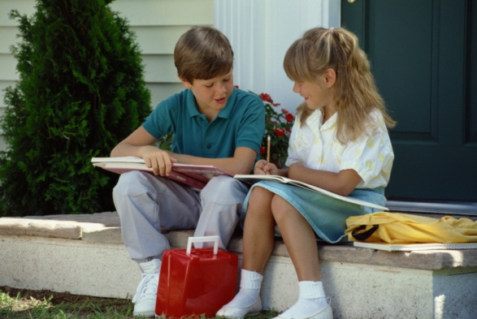
What is a friend?
A friend is kind and doesn’t tease.

Slide 7
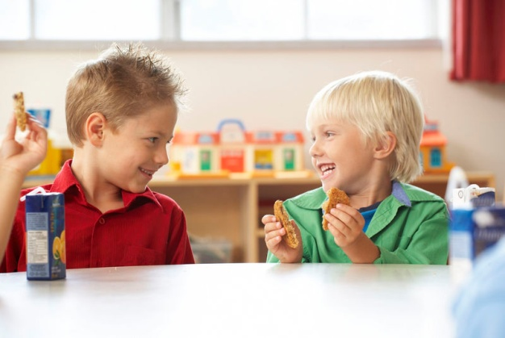
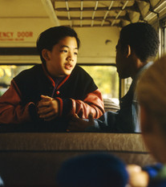
Are these children friends?
Yes! They are friends!
Notes:
Have them guess whether or not the children in each picture are friends.
Help students recognize some of the qualities that are shown in the picture that show that the children are friends:
Sitting together, laughing with each other, looking at each other.

Slide 8
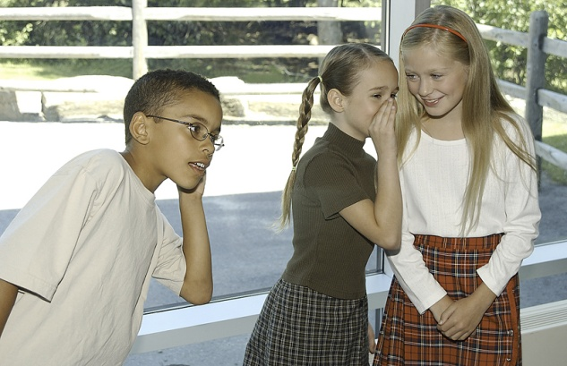

Are these children real friends?
These children are not being friendly!
Notes:
Tell a little about the picture:
Jessica and Jamie are talking inappropriately about James. They are laughing and telling secrets about him. James would like to join them and play together, but the girls just keep whispering and laughing.
Ask the children whether the girls are being friendly?
Discuss characteristics that show that these children are not being friendly:
Telling secrets, not including someone, laughing at/not with someone.

Slide 9
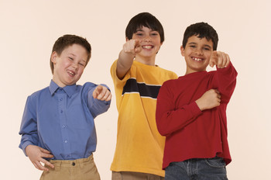
Are these children real friends?
These children are not being friendly!
Notes:
Tell a little about the picture:
Justin, Caleb and Marc are laughing at a classmate who fell in the hall and dropped all of her books. She is crying.
Discuss characteristics that show that these children are not being friendly:
Pointing, laughing when someone is crying, not helping

Slide 10
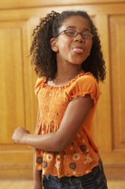
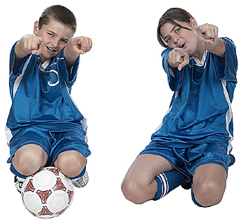
What is teasing?
Words or actions that make you feel bad
Notes:
Discuss behaviors that show that someone is not being friendly and may be teasing you:
Sticking out their tongue,
Leaving you out of a game
Pointing and laughing
Walking away with their friends
Trying to get other friends to not play with you.

Slide 11

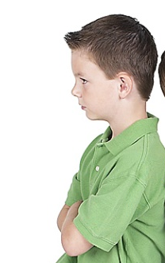
What should I do if someone is teasing me?
Cut it out!
Stop bothering me!
Notes:
Discuss what to do when someone is teasing by reviewing this and the next two slides

Slide 12
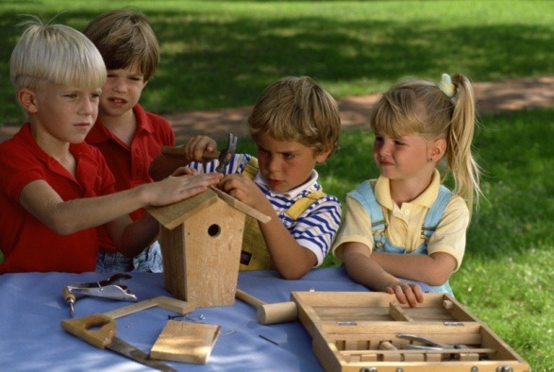
What should I do if someone is teasing me?
Join some friends who are being kind.

Slide 13

What should I do if someone is teasing me?
Go stand near or talk to a teacher or other adult

Slide 14

So what do you think?
What should you do if a friend is being teased?
Notes:
Ask students to discuss what they would do if they saw a friend being teased.

Slide 15
All about friends
Friends are fun to be with.
Friends like to spend time together and play.
Friends are kind and do not tease.
If someone is teasing, I should:
  Join some friends who are being kind
  Stand near or talk to an adult
  Ask them to stop.
“Social Power” Point
Notes:
Pass out the “SocialPower” Point cards or magnets. Remind students to place them somewhere at home so they remember the things they went over today.

