Slide 1

Feelings
Everybody has feelings
Notes:
The following resources were used in developing this lesson:
Skillstreaming the Adolescent New Strategies and Perspectives for Teaching Prosocial Skills by Arnold P. Goldstein, Ellen McGinnis
The Incredible 5-Point Scale:Assisting students with autism spectrum disorders in understanding social interactions and controlling their emotional responses. Kari Dunn Buron, Mitzi Curtis
Social Skill Training by Jed Baker
Life Centered Education Competency Units for Personal-Social Skills Volume 1 Donn E. Brolin
The following websites were used to provide visual support to this lesson:
www.flickr.com
www.movies.about.com
www.cyclingnews.com
www.sportolysis.com
http://commons.wilkimedia.org
www.veryfunnypic.com
www.guzer.com
www.prodigalsun.typepad.com
www.members.tripod.com
www.art.com
www.wga.hu
www.designcollection.biz
www.millenniomfineart.co.uk

Slide 2




Feelings
Everybody has Feelings!
There are many ways to feel!
Angry
Sad
Happy
Worried
Scared
Can you look at someone and know how they feel?
Notes:
Name different feelings. What makes you feel that way?
Explain that actions are something you can do or things that happen to you or someone else.
Do Feelings Match Up worksheet:
Match feelings words to feelings smiley faces to photos of feelings

Slide 3
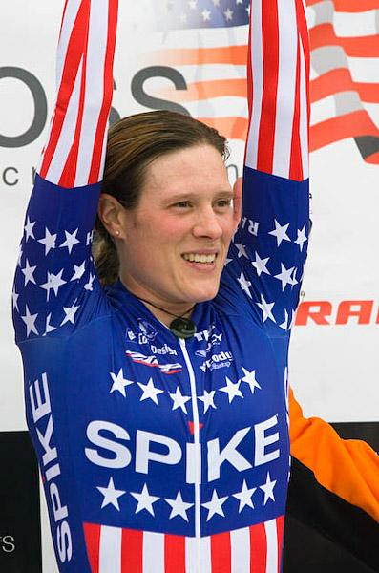

http://www.cyclingnews.com/cross.php?id=/photos/2006/nov06/radcup06/USGP_SEATTLE30
What are they feeling?
What are their actions?
http://www.movies.about.com
Notes:
Slides 3- 7 show the different emotions.
Have the students look at the slides to figure out what are the emotions shown.
Ask the students:
What do they see - What does his/her body look like? What does/his her face look like?
What are they seeing that helps them know the feeling he/she feels?
*Note: Instructor decides how many of these slides and which questions to discuss. There are a total of 5: #3-7.

Slide 4
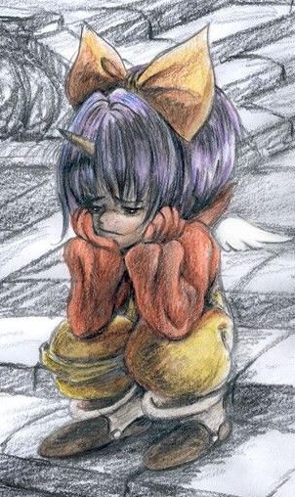
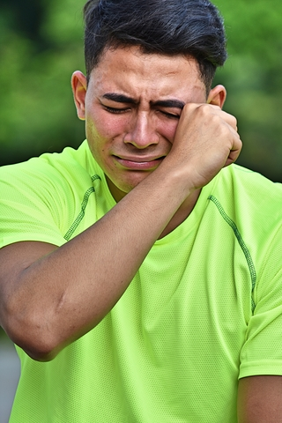
What are they doing?
What are they feeling?
Notes:
Slides 3- 7 show the different emotions.
Have the students look at the slides to figure out what are the emotions shown.
Ask the students:
What do they see - What does his/her body look like? What does/his her face look like?
What are they seeing that helps them know the feeling he/she feels?
*Note: Instructor decides how many of these slides and which questions to discuss. There are a total of 5: #3-7.

Slide 5
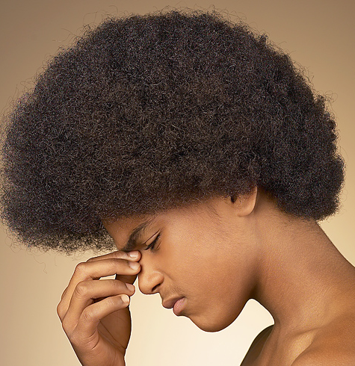
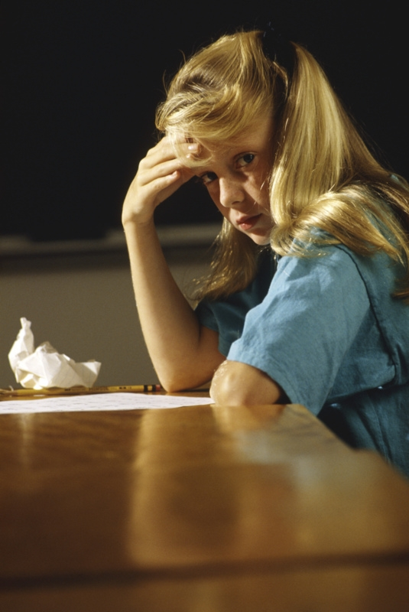
Look at the people.
What are they feeling?
Notes:
Slides 3- 7 show the different emotions.
Have the students look at the slides to figure out what are the emotions shown.
Ask the students:
What do they see - What does his/her body look like? What does/his her face look like?
What are they seeing that helps them know the feeling he/she feels?
*Note: Instructor decides how many of these slides and which questions to discuss. There are a total of 5: #3-7.

Slide 6
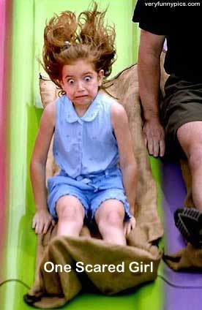
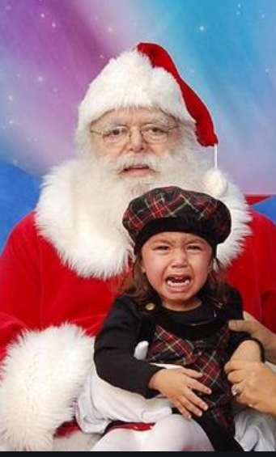
www.veryfunnypics.com
How do you think they feel?
Do their faces tell you something about how they feel?
Notes:
Slides 3- 7 show the different emotions.
Have the students look at the slides to figure out what are the emotions shown.
Ask the students:
What do they see - What does his/her body look like? What does/his her face look like?
What are they seeing that helps them know the feeling he/she feels?
*Note: Instructor decides how many of these slides and which questions to discuss. There are a total of 5: #3-7.

Slide 7


Look at their faces and bodies.
What do you see that tells you how they feel?
Notes:
Slides 3- 7 show the different emotions.
Have the students look at the slides to figure out what are the emotions shown.
Ask the students:
What do they see - What does his/her body look like? What does/his her face look like?
What are they seeing that helps them know the feeling he/she feels?
*Note: Instructor decides how many of these slides and which questions to discuss. There are a total of 5: #3-7.

Slide 8
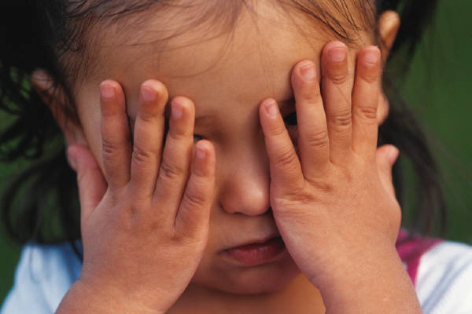
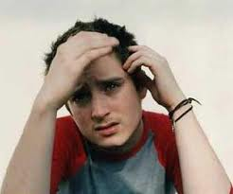
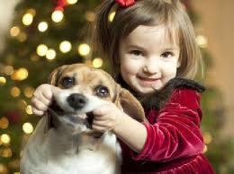
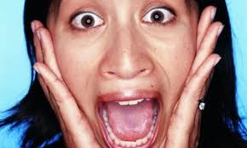
What makes our feelings happen?
You or someone else does something or says something
Something happens
like: Your computer breaks in the middle of a game
  You get invited to a friend’s birthday party
  You have a hard spelling test tomorrow
Notes:
Use to talk about what makes feelings happen?

Slide 9
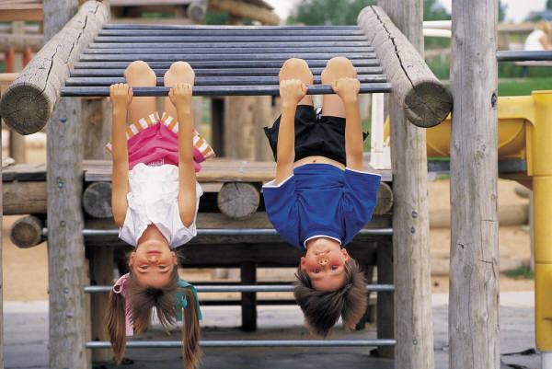
Feeling:
“I am so happy!”
I love playing on the playground with my friends
Notes:
Point out that doing things you like make you feel happy.

Slide 10
What are some things that make you feel:
Angry Sad
Happy Scared
Worried
Notes:
Activity #2 - The Mirror Activity
1. Go over the scenarios (choose as many as you like, make up your own and/or have the students make up scenarios)
2. Discuss how you would feel
3. Look in your mirror and show how you would look
4. If you wish, you may also role play the scenario
You’re ice cream cone falls on the ground after you just began to lick it.
You are home alone at night and you hear a loud, strange noise.
You have a big test to take at school and you didn’t study.
You find out that you won a million dollars.
Your father accidently runs over your bike with his car and breaks it.
Your best friend goes away for a whole summer.
You are watching a movie with monsters and when you are not looking your sister yells,”Boo!”
Your family moves and you have to go to a new school.
Your little brother falls and hurts himself.
Your best friend gets a new puppy.
Your brother breaks his favorite toy.
A lion escapes from the zoo and comes to your house.
Your family goes to Disney World.

Slide 11
How does she feel?
What made her feel like that?
How would you feel?
Notes:
*Note: Slides 11- 16 have the photos from previous slides with probing questions to help the students begin to talk about what makes feelings happen and relate the feelings to their own experiences. Instructor decides the number of slides to use and the number of questions to use with the group.
*Note: Instructor decides how many questions per slide to ask the group/s.
What is he/she thinking?
What is he/she feeling?
What is he/she doing (or What will he/she do?)
What may he/she do to feel better?
Point out facial expressions – how are they the same/different.
Point out body postures (when applicable).
Ask about a time when they have felt this emotion.

Slide 12
How does he feel?
What happened to him to make him feel like that?
How would you feel if that happened to you?
Notes:
*Note: Instructor decides how many questions per slide to ask the group/s.
What is he/she thinking?
What is he/she feeling?
What is he/she doing (or What will he/she do?)
What may he/she do to feel better?
Point out facial expressions – how are they the same/different.
Point out body postures (when applicable).
Ask about a time when they have felt this emotion.

Slide 13
How does she feel?
What is she doing that tells you she feels that way?
What do you do when you feel like that?
Notes:
*Note: Instructor decides how many questions per slide to ask the group/s.
What is he/she thinking?
What is he/she feeling?
What is he/she doing (or What will he/she do?)
What may he/she do to feel better?
Point out facial expressions – how are they the same/different.
Point out body postures (when applicable).
Ask about a time when they have felt this emotion.

Slide 14
How does she feel?
What made her feel that way?
Do you ever feel like that?
Notes:
*Note: Instructor decides how many questions per slide to ask the group/s.
What is he/she thinking?
What is he/she feeling?
What is he/she doing (or What will he/she do?)
What may he/she do to feel better?
Point out facial expressions – how are they the same/different.
Point out body postures (when applicable).
Ask about a time when they have felt this emotion.

Slide 15
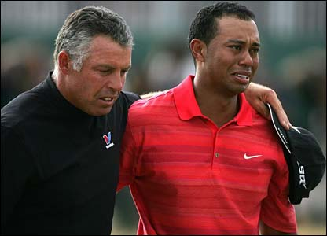
How do they feel?
What are they doing?
How can they help themselves feel differently?
Notes:
*Note: Instructor decides how many questions per slide to ask the group/s.
What is he/she thinking?
What is he/she feeling?
What is he/she doing (or What will he/she do?)
What may he/she do to feel better?
Point out facial expressions – how are they the same/different.
Point out body postures (when applicable).
Ask about a time when they have felt this emotion.

Slide 16
How does she feel?
What made her feel that way? What would you do?
Notes:
*Note: Instructor decides how many questions per slide to ask the group/s.
What is he/she thinking?
What is he/she feeling?
What is he/she doing (or What will he/she do?)
What may he/she do to feel better?
Point out facial expressions – how are they the same/different.
Point out body postures (when applicable).
Ask about a time when they have felt this emotion.

Slide 17
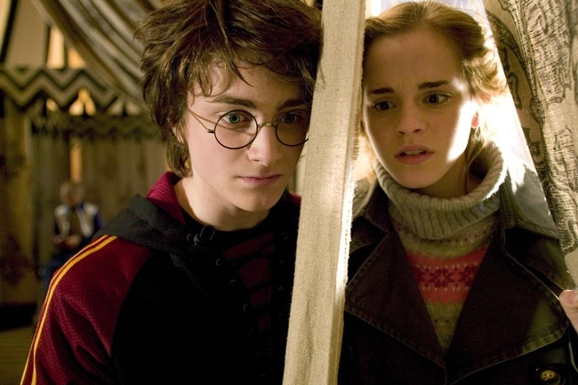
So, what do you think?
How can I help my friend when she is feeling sad or worried?
Notes:
Use this slide to lead a discussion about how you could make someone else feel better.

Slide 18
I Can Change Feelings!
1. Identify my feelings
or
Identify my friend’s feelings
2. Do something that will make me feel better
or
Do something for my friend to make them feel better
“Social Power” Point
Notes:
Pass out the “SocialPower” Point cards or magnets. Remind students to place them somewhere at home so they remember the things they went over today.

