Slide 1
Identifying Emotions and Triggers
Notes:
The following resources were used in developing this lesson:
Skillstreaming the Adolescent New Strategies and Perspectives for Teaching Prosocial Skills by Arnold P. Goldstein, Ellen McGinnis
The Incredible 5-Point Scale:Assisting students with autism spectrum disorders in understanding social interactions and controlling their emotional responses. Kari Dunn Buron, Mitzi Curtis
Social Skill Training by Jed Baker
Life Centered Education Competency Units for Personal-Social Skills Volume 1 Donn E. Brolin
The following websites were used to provide visual support to this lesson:
www.flickr.com
www.movies.about.com
www.cyclingnews.com
www.sportolysis.com
http://commons.wilkimedia.org
www.veryfunnypic.com
www.guzer.com
www.prodigalsun.typepad.com
www.members.tripod.com
www.art.com
www.wga.hu
www.designcollection.biz
www.millenniomfineart.co.uk

Slide 2
EMOTIONS:
Thoughts Feelings Actions
Emotions = Feelings
Emotions are not thoughts BUT an emotion may come from or cause a thought.
Emotions are not actions BUT an emotion may come from or cause an action.
Adapted from: LCCE Competency Unit: Personal Social Skills – Acquiring Self Confidence Chapter
Notes:
Use slide to define emotions.
Have students brainstorm a list of emotions.

Slide 3

THOUGHT:
“It is a beautiful day!”
FEELING: happy
ACTION: take a walk on the beach
http://www.flickr.com/photos/neloqua/276013406/
Notes:
Use slide to illustrate thoughts, feelings and actions.
Have students describe possible thoughts, feelings and actions for some samples situations:
Possible situations:
You are sitting in the living room, you hear a car pull into the driveway and then a loud “CRUNCH”. You remember you left your bike in the driveway.
You are home alone at night and you hear a strange noise.
You find out that you won a scholarship to the school you want to go to.

Slide 4
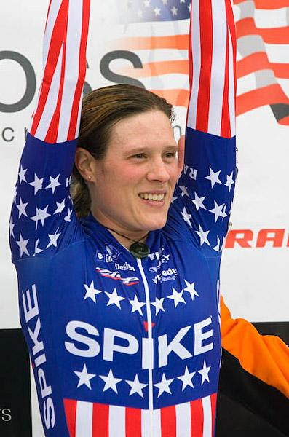

http://www.cyclingnews.com/cross.php?id=/photos/2006/nov06/radcup06/USGP_SEATTLE30
http://www.movies.about.com
Notes:
Have students answer the following questions – (Questions are also listed on Activity Sheet 1)
*Note: Instructor decides how many of these slides to discuss. There are a total of 5: #4-8.
*Note: Instructor decides how many questions per slide to ask the group/s.
What is he/she thinking?
What is he/she feeling?
What is he/she doing (or What will he/she do?)
Point out facial expressions – how are they the same/different.
Point out body postures (when applicable).
Ask about a time when they have felt this emotion.

Slide 5
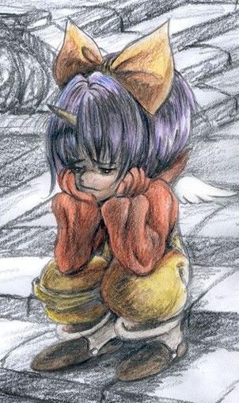

Notes:
Have students answer the following questions – (Questions are also listed on Activity Sheet 1)
*Note: Instructor decides how many questions per slide to ask the group/s.
What is he/she thinking?
What is he/she feeling?
What is he/she doing (or What will he/she do?)
Point out facial expressions – how are they the same/different.
Point out body postures (when applicable).
Ask about a time when they have felt this emotion.

Slide 6
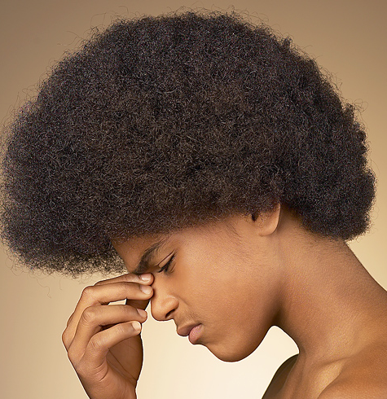

Notes:
Have students answer the following questions – (Questions are also listed on Activity Sheet 1)
*Note: Instructor decides how many questions per slide to ask the group/s.
What is he/she thinking?
What is he/she feeling?
What is he/she doing (or What will he/she do?)
Point out facial expressions – how are they the same/different.
Point out body postures (when applicable).
Ask about a time when they have felt this emotion.

Slide 7
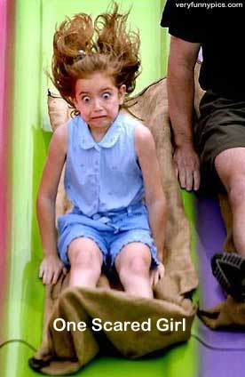
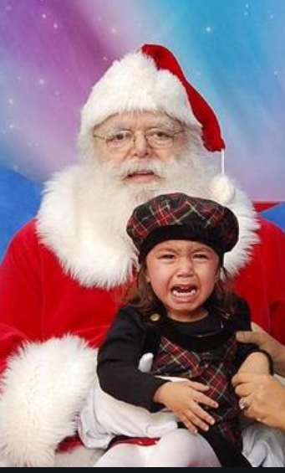
www.veryfunnypics.com
Notes:
Have students answer the following questions – (Questions are also listed on Activity Sheet 1)
*Note: Instructor decides how many questions per slide to ask the group/s.
What is he/she thinking?
What is he/she feeling?
What is he/she doing (or What will he/she do?)
Point out facial expressions – how are they the same/different.
Point out body postures (when applicable).
Ask about a time when they have felt this emotion.

Slide 8

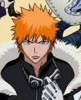
Notes:
Have students answer the following questions – (Questions are also listed on Activity Sheet 1)
*Note: Instructor decides how many questions per slide to ask the group/s.
What is he/she thinking?
What is he/she feeling?
What is he/she doing (or What will he/she do?)
Point out facial expressions – how are they the same/different.
Point out body postures (when applicable).
Ask about a time when they have felt this emotion.

Slide 9
Trigger
Something that happens that makes us feel a certain way.
Brainstorm triggers that might cause you to feel:
  Angry
  Sad
  Happy
Other examples:
  I have to wait in a long line – I feel frustrated.
  A family member dies – I feel ___________.
  I win a contest – I feel ___________.
  A friend wins a contest – I feel ___________.
Notes:
Use slide to define the TRIGGER for a FEELING.
Have students fill in blanks verbally and/or on Activity Sheet 1.

Slide 10
How does he/she feel?
Why does he/she feel that way? What was the trigger?
How would you feel in the same situation?
What would you do?

Slide 11
How does he/she feel?
Why does he/she feel that way? What was the trigger?
How would you feel in the same situation?
What would you do?
Notes:
*Note: Slides 11-14 have the same 5 questions for student discussion. Instructor decides the number of slides to use and the number of questions to as the group.

Slide 12
How does he/she feel?
Why does he/she feel that way? What was the trigger?
How would you feel in the same situation?
What would you do?

Slide 13

How does he/she feel?
Why does he/she feel that way? What was the trigger?
How would you feel in the same situation?
What would you do?

Slide 14
How does he/she feel?
Why does he/she feel that way? What was the trigger?
How would you feel in the same situation?
What would you do?

Slide 15
5
4
Levels of Feelings
3
2
1
Notes:
Note to facilitator: The incredible 5-point scale is designed to teach students social understanding. It is a visual, concrete depiction of abstract qualities such as emotions.
Tony Attwood also describes the use of an “angermometer” which helps people with autism visualize levels of anger. This illustration combines these ideas to help students learn about levels of emotions and the actions that correspond to the emotions
The Incredible 5-Point Scale is authored by Kari Dunn Buron and Mitzi Curtis and is available through Autism Asperger Publishing Company. The scale will be used in other lessons to help students identify appropriate ways to respond to their feelings.
Describe to students how different levels of FEELINGS can have the affect of changing their ACTIONS. Give the example of how differently you would act if you were just a little bit happy (you found a nickel) or if you were jubilant (you won a million dollars).
Thinking ahead of time about responding to different levels of FEELINGS can help you control your ACTIONS.

Slide 16
5
elated
4
overjoyed
3
delighted
happy
2
excited
1
pleased
Notes:
Show the different levels of “happy” with this slide.

Slide 17
5
4
3
sad
2
1
Notes:
Click out of the slide show by right clicking on the slide and clicking on “End Show”. Click on the word “sad” then go to the Thesaurus in the “Tools” section. Use the Thesaurus to help students decide on words that show the different levels of sadness. They can fill in their words on Activity Sheet 2.
For example: 5 – miserable
4 – depressed
3 – cheerless
2 – gloomy
1 - low

Slide 18
5
4
3
scared
2
1
Notes:
Click out of the slide show by right clicking on the slide and clicking on “End Show”. Click on the word “scared” then go to the Thesaurus in the “Tools” section. Use the Thesaurus to help students decide on words that show the different levels of sadness. They can fill in their words on Activity Sheet 2.
For example: 5 – petrified
4 – terrified
3 – afraid
2 – anxious
1 - worried

Slide 19
5
4
3
angry
2
1
Notes:
Click out of the slide show by right clicking on the slide and clicking on “End Show”. Click on the word “angry” then go to the Thesaurus in the “Tools” section. Use the Thesaurus to help students decide on words that show the different levels of sadness. They can fill in their words on Activity Sheet 2.
For example: 5 – enraged
4 – livid
3 – fuming
2 – mad
1 - annoyed

Slide 20
5
4
3
What happens to the ACTIONS when the FEELING is stronger?
2
1
Notes:
Lead a discussion about how the stronger the feeling is, the more likely the actions will be more intense.
The authors of the book, “The Incredible 5 Point Scale”, have a new book for adolescents that is called “A 5 is Against the Law”. This is especially true with anger. This may help students understand how important it is to control their THOUGHTS and ACTIONS.

Slide 21
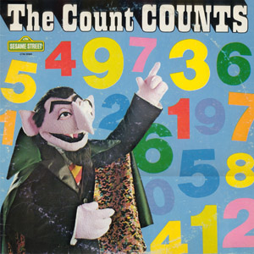
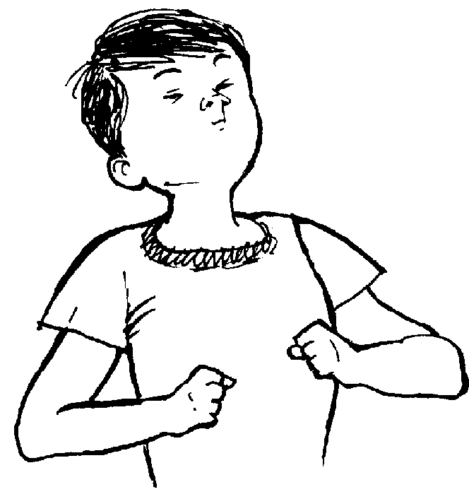

When my FEELINGS are a “5” – What ACTIONS will keep me calm?
Count to 10
Take deep breaths
Walk away
See calm pictures
www.members.tripod.com
Notes:
Help students identify other ACTIONS that may help them stay calm. Practice or role play some of strategies. (The next several slides are examples of artwork that may be good visuals for calming).

Slide 22

www.art.com
“Calm” by Kenny Primmer
Notes:
Ask students whether they feel a sense of calm when they look at this art work.

Slide 23
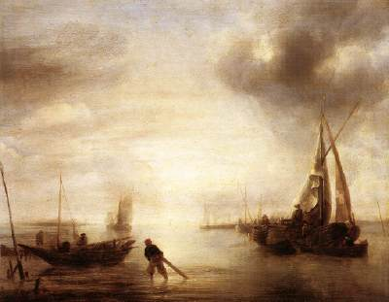
“Calm” by Jan van de Capelle
www.wga.hu
Notes:
Ask students whether they feel a sense of calm when they look at this art work.

Slide 24
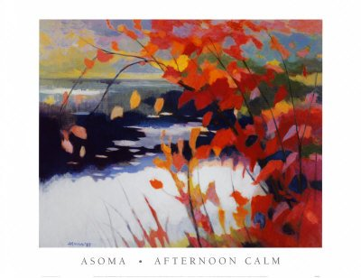
www.designcollection.biz
Notes:
Ask students whether they feel a sense of calm when they look at this art work.

Slide 25

“Summer Calm” by Stephen Lennon
www.millenniumfineart.co.uk
Notes:
Ask students whether they feel a sense of calm when they look at this art work.

Slide 26
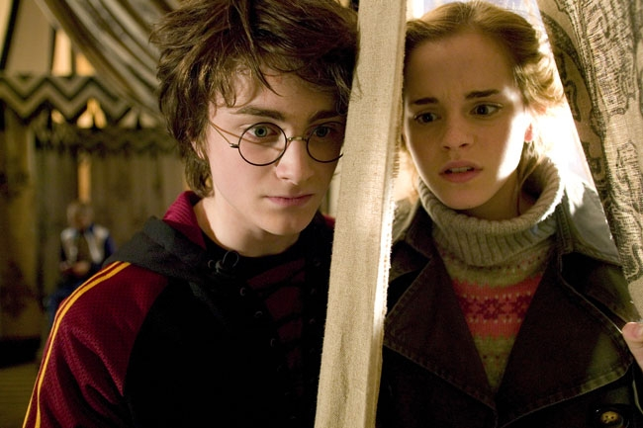
So, what do you think?
Can changing my THOUGHTS help me to change my FEELINGS? My ACTIONS?
I’m so embarrassed. He thinks I’m a geek.
I think he really wants to talk to me.
Notes:
Use this slide to lead a discussion on today’s lesson.

Slide 27
When a TRIGGER makes your FEELINGS a “5”:
These ACTIONS can help you change your THOUGHTS.
Take deep breaths
Count to 10
See calm pictures
“Social Power” Point
Notes:
This visual is a good summary of the information in this lesson. This slide has been made into a format that can be printed on card stock to give to each student (“Social Power” Point Card). You may also want to laminate the cards and place a magnet on the back as a visual that could be hung in the student’s home as a reminder of the lesson.

