Slide 1

Calming Down When Things Go Wrong
Notes:
Introduce lesson to students. Explain that today’s lesson is about learning how to calm down when things go wrong.

Slide 2
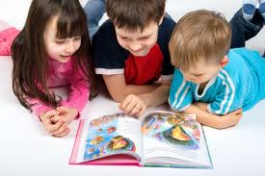
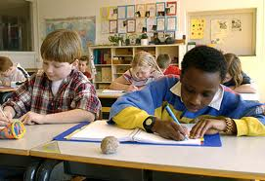
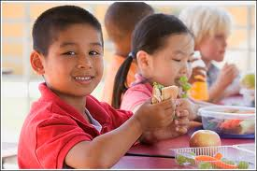
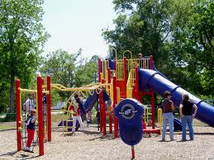
School can be fun!
We
Notes:
Read slide with students. Click for each picture to appear. Talk about what the students are doing in the pictures. Ask the students about other fun things that happen at school. List this on board.

Slide 3
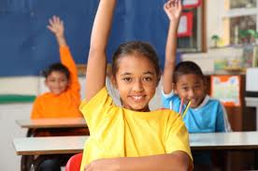
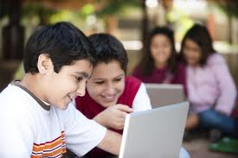
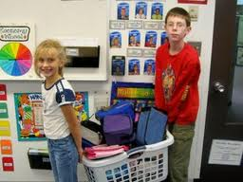
Usually, everything is fine at school
I might know the answer
I might make a new friend
I might help the teacher
Notes:
Click for title and read with students. Talk about each picture. Ask students how they feel when they know the answer, make a new friend, or get to help the teacher.

Slide 4
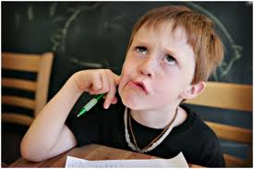
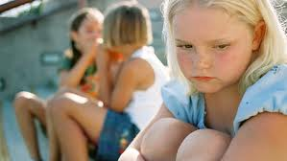
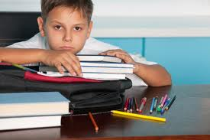
Sometimes, things don’t go so well.
I don’t know the answer
I can’t find a friend
I don’t get to help the teacher
Notes:
Click for title and read with students. Talk about each picture. Ask students how they feel when they don’t know the answer, can’t find a friend, or don’t get to help the teacher.

Slide 5
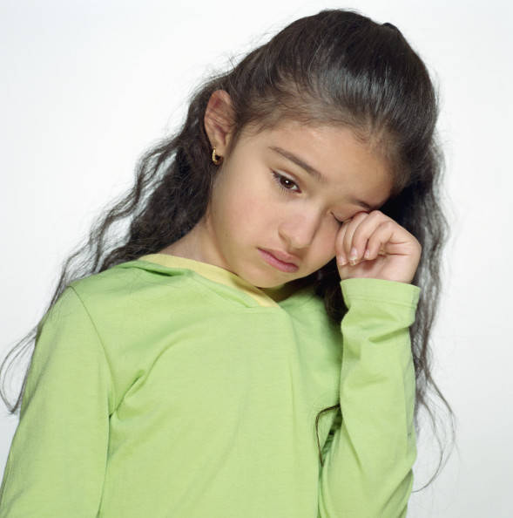
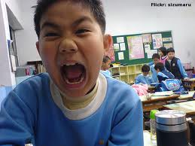
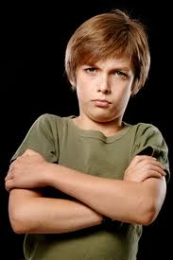
Sometimes when things don’t go well, we can get upset.
Notes:
Read slide with students. Talk about each picture – ask the students how they know that each child in the pictures is upset.

Slide 6

What kind of things
make YOU upset?
Notes:
Read slide with students. Lead discussion about things that are upsetting. Give you own example(s) to get things started if necessary.

Slide 7
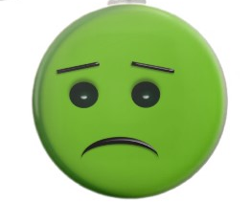
That’s OK! Everybody gets upset sometimes.
We just need to calm down.
Notes:
Read slide with students. Talk about how we all get upset now and then. We just need to learn ways to calm down so that we can feel better.

Slide 8

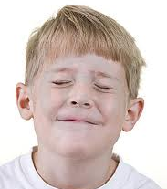

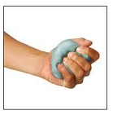
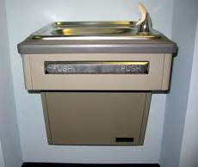
Here are some things we can try to calm down
Take 5 slow deep breaths
Close your eyes
Count slowly to 10
Squeeze a ball
Ask to take a break – get a drink
Notes:
Click for title and read with students. Go through each strategy and practice with students. Ask students if they’ve ever tried any of these strategies before. Did they work? How did they feel afterwards?

Slide 9
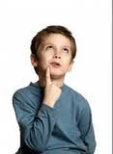



What are some other ways to calm down?
Let’s try to come up with 3 more!
Notes:
Read slide with students. Encourge them to come up with at least three other ways to calm down. List these on board/paper. Ask students whether anyone has tried these strategies before. Did they work? How did they feel afterwards?

Slide 10
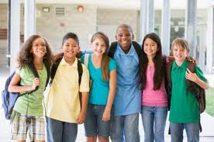
Being calm helps us all feel better and have fun at school!

Slide 11
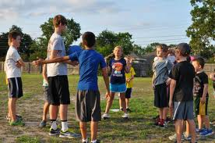
So…what do you think?
You’re playing at recess and your friend is upset because he got just got out in the kickball game.
What can you do to help?
Notes:
Read slide with students. Talk about ways to help the friend calm down. Encourage students to recall strategies learned today to apply to this situation.

Slide 12

Calming Down
When Things Go Wrong
Everybody gets upset sometimes
To calm down, I can:
  Take 5 slow deep breaths
  Close my eyes
  Count slowly to 10
  Squeeze a ball
  Ask to get a drink
Get back to having fun
Notes:
Review key points with students.

