Slide 1
Assertive vs. Aggressive
Notes:
The following resources were used in developing this lesson:
Skillstreaming the Adolescent: New Strategies and Perspectives for Teaching Prosocial Skills by Arnold P. Goldstein and Ellen McGinnis
Room 28 A Social Language Program by Carolyn LoGuidice and Nancy McConnell
Social Skills Training by Dr. Jed Baker
“The Cool Way to Respond to Conflict” by John Stanfield
The following websites were used to provide visual support to this lesson:
www.dreamscape.com
www.stanfield.com
www.jamesstanfield.com
www.crystalinks.com
www.dlt.ri.gov

Slide 2
Passive?
Assertive?
Aggressive?
Notes:
Introduce this lesson by asking students if they know the meanings of any of these words.
Talk about how these words are ways that people respond to some type of conflict.
Use the next three slides to define these words.

Slide 3
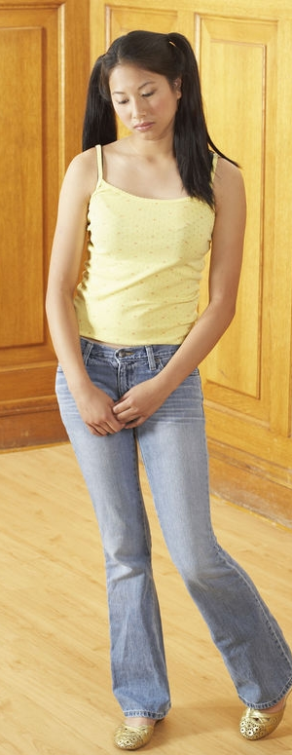
Passive
Saying “no” or “stop” weakly
Mumbling
Ignoring it – never solving the problem
Not getting help from an adult
Keeping it to yourself
Giving up
Notes:
After defining PASSIVE, ask students to relate experiences when they may have responded in a passive manner. Give some specific examples such as:
Kyle has tripped Luis in the hallway for three days in a row. Luis walks down another hallway to avoid Kyle.
Jill is loudly talking about a style of clothing that Joelle is wearing. She calls the style ugly and boring. She is making it obvious that she is talking about Joelle. Joelle turns her back and pretends to read.
Or, give examples from your own life or examples you have observed.
Ask students whether it is sometimes alright to respond to conflict in a passive manner.

Slide 4

Assertive
Standing up straight
Looking towards the person
Speaking in a firm voice
Saying it quickly and politely
Getting help from friends or adults when you need to
In control
Notes:
After defining ASSERTIVE ask students to relate experiences when they may have responded in a passive manner. Give some specific examples such as:
Jamal tells Maria that he feels hurt when she calls him a loser and he wants her to stop.
Jason tells Jake that he does not like horror movies and would rather see something else.
Or, give examples from your own life or examples you have observed.

Slide 5
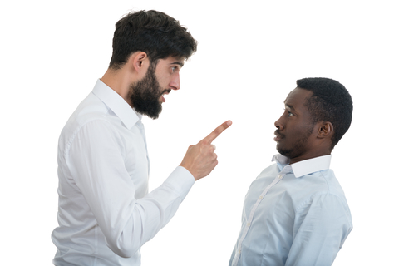
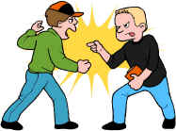
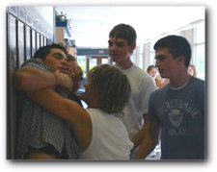
Aggressive
What does it look like?
  Angry face
  Finger pointing or fist
  Too close
  Touching, pushing, fighting
  Violence
www.stanfield.com (catalog)
Notes:
After defining AGGRESSIVE give some examples of aggressive responses to conflict such as:
Davey is late for practice so he angrily yells at his mom on the way there.
Louie punched Kareem because he heard that Kareem called him a name.
Or, give other examples that you have observed.

Slide 6
Survey – Conflict Resolution Style
When I speak to someone,
    I look the person right in the eye
    I sometimes look the person in the eye
    I try not to look the person in the eye
Survey adapted from: Room 28: A Social Language Program by C. LoGiudice and N. McConnell
Notes:
Give each student copy of Activity Sheet 1 to write down their response to each question.

Slide 7
Survey – Conflict Resolution Style
When someone criticizes me,
  I criticize the person right back
  I think about what they say and answer honestly
  I walk away with my feelings hurt

Slide 8
Survey – Conflict Resolution Style
If I don’t win at something
  I get angry
  I don’t worry about it
  I feel sad

Slide 9
Survey – Conflict Resolution Style
When someone pushes me or bumps into me
  I get angry and push right back
  I think about whether it was on purpose – I might say, “Hey, watch out”
  I walk away and try to avoid the person

Slide 10
Survey – Conflict Resolution Style
If someone tells a lie about me
  I call the person a liar
  I ask the person why he/she said that and tell them it is not true
  I ignore it and pretend it didn’t happen

Slide 11
How Did You Score?
Mostly A’s – Your response to conflict is
AGGRESSIVE
Mostly B’s – Your response to conflict is
ASSERTIVE
Mostly C’s – Your response to conflict is
PASSIVE
Notes:
Go over the scoring for this survey. Allow students to share answers only if they want to.

Slide 12
Passive?
Assertive?
Aggressive?
Notes:
“Let’s look at some pictures and see if you can tell if the person is responding in a PASSIVE, ASSERTIVE or AGGRESSIVE manner.”

Slide 13
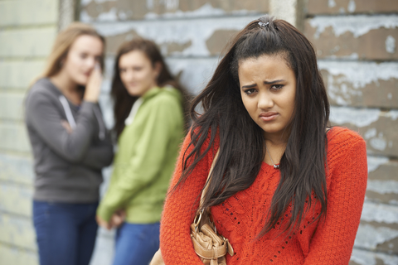
Notes:
As you show each picture, ask the following questions:
What do you think might be happening in this picture?
In what manner is/are the person/people responding? Passive, assertive or aggressive?
Is this a good response in this situation? Would you respond differently?

Slide 14
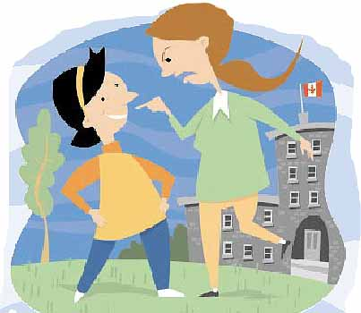
www.crystalinks.com
Notes:
As you show each picture, ask the following questions:
What do you think might be happening in this picture?
In what manner is/are the person/people responding? Passive, assertive or aggressive?
Is this a good response in this situation? Would you respond differently?

Slide 15
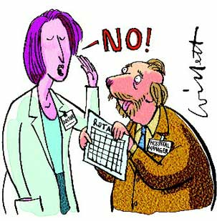
www.studentbmj.com
Notes:
As you show each picture, ask the following questions:
What do you think might be happening in this picture?
In what manner is/are the person/people responding? Passive, assertive or aggressive?
Is this a good response in this situation? Would you respond differently?

Slide 16
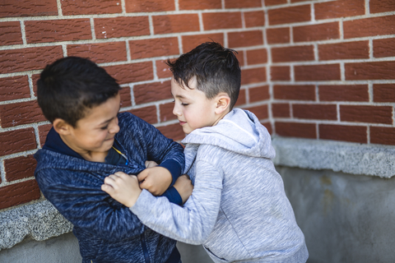
Notes:
As you show each picture, ask the following questions:
What do you think might be happening in this picture?
In what manner is/are the person/people responding? Passive, assertive or aggressive?
Is this a good response in this situation? Would you respond differently?

Slide 17

Notes:
As you show each picture, ask the following questions:
What do you think might be happening in this picture?
In what manner is/are the person/people responding? Passive, assertive or aggressive?
Is this a good response in this situation? Would you respond differently?

Slide 18
Notes:
As you show each picture, ask the following questions:
What do you think might be happening in this picture?
In what manner is/are the person/people responding? Passive, assertive or aggressive?
Is this a good response in this situation? Would you respond differently?

Slide 19
Notes:
As you show each picture, ask the following questions:
What do you think might be happening in this picture?
In what manner is/are the person/people responding? Passive, assertive or aggressive?
Is this a good response in this situation? Would you respond differently?

Slide 20
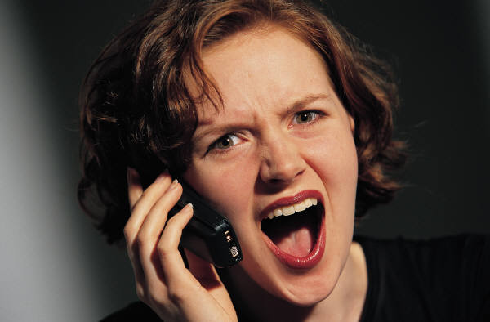
www.dlt.ri.gov
Notes:
As you show each picture, ask the following questions:
What do you think might be happening in this picture?
In what manner is/are the person/people responding? Passive, assertive or aggressive?
Is this a good response in this situation? Would you respond differently?

Slide 21
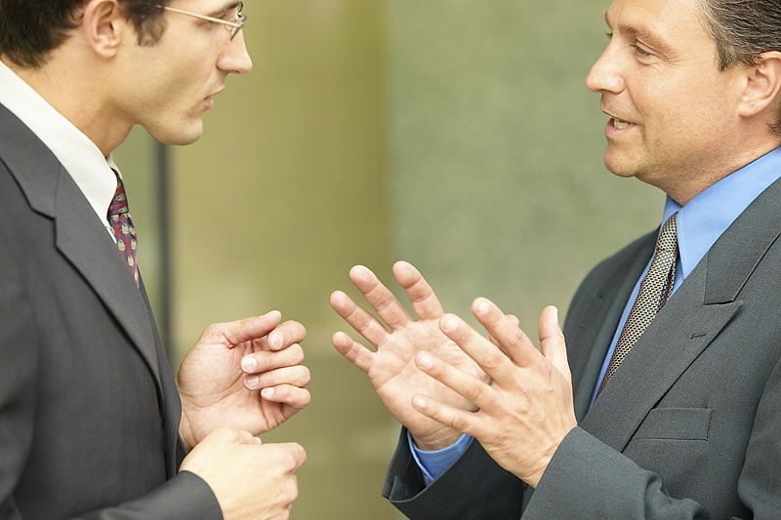
Notes:
As you show each picture, ask the following questions:
What do you think might be happening in this picture?
In what manner is/are the person/people responding? Passive, assertive or aggressive?
Is this a good response in this situation? Would you respond differently?

Slide 22
Which One is Usually the Best Response to Conflict?
Passive?
Assertive?
Aggressive?
Assertive!
Notes:
(When you click on this slide, each word will come up individually, then they will disappear and the correct answer (Assertive) will come up).

Slide 23
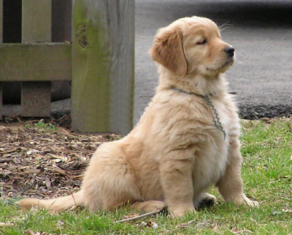
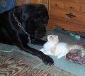
Asserting Yourself
Hold your head up high
Look at the other person
Use an “I” statement to tell how you feel
Notes:
Go over this information. The next slide will elaborate on the “I” statement.

Slide 24

Assert Your Feelings
Tell the person how you feel in a positive way. Use an “I” message:
I feel ______________________________
when you _________________________
because ___________________________.
What I want you to do is __________.
Notes:
Give students situations and have them use an “I” statement to role play an assertive response.
Activity Sheet 2 has some sample situations which can be cut apart and distributed to each student.

Slide 25

So, what do you think?
Why is ASSERTIVE a better way to respond than PASSIVE? Why is it better than AGGRESSIVE?
Notes:
Use this slide to lead a discussion on today’s lesson.

Slide 26

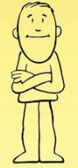

Don’t be hot!
“Social Power” Point
Be Cool!!!
aggressive
BLOWING UP!
assertive
IN CONTROL!!!
From John Stanfield’s “The Cool Way to Respond to Conflict”
Don’t be cold!
passive
GIVING UP
Notes:
This visual is a good summary of the information in this lesson. This slide has been made into a format that can be printed on card stock to give to each student (“Social Power” Point Card). You may also want to laminate the cards and place a magnet on the back as a visual that could be hung in the student’s home as a reminder of the lesson.

