Slide 1

What Should I Do When I’m Really Upset?
Usually everything at school is just fine. Kids listen to teachers and do their work, share, and play.

Slide 2

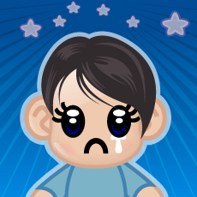
But sometimes a kid can get really upset. Sometimes kids just want to scream or cry.

Slide 3
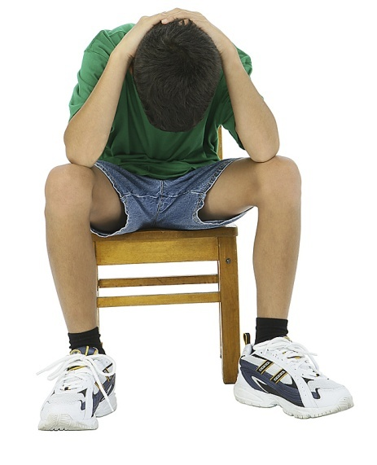
Sometimes kids just want to fall down. Sometimes a kid just can’t move.

Slide 4

When kids feel like that they can do things to feel better!
Let’s think! What can I do?

Slide 5
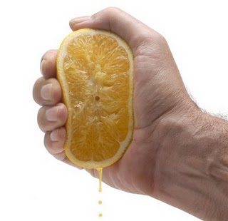
I can squeeze my hands and
pretend I’m squeezing an orange
Then get the teacher to
help you feel better. She
will know what to do.

Slide 6

Slowly count to five.
Then get the teacher to help me feel better. She will know what to do!

Slide 7
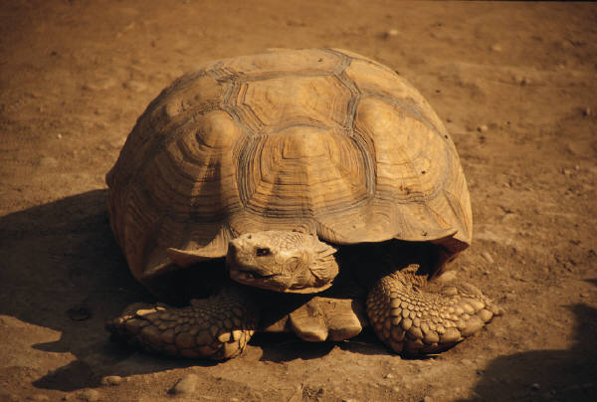
I can sit quiet and still and pretend I’m in a shell like a turtle.
Then I can get the teacher to help me feel better. She will know what to do.

Slide 8
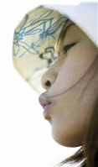
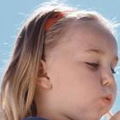

I can remember this rhyme and breathe in and out slowly.
Then I can get the teacher to help me feel better. She will know what to do.
Breath in breath out, no need to pout.
Breath one, breath two, I‘ll start anew!

