Slide 1

Talking and Friends

Slide 2
In my school we have some rules that kids in kindergarten know. One of the rules is to
USE AN INSIDE VOICE.
INSIDE VOICE means in the middle.
See what an inside voice looks like

Slide 3

STOP!
Middle one – INSIDE VOICE – use this
Can’t hear, too quiet

Slide 4
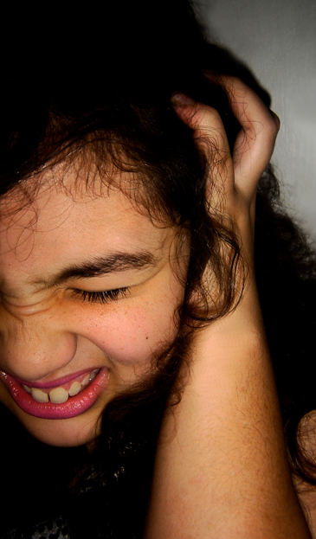
INSIDE VOICE or middle voice is a good rule. If we talk higher then it is too LOUD and no one can hear the teacher!
Someone is talking so LOUD I can’t hear my teacher at all!!

Slide 5
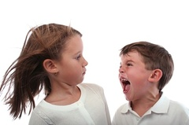
If we talk higher then it could hurt someone’s ears.
WOW, my ears really hurt – he is really LOUD!

Slide 6

Sometimes I forget because I get excited and I go higher than in the middle.
If I forget I can just say it again in an INSIDE VOICE.
Oh no, I forgot and talked too HIGH!
I have to remember to talk in the MIDDLE

Slide 7

If I remember to use an INSIDE VOICE in the middle, my teachers will be so proud of me. I’ll be happy too!!
Inside voice – just right!

