Slide 1
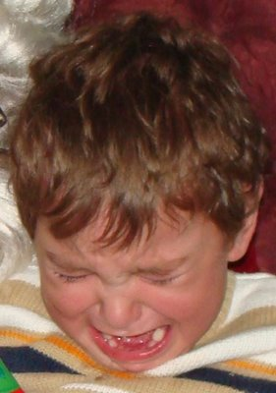
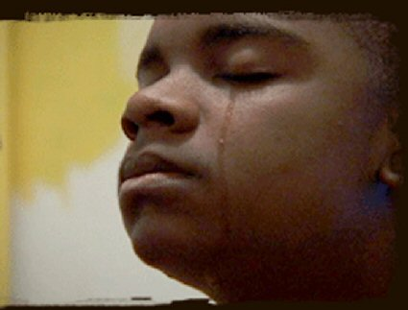
Someone is Crying
Sometimes in school, someone in my class cries.
Maybe they don’t feel well.

Slide 2

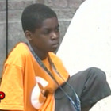
Maybe they got hurt.
Maybe they feel sad.

Slide 3

When someone is crying, I can Say,
“Are you OK?” or
“What’s wrong?”

Slide 4
When someone is crying, I don’t have to cry.
When someone is crying, I don’t have to be sad.

Slide 5
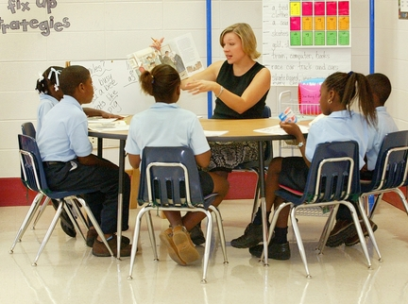
When someone else is crying, I will try to keep working.

Slide 6
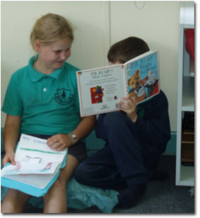
If I need to, I will ask the teacher if I can move to a quiet place in the room.

