Slide 1
Individual Schedules
“A Routine to Teach Flexibility”
Visuals to show activities that will occur and in what sequence
A visual to help students understand “what’s next”
Type of schedule based on child’s abilities and interests

Slide 2
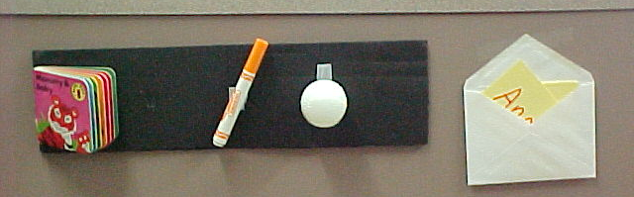
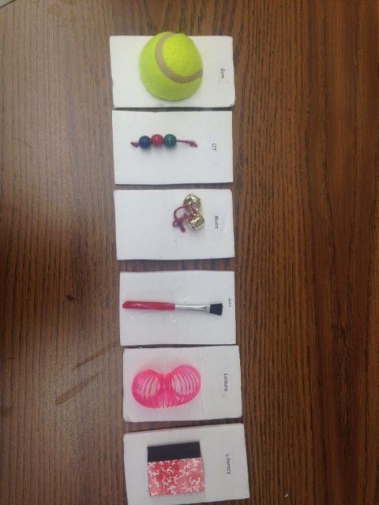
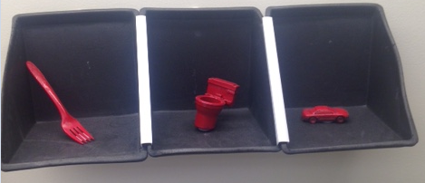
Object Schedules:
Object schedules are used for students who require a very concrete way to understand what activities are scheduled. Each object corresponds to a center or activity. The student holds the object as he/she transitions to the activity.
This schedule was created for a student with a cortical visual impairment. It is velcroed to the wall and can then be portable throughout the classroom.

Slide 3
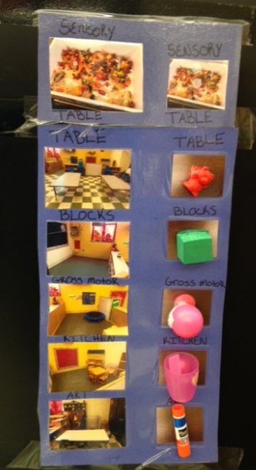
Picture /Object Schedule
Preschool Setting
In this preschool setting a picture is paired with an object. As the student demonstrates increased understanding, the objects will be faded.
Leap Preschool

Slide 4
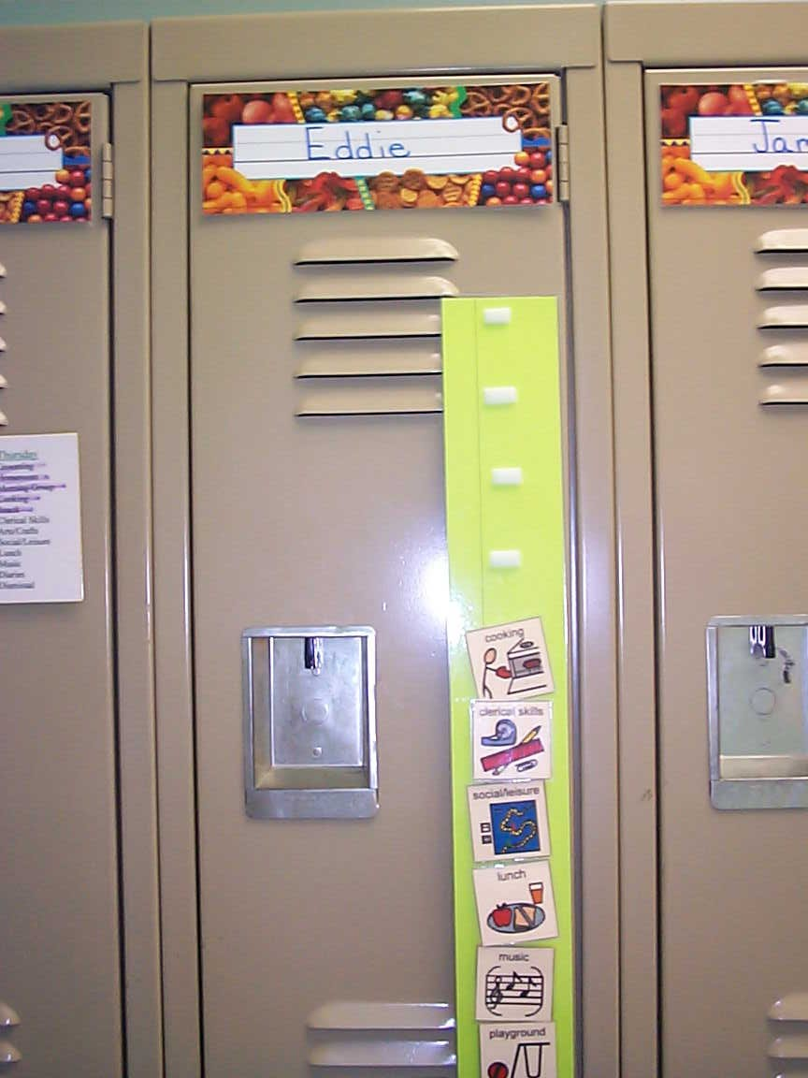
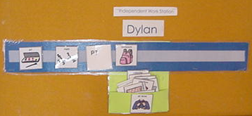
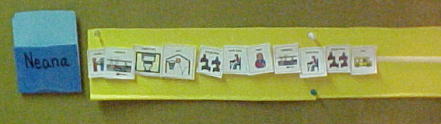
Picture Schedules:
Picture schedules are useful for students who are not yet reading. The pictures are paired with the typed or written word.

Slide 5
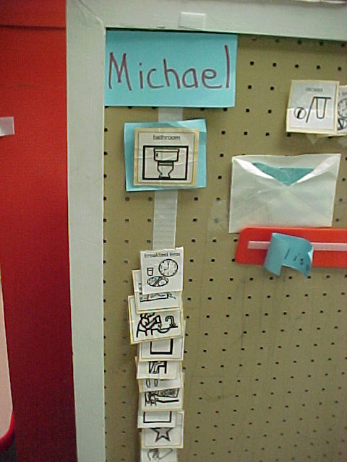
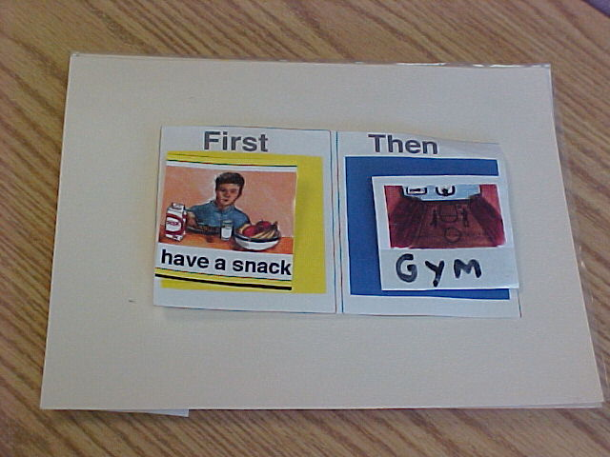
This picture schedule was made on a file folder. Pictures are stored inside the folder. This is an example of a very simple picture schedule in a “First-Then” format.
This picture schedule includes a blue card at the top which outlines the next activity. This was designed for a student who was having a difficult time understanding which activity came next.

Slide 6
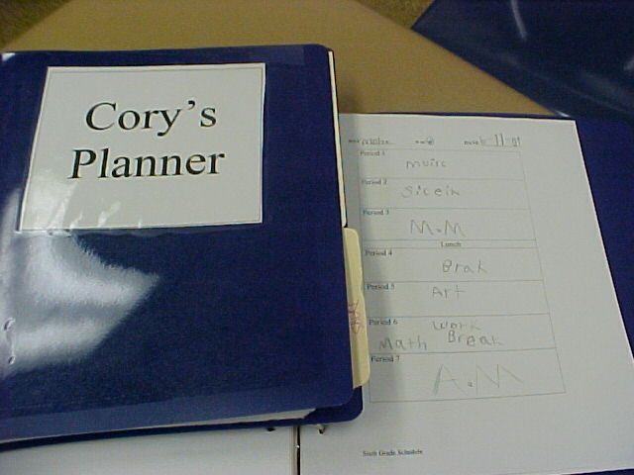
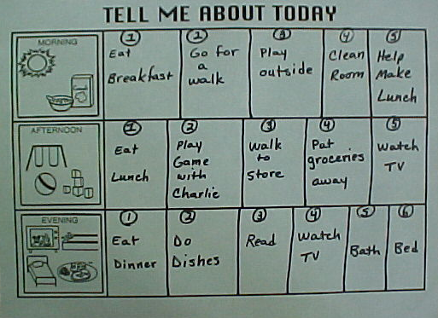
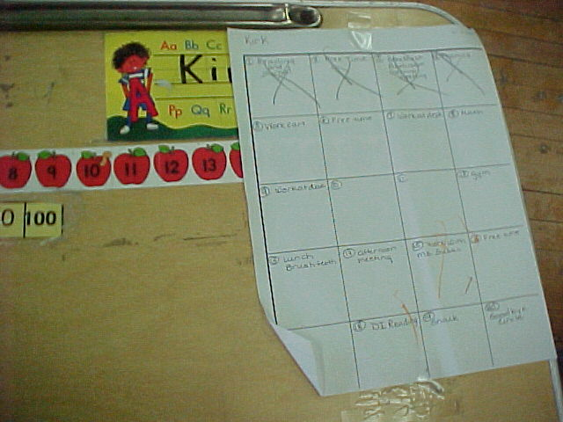
Written Schedules:
Written schedules are used for students who are already reading. They are very easy to develop and can change as needed. Students can use a pencil or marker to transition to their schedules and cross off each item as it is completed.

Slide 7
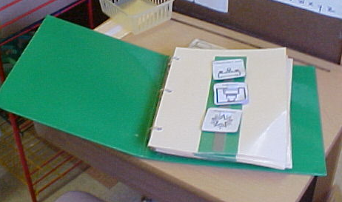
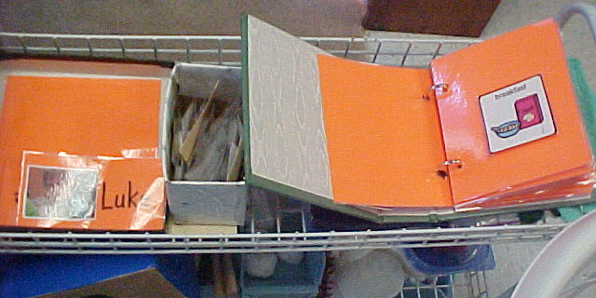
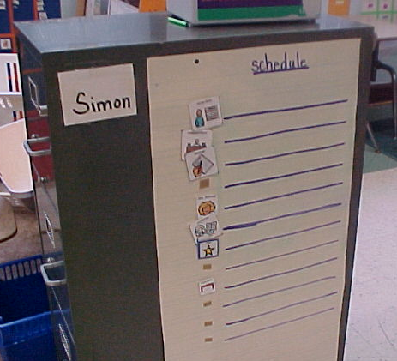
Individualizing Schedules
This picture schedule has been created in a binder that can be stored in the student’s desk. This limits the opportunity for the student to move pictures around or play with pictures that are more accessible.
This picture schedule shows one picture at a time. This was designed for a student who was easily distracted when checking his schedule
This schedule was developed for a student who enjoyed writing on wipe off boards. The schedule is laminated so that the student can write the name of the activity or center as he transitions.

Slide 8
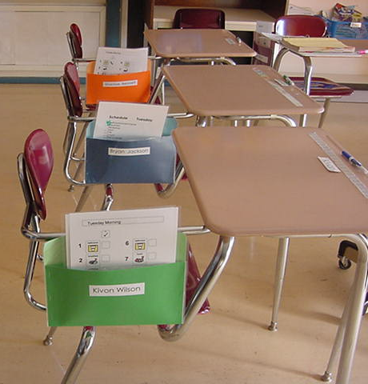
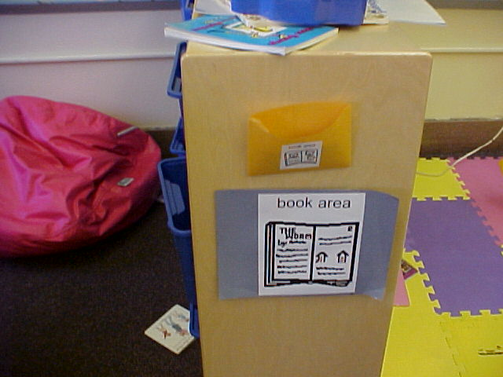
This classroom has individual student schedules in pockets that hang on the side of the student desks.
Pockets can be placed in classroom centers to hold schedule cards.

Slide 9
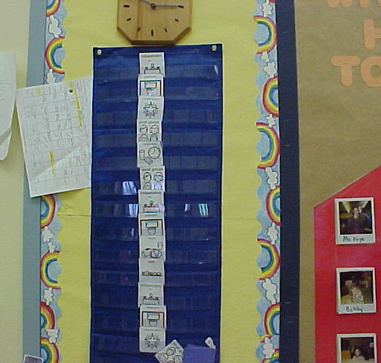
Whole Class Schedule:
A full day schedule for classrooms should also be displayed visually.

Slide 10
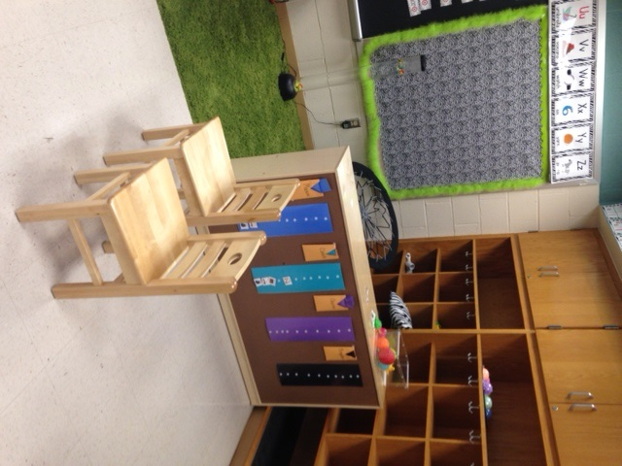
Schedule Location
Students can access their schedules immediately upon entry to the classroom – door to the right

Slide 11
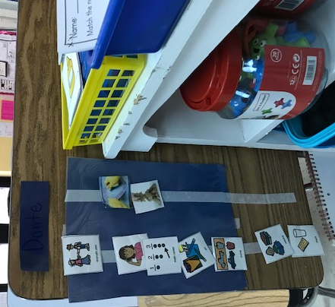
Schedules Indicating Use of Centers, Pre-Voc Jobs, Instruction, and Preferred Activity – Life Skills Elementary
Dramatic Play
Listening Center
Math Center
Art Center
Puzzle Center
Reading Instruction
Snack Time
Washing Dishes
Sand play

Slide 12
 | Work Day
 | ARRIVAL – PUT BELONGINGS AWAY AND USE RESTROOM
 | REVIEW DAILY SCHEDULE-
 | WORK TIME IN KITCHEN
 | BREAK TIME
 | ACTIVITY –
 | LUNCH
 | SOCIALIZE WITH FRIENDS
 | WORK TIME/ ACTIVITY
 | LEISURE TIME
 | CLEAN UP
 | DEPARTURE FOR HOME- GATHER BELONGINGS AND USE RESTROOM
Sample Work Day Schedules
 | Monday
 | Bathroom / Hygiene
 | Workbench / In House Community Based Instruction
 | Swimming
 | Bathroom
 | Calendar
 | Workbench
 | Lunch / Socialization
 | Bathroom / Hygiene
 | Workbench /In House Community Based Instruction
 | Leisure Skills
 | Bathroom / Home
Community Based Job Site
In School Work Schedule

Slide 13
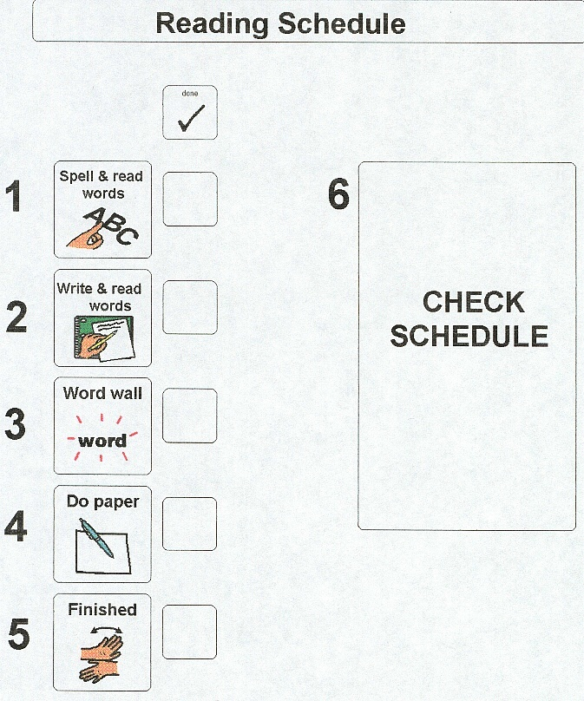
Mini-Schedules
Mini-Schedules define what will take place within a specific time period of the whole day. They can be powerful tools for student engagement, focus, and task completion.
This example shows an academic mini-schedule for reading class.
http://www.cindysautisticsupport.com/

Slide 14
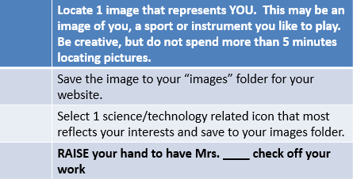
Mini-Schedules
Work To Do
____________
____________
____________
_____________
Mini-Schedules can simply be a listing of activities on paper – student, teacher, or support adult can fill in before a task or class begins.
This example shows a section of a mini-schedule for a computer class
Pittsburgh Public Schools

Slide 15
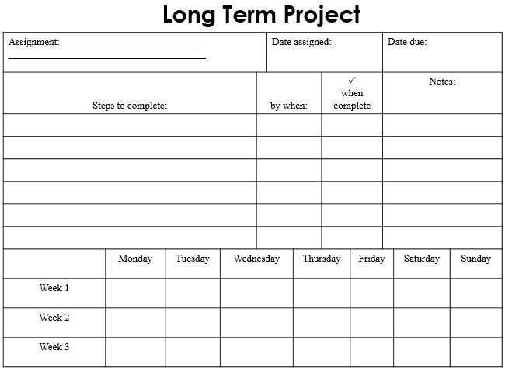
Research Project – Long Term Project Schedule
Get Organized Without Losing It by Janet Fox

Slide 16
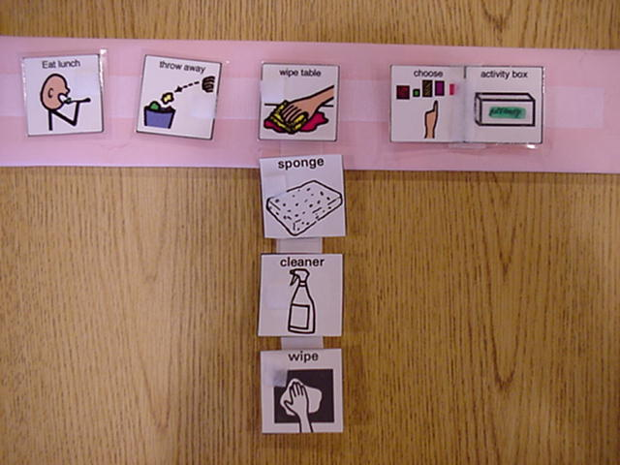
Mini-Schedules
This mini-schedule utilizes pictures and words for students who are non-readers or emerging readers. It includes 2 mini-schedules in one.

Slide 17
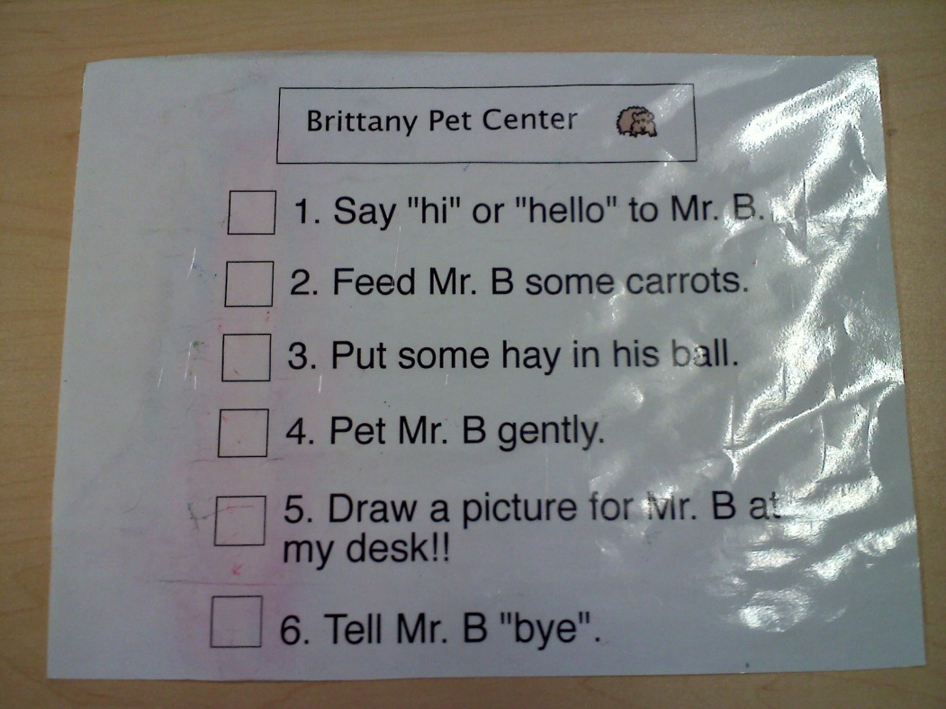
Pet Center Mini-Schedule
This mini-schedule is for use in a center area (pet center) of the classroom.
Norwin School District

Slide 18
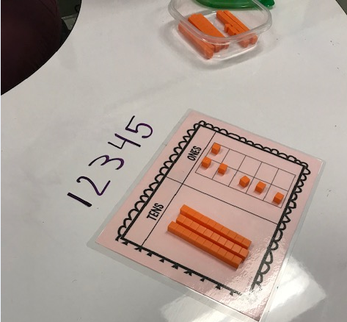
‘In the Moment’ Mini-Schedule
When a student continually asked: “Are we done?” A quick use of a marker on the desk in front of the student indicated the # of problems to complete. As each problem was solved the numeral was erased.

Slide 19
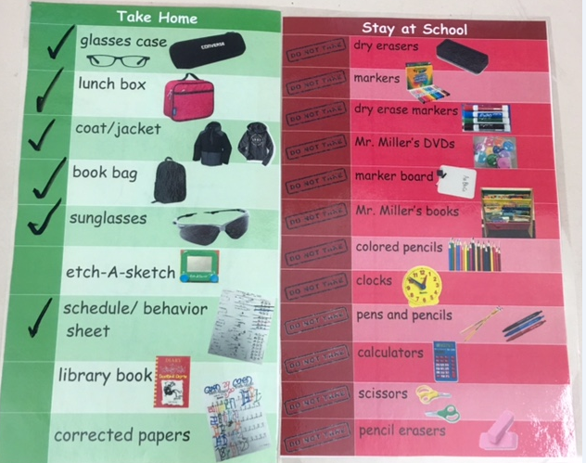
End of day Scheduled Checklist for Targeted Behavior – Taking Items Home

Slide 20
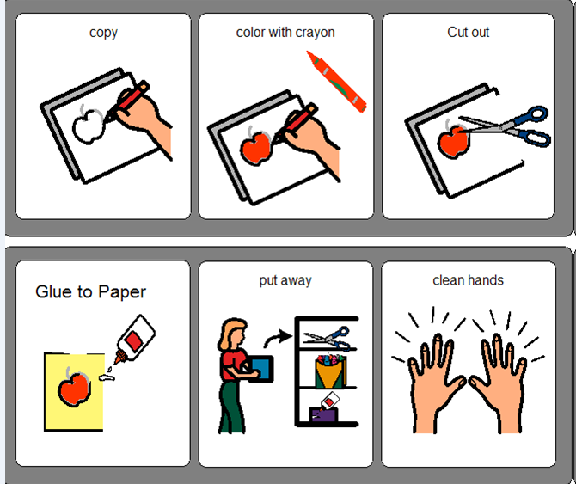
Art Center Schedule

Slide 21
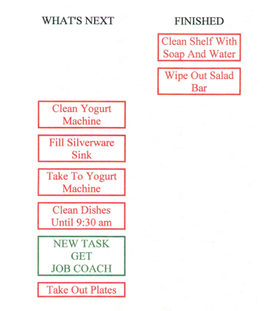
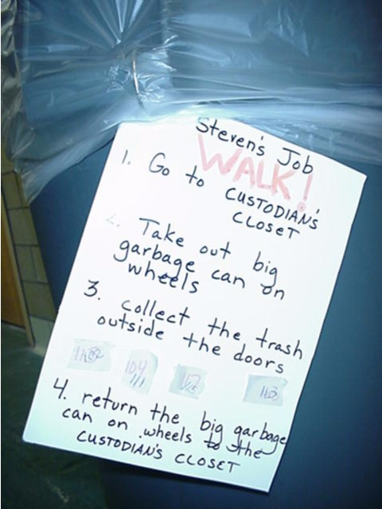
VOCATIONAL MINI-SCHEDULES
In School Job
Mini-Schedule on the job site
TEACCH

Slide 22
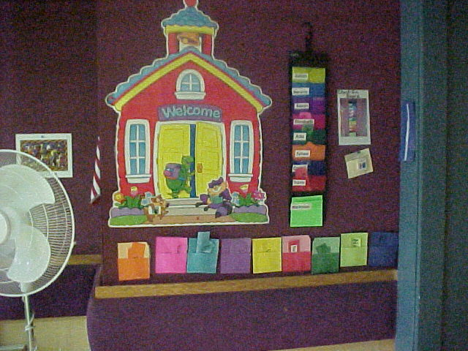
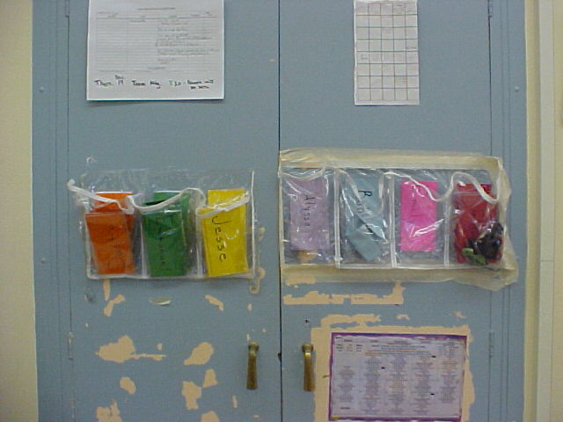
Transition Cards:
Transition cards can be handed to a student to indicate that it is time to check his/her schedule. Transition cards can be color coded and a student’s name is often printed on the card. A pocket near the student’s schedule holds the transition cards.
Pittsburgh Public Schools

Slide 23
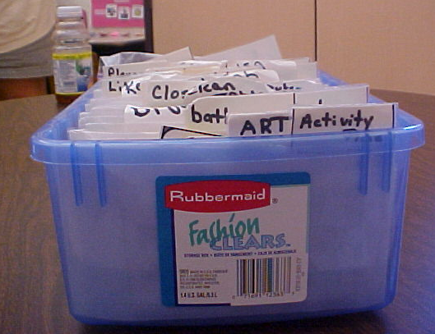
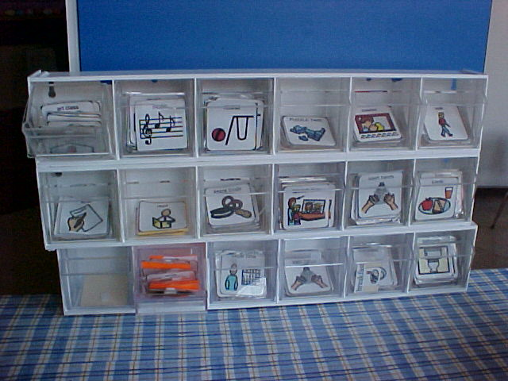
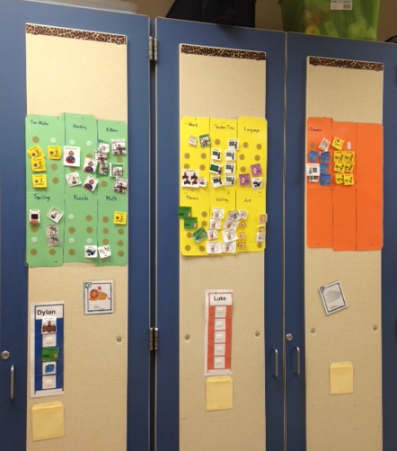
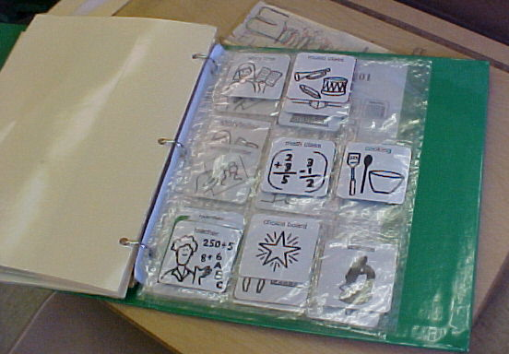
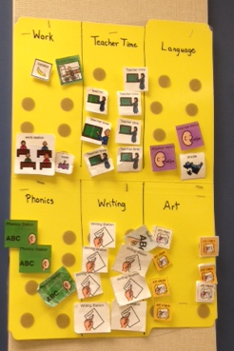
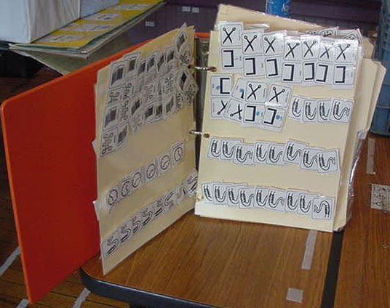
Storing Schedule Cards
Pittsburgh Public Schools & The Watson Institute
Chartiers Valley School District

Slide 24
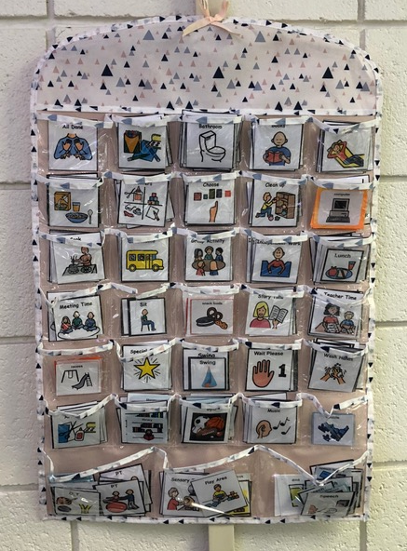
More …Storing Schedule Cards
Jewelry holder purchased at ‘5 Below’ – perfect for storing schedule cards!
Butler School District

Slide 25
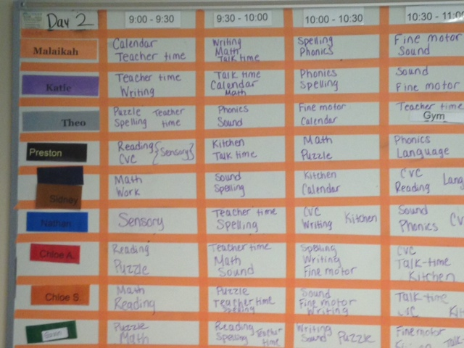
Adults need Schedules Too!
Bonnie
Kate
J.T.
Pauly
Joey
Julie
Michele
Gina

