Slide 1
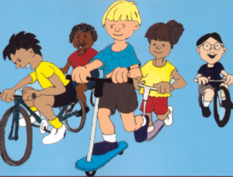
New Friends
Adapted from ‘My Friend with Autism by Beverly Bishop; Illustrated by Craig Bishop
Available now with CD

Slide 2
There are new friends at our school.
Some of our new kids have ears that work really well. They can hear sounds I can’t hear. That is why sometimes they cover their ears!
Adapted from ‘My Friend with Autism by Beverly Bishop; Illustrated by Craig Bishop
Available now with CD

Slide 3
Our friends eyes work really well. Sometimes they see little things other kids might not even notice! Sometimes bright lights can hurt their eyes.
Adapted from ‘My Friend with Autism by Beverly Bishop; Illustrated by Craig Bishop
Available now with CD

Slide 4
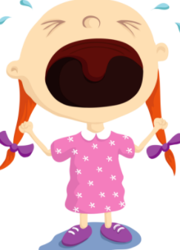
Change is hard for our new friends. Coming to a big new school was very hard. Sometimes they just want to go home but don’t know how to tell everyone. So they might just lay down and cry.
Teachers will help my friends feel better.
Adapted from ‘My Friend with Autism by Beverly Bishop; Illustrated by Craig Bishop
Available now with CD

Slide 5
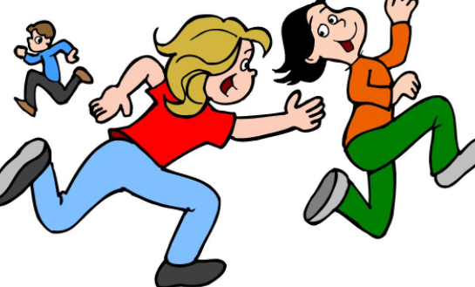
Some of our new friends are still learning to talk. Talking can be hard. Their brain works a little different.
Some of our friends love to run and swing. We can play games with lots of moving, running, and swinging!
Adapted from ‘My Friend with Autism by Beverly Bishop; Illustrated by Craig Bishop
Available now with CD

Slide 6
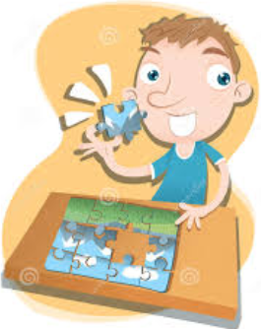
Our new friends can do many things better than us! Some of our friends are REALLY good at puzzles. Some of them are really strong. Some are great at running and swinging. Some kids really want to be friends!
We can be good friends by understanding and helping our friends when we can. They like friends just like we do.
Adapted from ‘My Friend with Autism by Beverly Bishop; Illustrated by Craig Bishop
Available now with CD

