Slide 1
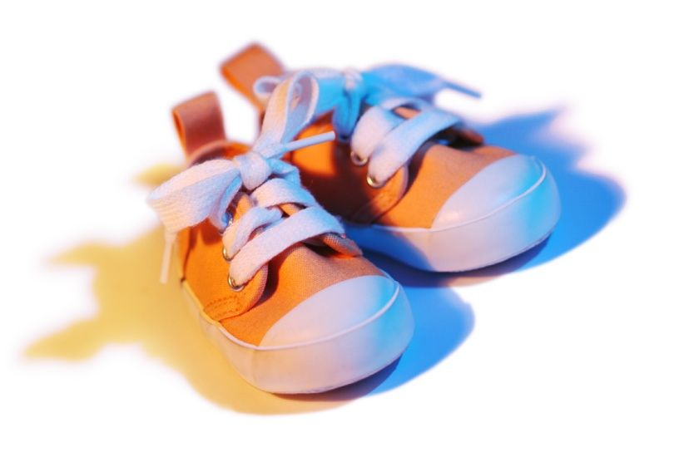
My Shoes

Slide 2
When I leave my house, I wear my shoes.

Slide 3
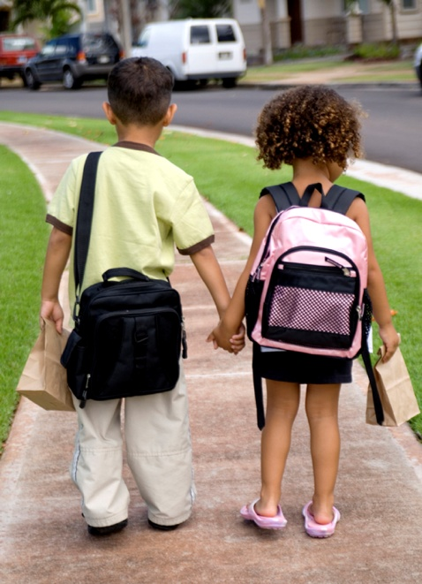
I wear my shoes at school!

Slide 4
I wear my shoes outside!

Slide 5
My shoes keep my feet warm and dry!
We are shoes! We keep your feet warm and dry!

Slide 6
