Slide 1

Life Can Feel Unfair…But…
Things at school seem unfair to me!
Amisah.wordpress.com

Slide 2

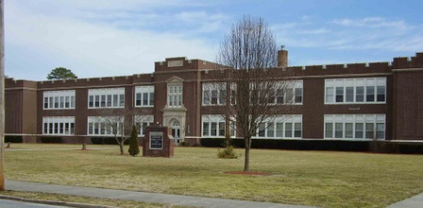

Kids in elementary and middle schools often find out that life doesn’t seem fair at times.
Most of the things kids complain about seem the same no matter where they go to school.

Slide 3
Many times kids complain that life isn’t fair at lunchtime.
Sometimes you get assigned to the worst lunch time. Sometimes you don’t get to sit with your friends.
Sometimes teachers make you late for lunch then you don’t have time to eat and play. Sometimes the lunch monitors yell at kids.
Do I know you guys?

Slide 4
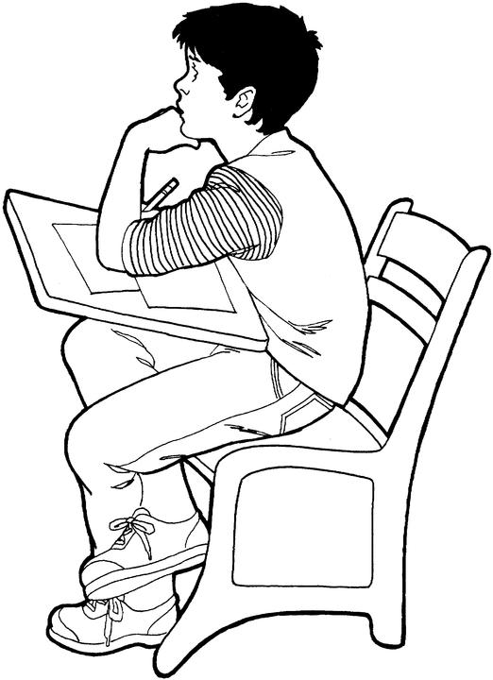
The good news is – it isn’t just one student who feels this way. It happens to almost everyone. Sometimes there are solutions, and sometimes you just have to find a way to feel better about it.
How can I find a solution…maybe I can try to just feel better?

Slide 5
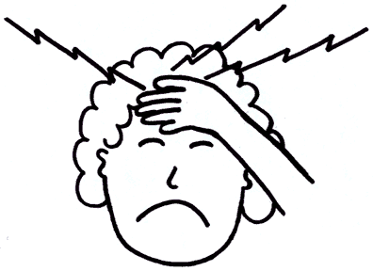
When there are hundreds of kids in a school the person who has to schedule the kids probably gets big headaches. That person can’t make everybody happy.
Changing a lunch period probably is not possible.
How can I schedule all these kids and lunch periods!
Dotolearn.com

Slide 6
When lunch monitors have lots of kids to watch they feel stressed and can yell. The best thing to do is to follow the rules.
There are too many kids…no one is listening, they are forgetting the rules, I think I have to yell!

Slide 7
How to Feel Better About Things That Can’t Be Changed
Focus on how hungry you are and that now you can eat your food.

Slide 8

Try to remember that you can see your friends later.
See you guys after lunch!
www.matafyde.com

Slide 9
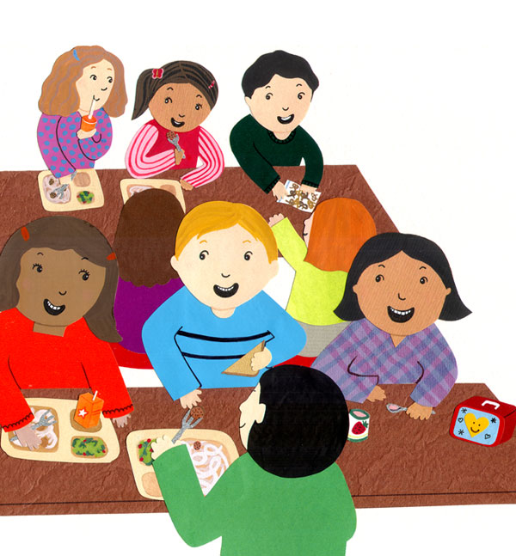
Remember that other kids probably feel the same way.
Hey, let’s try to follow the rules so the lunch monitor doesn’t yell at us!
I’m not with my regular friends but that’s OK I’m eating then I’ll see them at recess

Slide 10

Think About Telling An Adult Who You Like and Trust….
you never know – they might be able to make a small change and make things better.
Maybe we can work something out. But if not, we can think of ways to feel better!
I don’t like my lunch time, I might have to eat apples in the room!
www.grinningplanet.com

Slide 11

Hmmm, things aren’t that bad!

