Slide 1

I am Special and so is My Body!
I am a neat kid! I like lots of things in school. Some of my favorite things are:
_________________
_________________

Slide 2

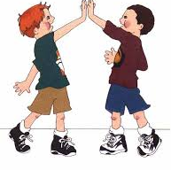
I have friends at school
Friends like to talk to each other
Sometimes friends pat each other on the back and say: “Good Job!” or give ‘high fives’

Slide 3
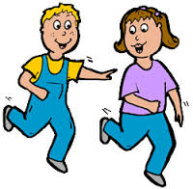

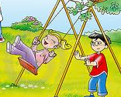
Sometimes we touch when we play a game like tag in gym class.
All of these touches are OK to do with friends.

Slide 4

I am a neat kid and so are my friends. My body is special too. My body has private places.
My private places are covered by my clothes.
People keep their private places covered in public and NO ONE should be touching my private places!

Slide 5

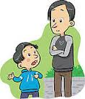
I have to remember NOT to touch anyone else’s private places either!
If someone tries to touch my private places I need to tell an adult RIGHT AWAY!

Slide 6

If I feel like touching someone I need to keep my hands to myself and tell my parents how I feel. They will help me with this.

Slide 7
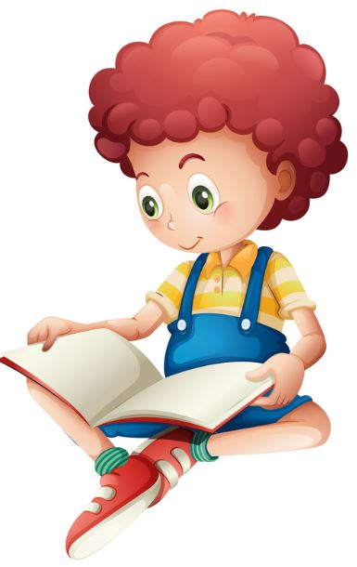
Sometimes I just feel CURIOUS
Curious means wanting to know more. It is OK to be curious.
When I feel CURIOUS about private places on a body I NEED TO TALK TO MY PARENTS.

Slide 8

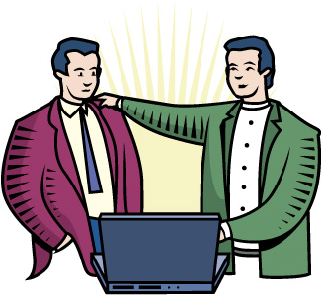
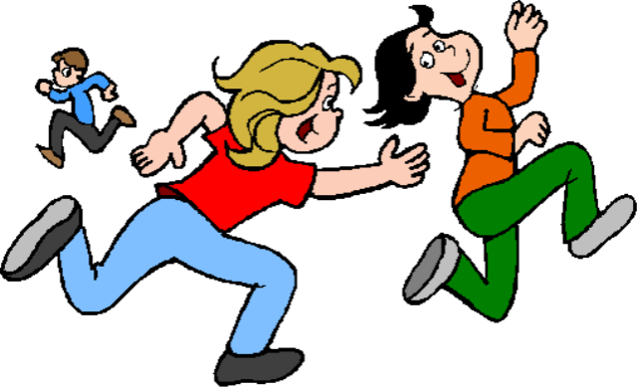
Good job, a pat on the back is OK touching!
High-five! This is OK touching!
I’m tagging you in gym. This is OK touching!

Slide 9

Remember, your body is special and no one should touch your private places.
Remember not to touch anyone else’s private places.

