Slide 1

Green Words and Red Words

Slide 2
Let’s talk about the words we use when we talk to our friends, teachers and family.
When we are happy and calm we usually use green words.
Green words help us stay happy and calm and friendly.
The next page shows people using green words

Slide 3
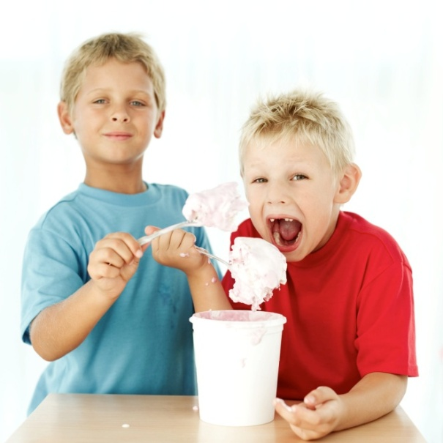
Here are some people using green words
like
fun
Share
These are green words – they are happy and calm and friendly.
I like ice cream. It’s fun to share.

Slide 4
favorite
great
These are green words too. Green words help us to be friendly and happy.
It’s great. Reading is my favorite class.
This is my favorite story.

Slide 5
Like
easy
Good
proud
Green words are everywhere. My teachers will be proud of me when I use green words.
That’s an easy one. The answer is 11. I like Math class.
Good. I’m proud of you.

Slide 6
But there are many red words out there too. Red words make us feel bad and angry. Red words are not friendly.

Slide 7
hate
Stupid
These are red words. They make us feel angry and sad.
I hate school. It’s stupid.

Slide 8
hate
can’t
dumb
My teacher doesn’t like red words. Red words make us feel bad.
I can’t do this. I hate it. It’s dumb.

Slide 9
Now we know about green words and red words.
Let’s try to use more green words everyday
happy
share
fun
like
No problem
great
simple

Slide 10
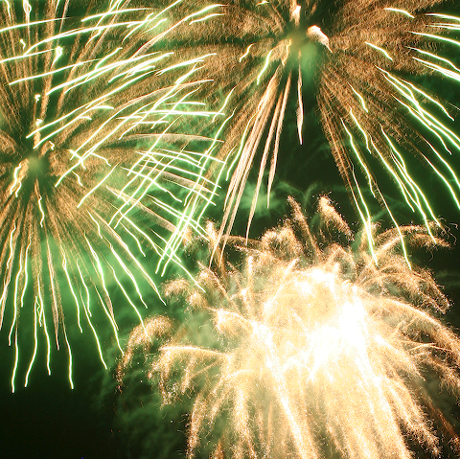

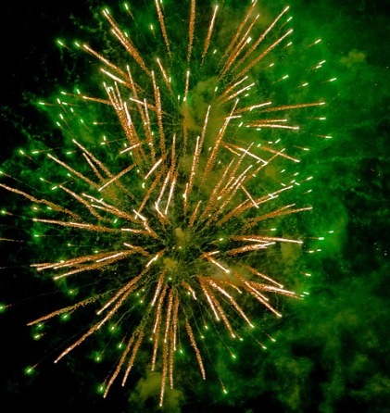
Green words – woo Hoo!!!!

