Slide 1

Everybody Thinks Differently
Everybody has a Point of View

Slide 2

I think a lot about things!
I have opinions about things.
The dictionary says an opinion is:
A person’s ideas and thoughts towards something.
It is a judgment of something.
An opinion is NOT a fact.

Slide 3

I definitely have an opinion about that but I think they have a different one. That’s OK

Slide 4
Everyone has their own opinions…
And that is GOOD..because the world would be boring if everyone thought the same!
How boring. We all think the same! We’re starting to look the same!

Slide 5
Since everyone has an opinion…
Some people might disagree on things. That is OK too.
People can AGREE TO DISAGREE.

Slide 6
At School…
When we discuss things at school, I have an opinion – like about a story.
But another student might have a different opinion than me.
When that happens it is fun to tell each of our opinions AND THEN STOP.
This was fun sharing opinions. We should stop now so we DO NOT ARGUE.

Slide 7
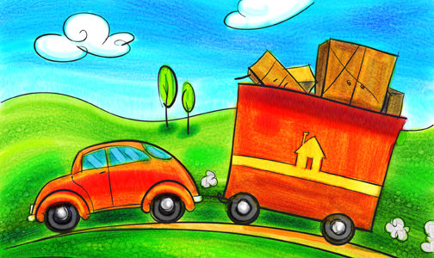
IT IS NOT A GOOD THING TO ARGUE
Each student tells their opinion and why it is their opinion
AND THEN…..
They should stop and move on with what they were doing…..

Slide 8
When people argue about opinions they start to feel bad.
I didn’t want to argue. I feel so bad now!

Slide 9

They Should Celebrate That They Can Share Their Ideas!
We share great ideas!!! High Five!!

Slide 10

There are some countries…
Where people are NOT ALLOWED to share their opinions. How sad for them!
Some of us can share our opinions BUT some of us CANNOT!

Slide 11
We are lucky in our schools to share and disagree
THEN MOVE ON!
No problem. I like to hear other opinions
Thanks for sharing your opinion even though it is different than mine!

