Slide 1
Classroom Centers
A Variety of Centers Can Be Created to Encourage Student Engagement and Independence
Centers Can Include:
Writing
Computer/Ipad
Language Master
Listening
Sensory
Language
Break/Leisure
Reading/Library
Art
Language Arts/Math
Fine Motor/Puzzle
Play area/Building Center
Vocational/Hygiene

Slide 2
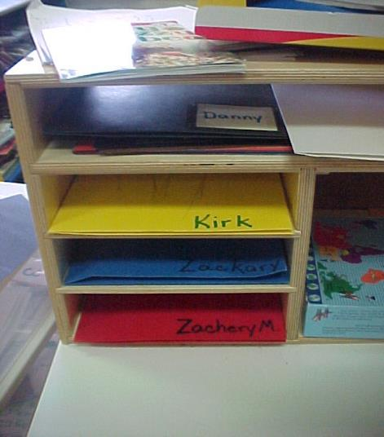
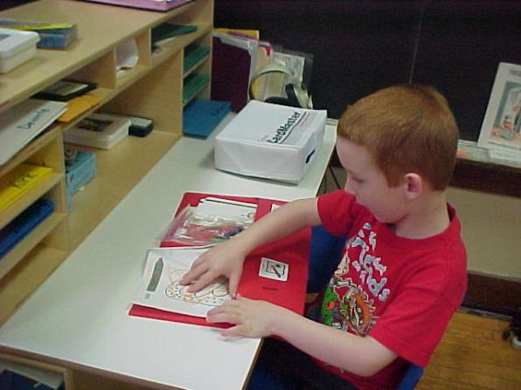
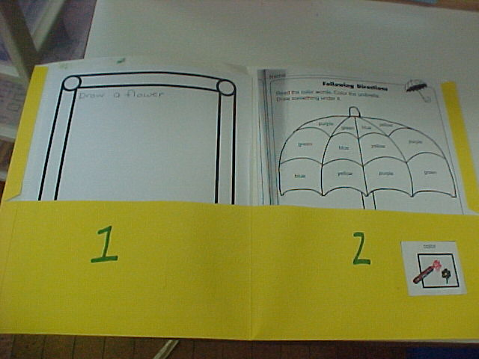
Writing Center:
This writing center is set up so that each student has individualized tasks to complete. The folders are labeled and visually organized to increase independence at this center. Materials that can be located at a writing center can include:
A variety of writing utensils
Variety of paper, white boards, Etch-A-Sketch or Magnadoodle,
Journals, diaries
Stencils, scissors, glue, tape, paper clips, stapler
Lap top/ Ipad
Alphabet stamp sets
Envelopes, stationary
Class Materials that promote IEP goal completion

Slide 3
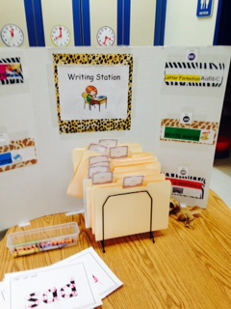
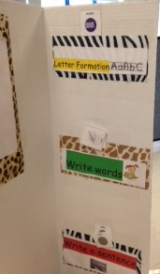
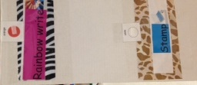
Writing Center:
Writing activities aligned to the curriculum
Chartiers Valley Primary School

Slide 4
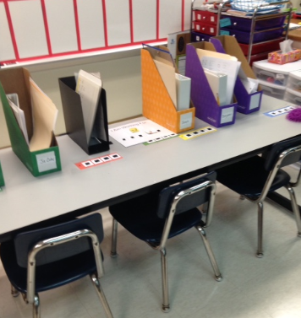
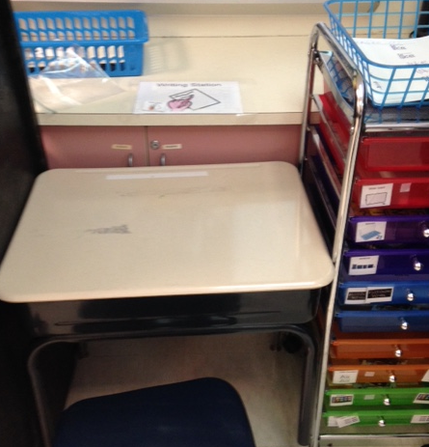
Writing Center
Chartiers Valley School District
Student chooses the drawer that is listed on their schedule or placed on the desk
Student either locates his name on boxes or matches a # on his/her schedule to the box. Boxes contain writing tasks based on their IEP goals.

Slide 5
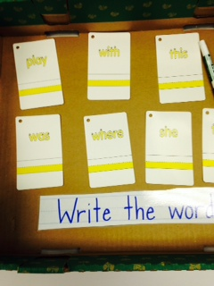
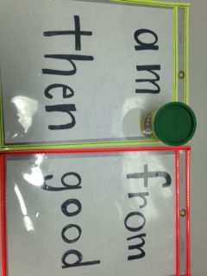
Writing Center Activities
Students trace with 3 different colors OR use playdoh to make the letters
Commercial kit with laminated cards used in a writing center
Keystone Oaks and Chartiers Valley School District

Slide 6
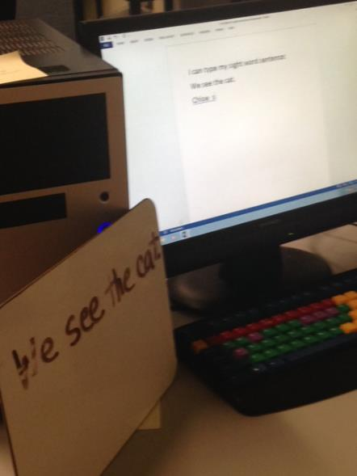
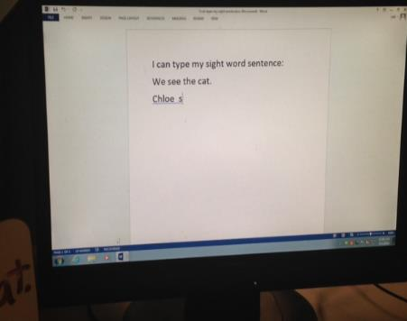
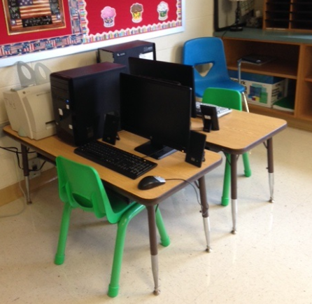
Computer Center:
There are many ways to use the computer center. Some students may complete writing or spelling assignments at the computer center while others may be assigned educational software games. Typing practice, internet research, and learning to write and receive emails can occur at this center. Some classrooms also use the computer center as a motivator and/or break area for students and include more game software. For older students learning to use the computer, it serves as a leisure and social skill.
Chartiers Valley and Trinity Area School Districts

Slide 7
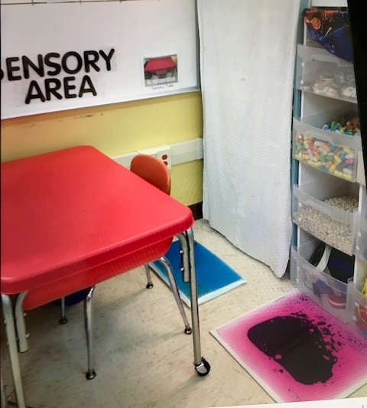
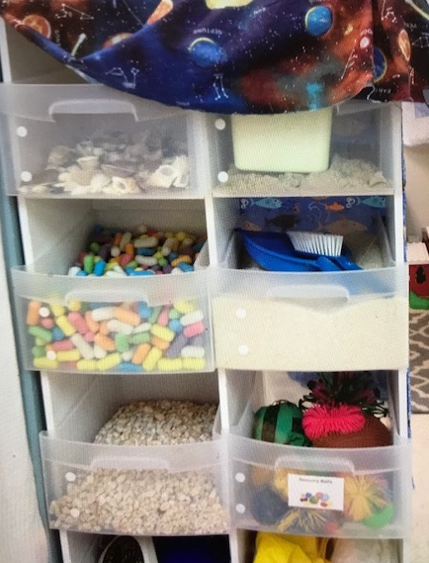
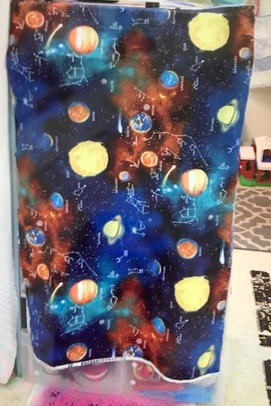
Small area organized to accommodate a sensory table.
Garage sale purchase of furniture that holds drawers containing items used in the Sensory Table – covered with cloth to ‘hide’ until utilized

Slide 8
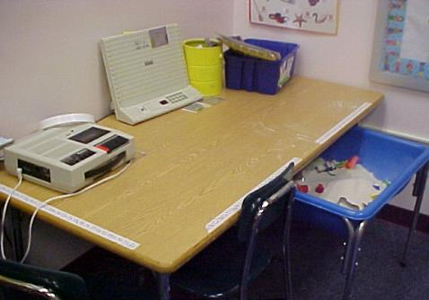
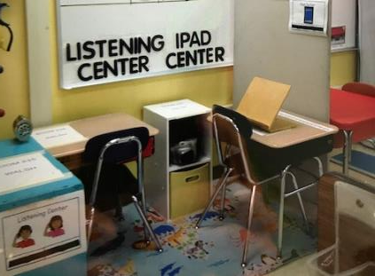
Listening/Sensory Center:
This center was designed for a classroom with limited space. This corner serves as both a listening center and as a sensory center (sand table).
Listening Center:
This small area is organized to maximize use utilizing the space as a Listening Center with story books and an Ipad Center

Slide 9
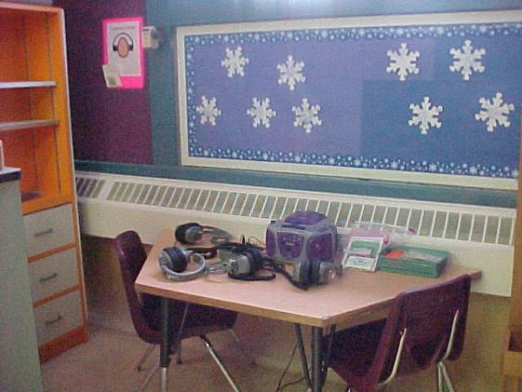
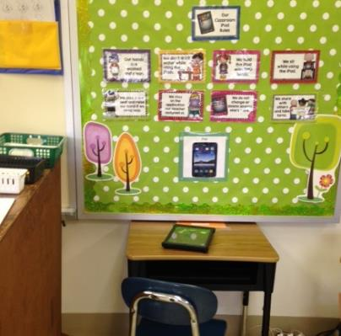
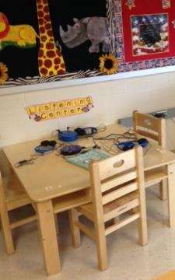
Listening Centers:
Listening Centers can include:
Books on tape or CDs
iPads with story Apps
Following direction activities
LeapPad
Music on tape or CD
Language Master
Middle & High School
Pittsburgh Public Schools
Trinity Area SD
Ipad Center with posted rules. A timer is set. Some teachers create a list of academic programs for the student to choose from.
West Jefferson Hills SD

Slide 10
Language Master or Card Reader Center:
A Language Master or Card Reader with its simple to use language cards allows students to work independently and receive repeated practice with immediate reinforcement. Sliding a prerecorded card through the player allows the student to hear the name of the letter, word, shape, color or vocabulary word that is displayed on the card. Pre-recorded packages of cards are available as well as blank cards that can be programmed to reinforce new concepts and vocabulary. Students with autism and other students with special needs benefit from repeated practice in learning the names of pictures, objects and sight words. The language master cards can be placed in shoe pockets by student name, or by a number, or other designation. Notice small bins for indicating beginning and “finished”.
For more information about this product check out the Califone website:
www.califone.com
Note: Many teachers have made this activity interactive by providing visual Velcro responses to choose from when hearing the recorded cue. (see following slides)
Intermediate Unit 1

Slide 11
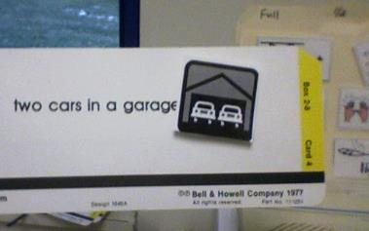
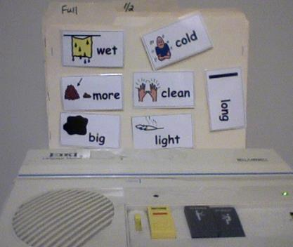
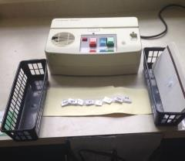
Language Master or Card Reader Center:
Many teachers have made this activity interactive by providing visual Velcro responses to choose from when hearing the recorded cue.
For more information about this product check out the Califone website:
www.califone.com
Chartiers Valley School District

Slide 12
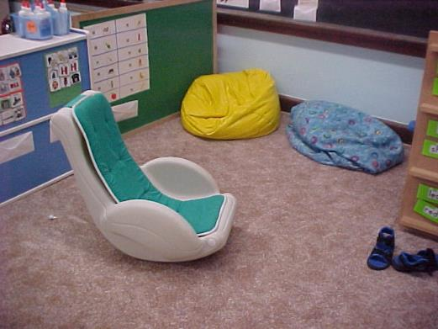
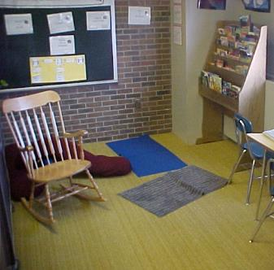
Break Area or Rest Area
This area can include materials for sensory needs and materials that are calming and/or motivating to students. Elementary classroom break areas may include shelves with toys and puzzles. Language tasks are taped on the back of the shelves offering more independent engagement.
Break areas in a Middle School or High School classroom can contain age-appropriate activities such as a computer, iPads, magazines, books and board games. Visuals for helping students decide what to do with their free time are added on the blackboard in the picture to the right.
Pittsburgh Public Schools

Slide 13
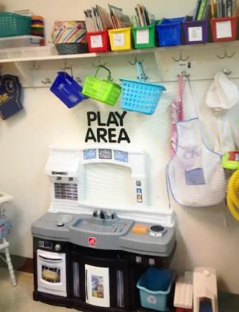
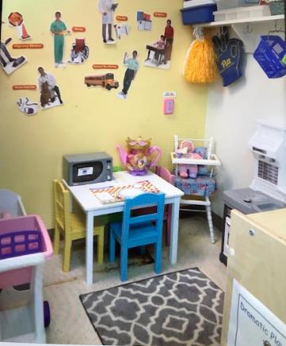
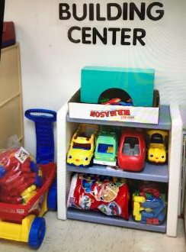
Play Area – Promotes Life Skills and Communication from an Early Age
Kitchen, Babies, grocery carts, aprons
Not shown – road map and additional blding items including blocks

Slide 14
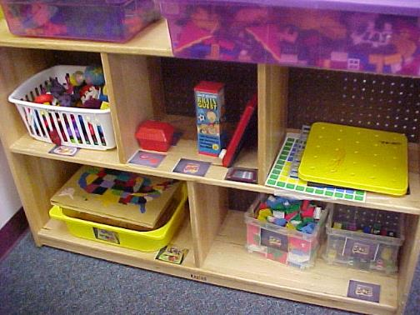
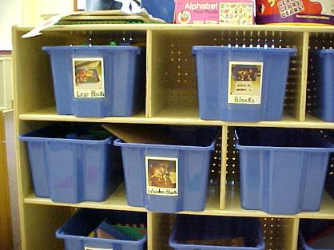
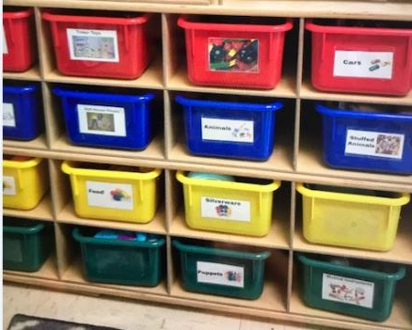
Break or Play Area Storage:
Note visual organization and labeling. This makes it easier for students to independently access and clean up areas. Labels can be made by writing or typing, using Clip art or actual photographs
Pittsburgh Public Schools and West Jefferson Hills School District

Slide 15
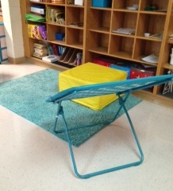
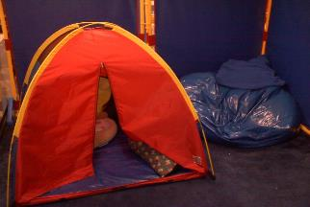
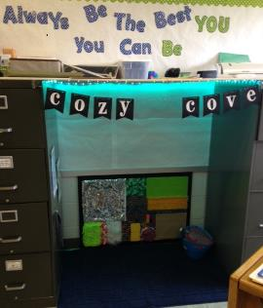
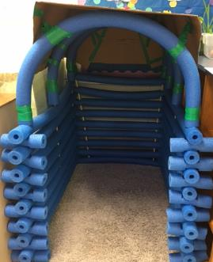
FAVORITE BREAK AREA ‘LOUNGES’
Norwin & Trinity Area School District
Bungie Chairs can offer sensory input during leisure/break times
Children often love enclosed environments to read or handle anxiety
Butler Area School District
Ideas from Pinterest!
West Jefferson Hills School District
Ideas from Pinterest!

Slide 16
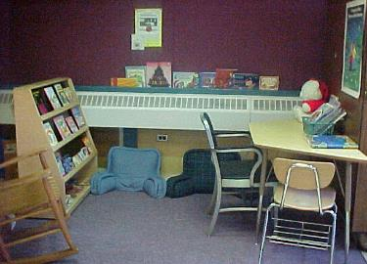
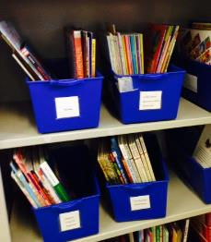
Reading or Library Center:
Comfortable seating and visual organization of age appropriate books and magazines make the reading center a favorite. Some additional materials that can be included in a reading center are:
Scrapbooks or Photo Albums
Folder Matching Games
Magnetic Letters
Comic books or Catalogs
Cookbooks or Menus
iPads
Pittsburgh Public & Keystone Oaks School Districts
Cindysautisticsupport.com

Slide 17
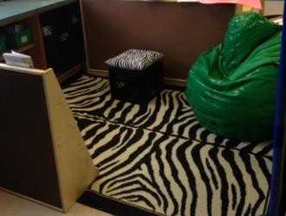
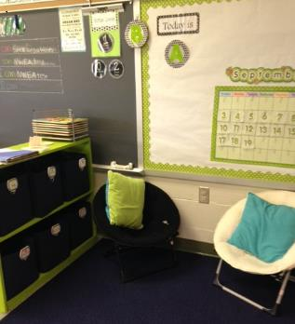
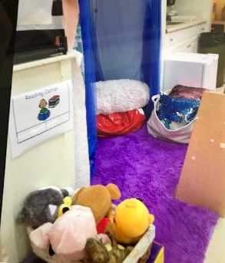
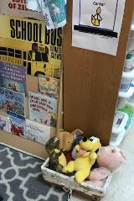
Reading Centers Lower and Higher Elementary
Trinity Area School District
Note the curtain and beanbag/cushion providing ‘private’ time and a Velcro strip for the student’s schedule card. Favorite stuffed characters to match books are available.
West Jefferson Hills School District

Slide 18
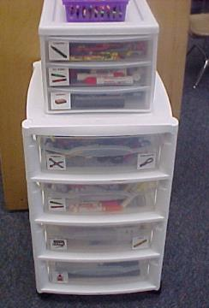
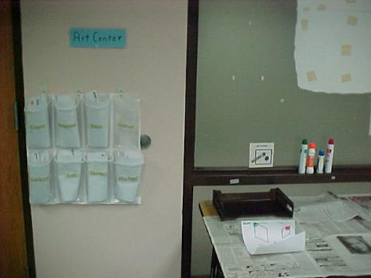
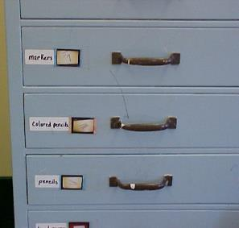
Art Center:
The art center includes a wide variety of art items. Materials for drawing, painting, coloring, and making collages can be included. Careful organization and labeling of storage is important. Students can be assigned tasks to complete in this area or can be given time to choose materials and activities.
The art center below uses shoe pockets to designate each child’s task. The materials and visuals for completion of the tasks are on the art table.
Pittsburgh Public Schools & Intermediate Unit 1

Slide 19
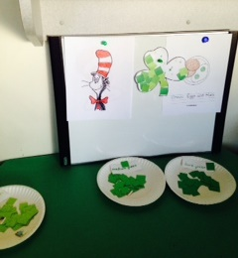
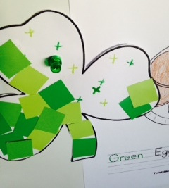
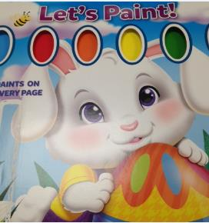
ART CENTER-THEMED/CURRICULAR and COMMERCIAL ITEM
The Cat in the Hat, Green Eggs and Ham, and St. Patrick’s Day – Current Regular Education Themes carried over to an Art Center with choices for activities.
Note the visual supports: Completed models displayed and small ‘x’s to guide placement of the tissue paper
Keystone Area School District
Students loved painting from pages in the large ‘Let’s Paint’ booklet. The teacher placed pages in the art center for the Art Center Activity – nothing to prepare
Trinity Area SD

Slide 20
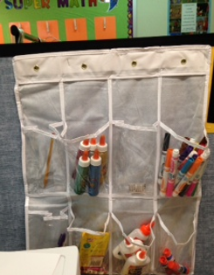
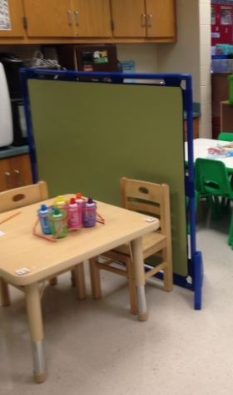
Art area located near sink
Shoe holder art storage
This container sequences the materials needed for a project. Student has a matching strip of colors to designate the order with a reward shown at the completion of the strip.

Slide 21
Art Centers Middle & High School
Art centers for older students include a variety of age-appropriate materials that can include Special Interest Areas as well. This type of center serves as a leisure activity that can follow students into adulthood.
Pittsburgh Public Schools
Art Center – students can work here or gather items and take to their designated area
Butler Middle School

Slide 22
LANGUAGE ARTS - Teachers utilize materials found in their classrooms to create centers
Chartiers Valley Primary School
This center was made from an existing child easel and cut-outs from a coloring book:
This center utilized a dry erase board and magnetic letters. Note the visual support ‘mini-schedule’ for words. As the student completes making the word he/she checks it off as completed

Slide 23
Keystone Oaks & Chartiers Valley School Districts
LANGUAGE ARTS - Teachers make & use materials found in their classrooms to create centers
CVC Word Building: Magnetic Tray – found in car repair section to catch oil and magnetic letters
Magnetic Shelves and dividers used for make words

Slide 24
LANGUAGE ARTS - Teachers use materials found in their classrooms to create centers
Chartiers Valley & Keystone Oaks Districts

Slide 25
Phonics:
Word sort
Language Arts Classroom Materials to Create Centers
Spelling Center – Student can use magnetic letters or write on white board. When completed student flips the word over in the holders

Slide 26
LANGUAGE ARTS - Teachers use materials found in their classrooms to create centers
Chartiers Valley School District

Slide 27
West Jefferson Hills SD
Categorizing
Keystone Oaks SD
Teacher utilized the side of a filing cabinet and magnetic ‘knobs’

Slide 28
Children who have a difficult time with paper/pencil tasks love this grammar center – correcting mistakes.
See one student’s response to the center below
Though a little difficult to see, this teacher left a message for the student to create his own sentences for the teacher to correct.
West Jefferson Hills School District

Slide 29
Math Center
Each student has a strip with colors or numerals designating what bin tasks to complete in the math center

Slide 30
Velcro activity located on divider
Math Center Activities
Bingo Daubers for numerals
Sequencing & Matching (use of a divider as a center)
Laminated strips for reuse
Trinity Area and West Jefferson Hills School Districts

Slide 31
KITCHEN CENTER – STUDENTS FOLLOW A SEQUENTIAL SCHEDULE TO COMPLETE TASKS LOCATED IN A KITCHEN CENTER

Slide 32
KITCHEN CENTER WITH A VARIETY OF TASKS
Chartiers Valley School District
Choose a food items and locate the picture/word to complete the sentence
Do your grocery shopping by following the list, locate the item, and place in a cart
Sort food items by picture/word in shoe pockets

Slide 33
KITCHEN CENTER WITH A VARIETY OF TASKS
Visual Supports to Match shapes to set the table
Sorting Task
Velcro utensils to quantities

Slide 34
Chartiers, Keystone oaks, Norwin Districts
FINE MOTOR CENTERS
This bead activity includes patterns to replicate and each string is taped for easy manipulation
A drawer bin indicates the order for 3 fine motor activities. Items needed for the tasks in contained in the drawers.
Letter beads with pipe cleaners and notecards indicating words create a center of its own

Slide 35
Fine Motor - Puzzles
This 4 drawer bin is labeled with colors. Two colors are on the center desk. The student matches the color to the drawer, removes the puzzle then replaces it once completed
Student stands at the shelf and takes assigned puzzle to completed. Visually organized
Students follow the sequence of colors indicating which puzzle to complete at this Puzzle Center OR they follow a laminated checklist of numbered puzzles

Slide 36
Fine Motor
Commercial Materials for a BUILDING CENTER.
This item provides visual supports. Language and Fine Motor Skills are a target.
In addition, many students have Lego materials as their Special Interest Area.
There are a number of books and block kits available from LEGO (Duplo)

Slide 37
FINE MOTOR
Note the divider used to house fine motor tasks. Students take the assigned tasks, complete and replace. Two desks are located on each side. This student is using tongs to grab and place into egg container depressions.

Slide 38
SENSORY /EXERCISE CENTER
Norwin School District and Watson Institute

Slide 39
Centers in Middle and High School Special Education Classrooms
In addition to Leisure Activity areas, centers in classrooms for older students begin to focus on independent home skills such as meal preparation and on vocational skills.
Activities of Daily Living (ADL) Center:
Students can learn cooking, serving and cleaning skills in the ‘kitchen’ area and grooming skills in the hygiene center.
Pre–vocational Center:
This center can include a variety of tasks designed to introduce students to work skills. Tasks for sorting, collating, mailing, stapling and packaging are just a few examples of materials that could be included in this area.
Pittsburgh Public Schools

Slide 40
Organization of Materials for Centers and General Teaching Neatly Labeled for Easy/Quick Access
Drop Cloth covers when not being accessed

Slide 41
Room Organization in a Simple Center Format utilizing Structured Teaching System

